Slide 1


2024
Design Report
1

Slide 2





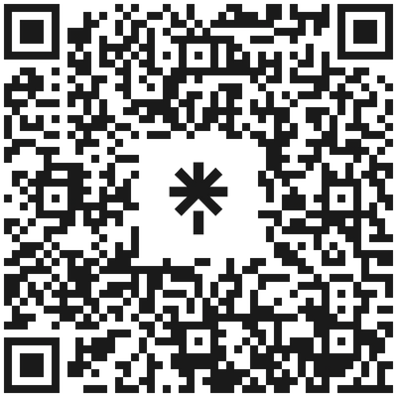

TEAM INFO
Instagram
Team Name:
Team Anveshak
LinkedIn
Youtube
Contact:
Team Heads
Darshan K: +91 97906 35031
Anuraag R: +91 93989 87581
2

Slide 3
TEAM INFO
Academic
Institution:
Indian Institute of Technology Madras (IIT-Madras),
Chennai, Tamil Nadu, India-600036
Academic
Consultant:
Prof T Asokan, Department of Engineering Design, IIT-Madras.
Contact: asok@iitm.ac.in
Phone: +91 (44) 2257 4707
3

Slide 4
TEAM INFO
History of
the Team:
Team Anveshak is now a group of more than 50 enthusiastic students from IIT Madras who have a great passion for robotics. Since our inception in early 2017, we have devoted numerous days and nights to making our own remote-controlled/autonomous all-terrain rovers equipped with a robotic manipulator and soil scooper. Our team comprises highly committed and skilled students who work in mechanical design, system architecture and control, outreach, and business relations. The technical expertise and practical experience that our team members gain are second to none, preparing them to become effective team players and leaders in industry and research.
4

Slide 5
TEAM INFO
History of
the Team:
Our Experiences:
❖ IRC 2019 - Champions!
❖ URC 2019- 12th Place
❖ IRC 2020 - 5th Place
❖ ERC 2021- 12th Place (Remote edition)
❖ IRDC 2021- 6th Place
❖ URC 2022- Qualified
❖ ARC 2022- 6th PLace
❖ ERC 2022 - 4th Place (Remote edition, Qualification A)
❖ IRDC 2022-12th Place
❖ IRC 2023- 14th Place
❖ URC 2023- 30th Place
❖ ARC 2023- 6th Place
❖ IRC 2024- 2nd Place
4

Slide 6
TEAM INFO
Name | Designation | Module Name | Major
Anuraag Rapaka | Team Head | NA | Mechanical Engineering
Darshan K | Team Head | NA | Mechanical Engineering
Jaswanth VG | Head Of Operations | NA | Metallurgical and Materials Engineering
Chandra Hasa | Head Of Operations | NA | Aerospace Engineering
Saketh Polamraju | Module Lead | Mechanical | Mechanical Engineering
Yegneswaran | Module Lead | Mechanical | Mechanical Engineering
Gokul M K | Module Lead | Elec and Software | Engineering Design
Manjari Sengupta | Module Lead | Elec and Software | Engineering Physics
Sanyukta Gedam | Module Lead | Astrobiology | Biotechnology
Divyanshu Singh | Module Lead | CPR | Mechanical Engineering
Pratham Kogta | Project Member | Elec and Software | Engineering Physics
Anuj Sreenivasan | Project Member | Elec and Software | Mechanical Engineering
Kavin Arvinth Ravichandran | Project Member | Elec and Software | Aerospace Engineering
Venkata Sai Vishwesvar | Project Member | Elec and Software | Biotechnology
Pranav Ramesh | Project Member | Elec and Software | Computer Science and Engineering
Om Shende | Project Member | Elec and Software | Civil Engineering
Amogh G. Okade | Project Member | Elec and Software | Engineering Physics
Aadit Chugh | Project Member | Elec and Software | Engineering Physics
Active Members List:
5

Slide 7
TEAM INFO
Active Members List:
Name | Designation | Module Name | Major
Kishore kumar | Project Member | Elec and Software | Computer Science and Engineering
Tanish Oleti | Project Member | Elec and Software | Engineering Physics
Santhosh V | Project Member | Elec and Software | Mechanical Engineering
Debanjan Guha | Project Member | Mechanical | Civil Engineering
S. Pon Adithi | Project Member | Mechanical | Mechanical Engineering
Hithysh Lakshmi Kanth | Project Member | Mechanical | Computer Science and Engineering
Chinmay Gurujee | Project Member | Mechanical | Engineering Design
Anush Adithya | Project Member | Mechanical | Chemical Engineering
Kousikan | Project Member | Mechanical | Mechanical Engineering
Yukteshwar | Project Member | Mechanical | Mechanical Engineering
Aayush Chodhary | Project Member | Mechanical | Civil Engineering
Adarsh Hegde | Project Member | Mechanical | Chemical Engineering
Sahil Kelkar | Project Member | Mechanical | Mechanical Engineering
Shrey Ramanujam | Project Member | Astrobiology | Physics
R.P.Nishok | Project Member | Astrobiology | Computer Science and Engineering
Sneha Dharshini P | Project Member | Astrobiology | Mechanical Engineering
Amrutha Krishnan Rajashree | Project Member | Astrobiology | Engineering Physics
6

Slide 8
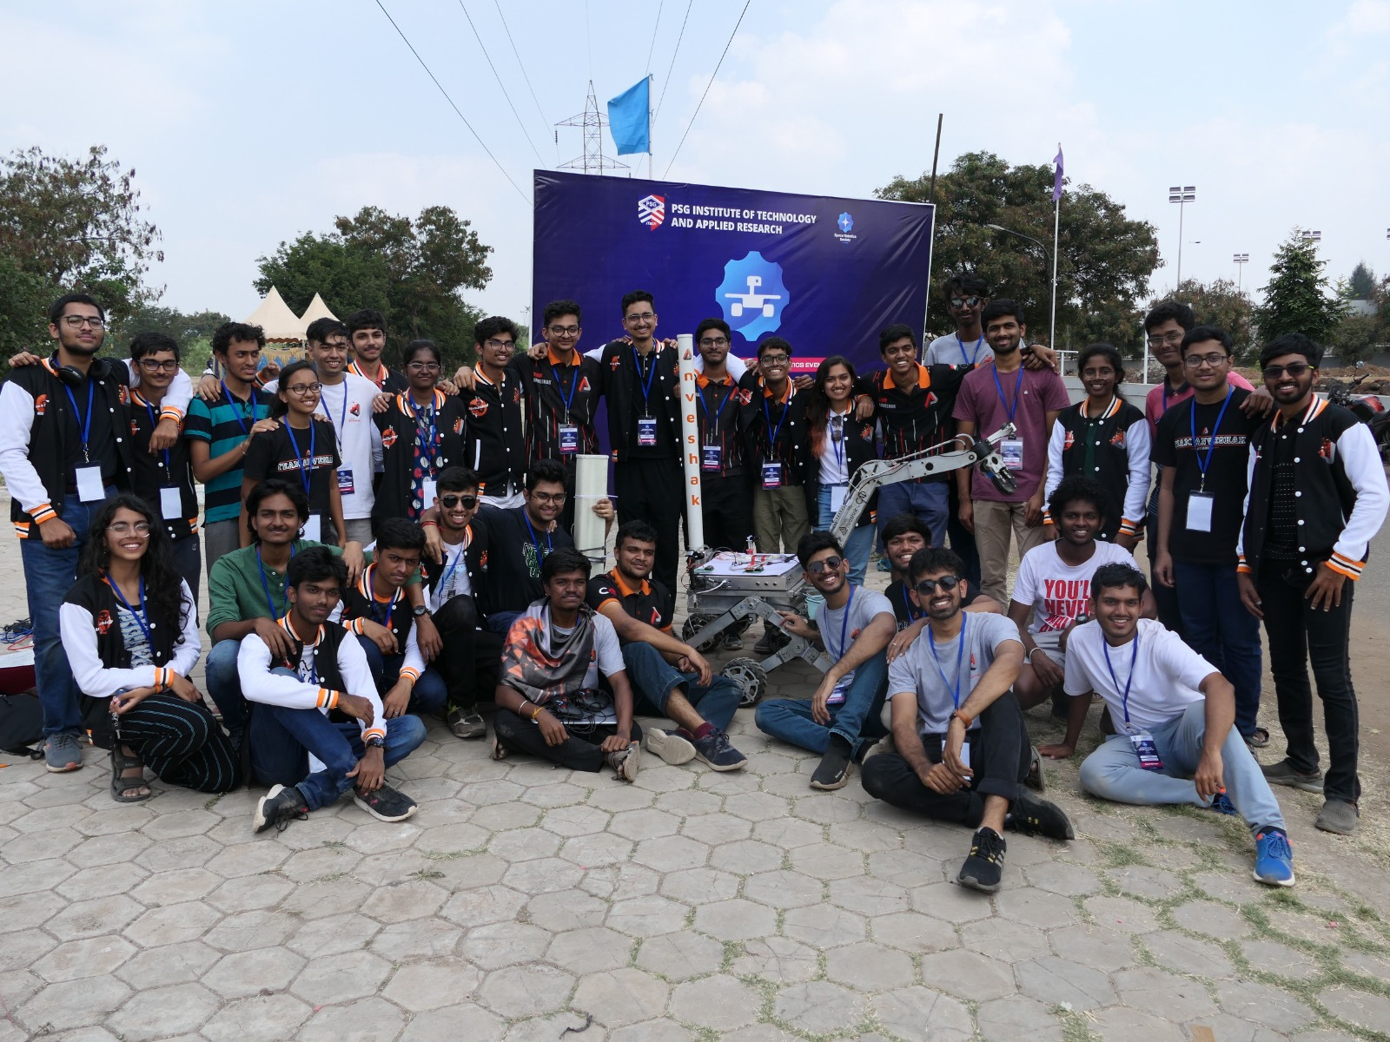
TEAM INFO
Team Photo:
7

Slide 9

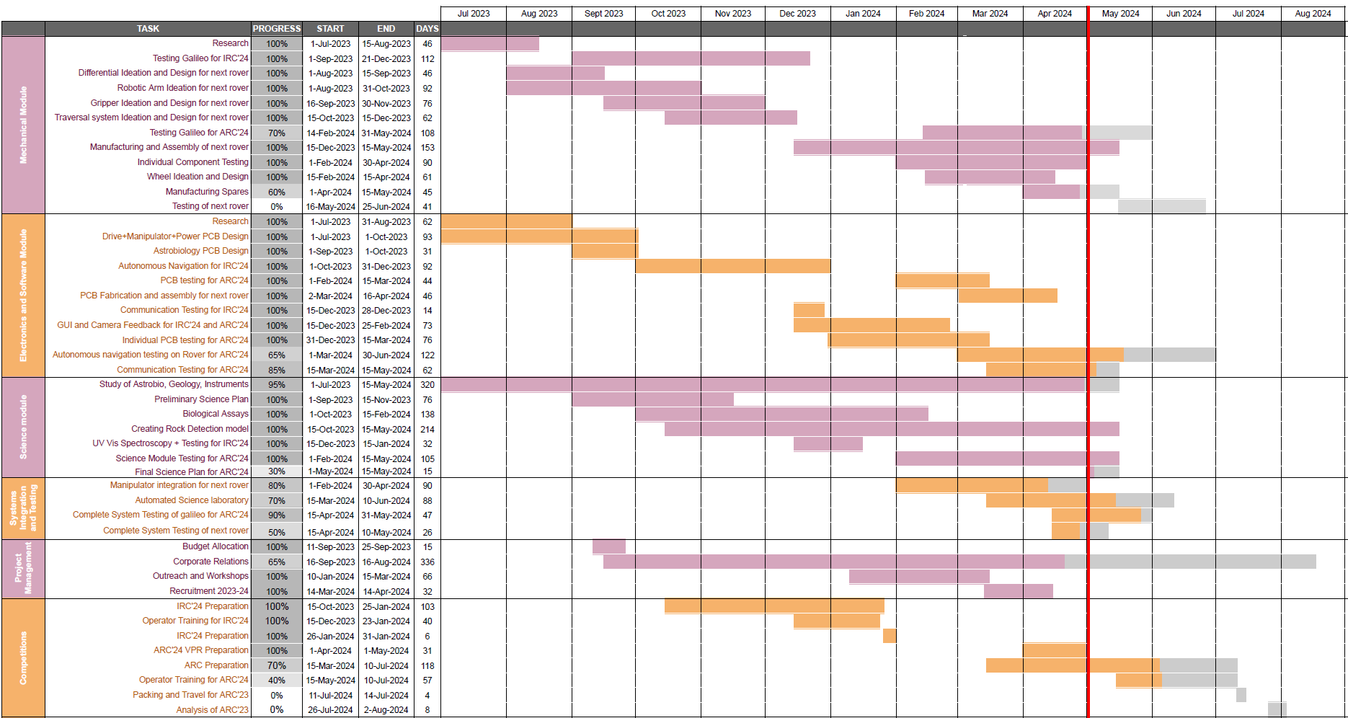

MANAGEMENT
Work
Calendar:
8

Slide 10
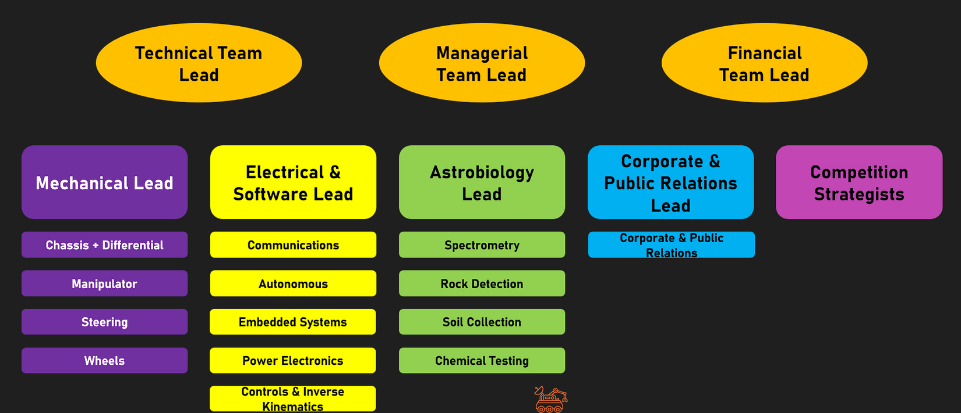
MANAGEMENT
Team Formation:
The overall team comprises four modules: Mechanical, Electronics & Software, Astrobiology, and Corporate & PR. Each of them consists of a few members chosen per the requirements and is led by a module head. Each module consists of multiple subsystems that work on specific tasks in the respective module. The Corporate and PR subsystem handles budget, sponsorship, scheduling, logistics, public outreach, etc. We also have competition strategists who mainly develop strategies for approaching competition-specific tasks.
9

Slide 11
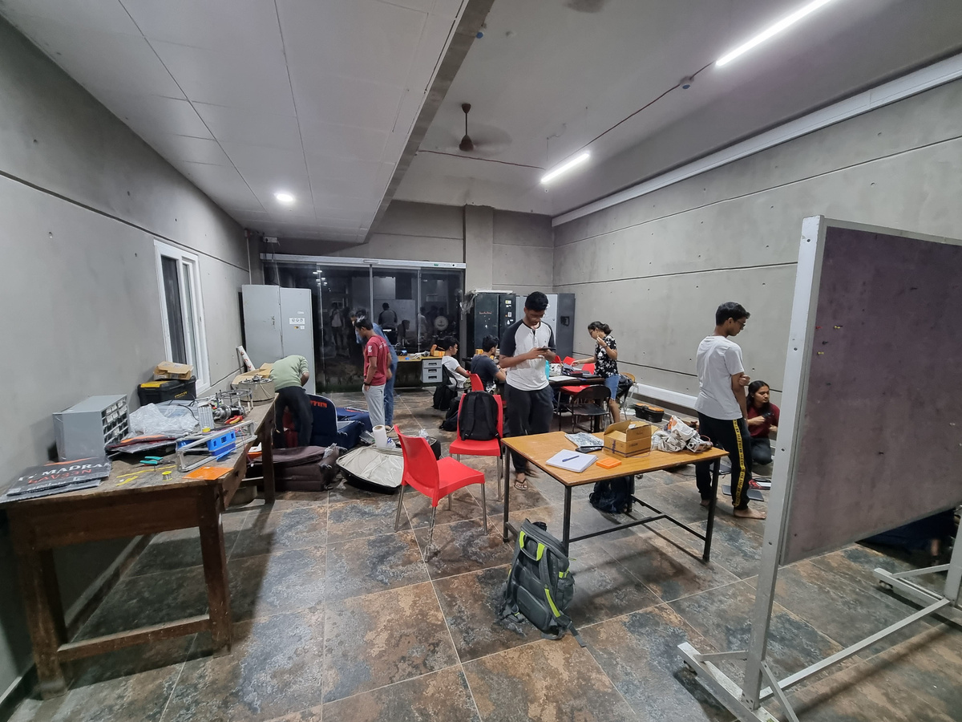
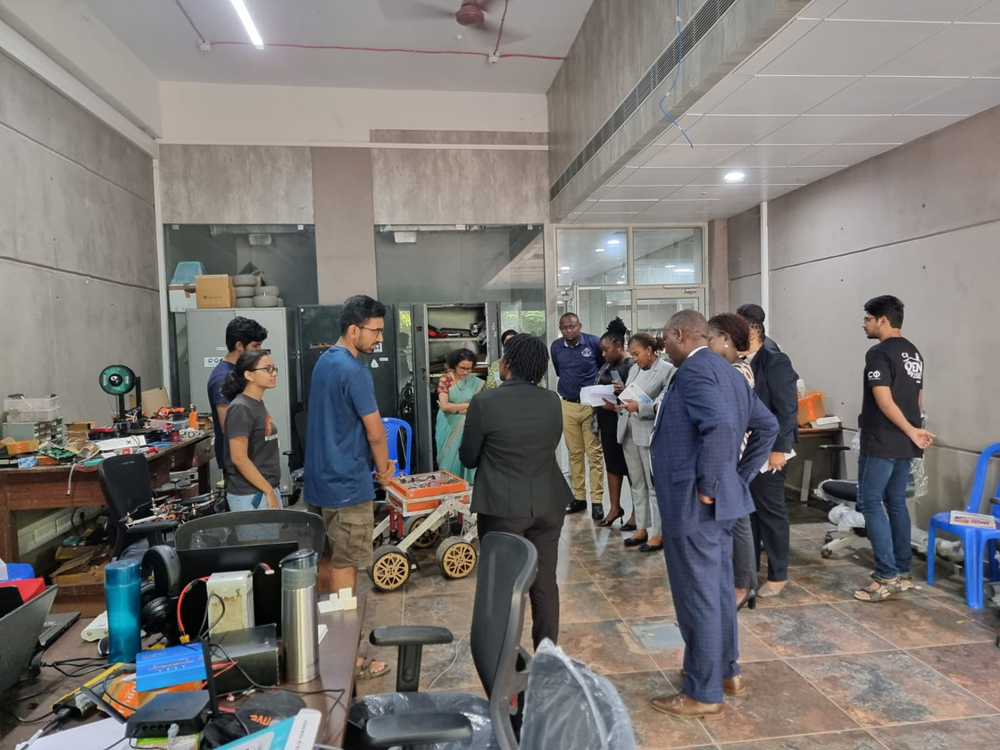
MANAGEMENT
Workplace:
At IIT Madras, the Center for Innovation serves as a collaborative workspace where all subsystems work together to ideate, design, and assemble the rover. Equipped with an inventory, power tools, WiFi, bulletin boards, and a projector, this space also provides storage for our tools and spare parts. To manufacture parts, we obtain raw
materials from external vendors and utilize the mechanical workshop tools available
in our campus, such as the lathe, CNC machine, and laser cutter. Testing the rover
involves taking it to off-road areas within our campus that offer uneven terrain, various soil consistencies, and unique terrains that can be autonomously mapped and traversed.
10

Slide 12
MANAGEMENT
Funding:
❖ The total amount budgeted for this year was $ 16,000, of which $ 15,000 would be provided by our institute, and the remaining would be obtained from corporate sponsorship.
➢ Our next rover is expected to cost less than $6000, and no component is reused from our old rover, galileo.
➢ We have spent $5,703 so far this year, most of which was spent on manufacturing our next rover.
❖ The estimated future expenditure for rover development is expected to be around $1100.
❖ Travel to ARC is expected to cost at most $21,000 for 15 members
➢ If we get invited to the final round of ARC 2023, $9000 will be provided by our institute.
➢ The remaining expenditure will be borne by individual team members.
❖ We have been allocated sufficient budget - a bit more than what we plan to use on our rover, hence budget constraints are unlikely.
➢ In case of constraints, we have a reserve amount of $4300 from alumni donations.
➢ We also have a well-connected alumni network that we can approach in such scenarios.
❖ A detailed breakdown of our expenditure is shown in the following slides :
11

Slide 13
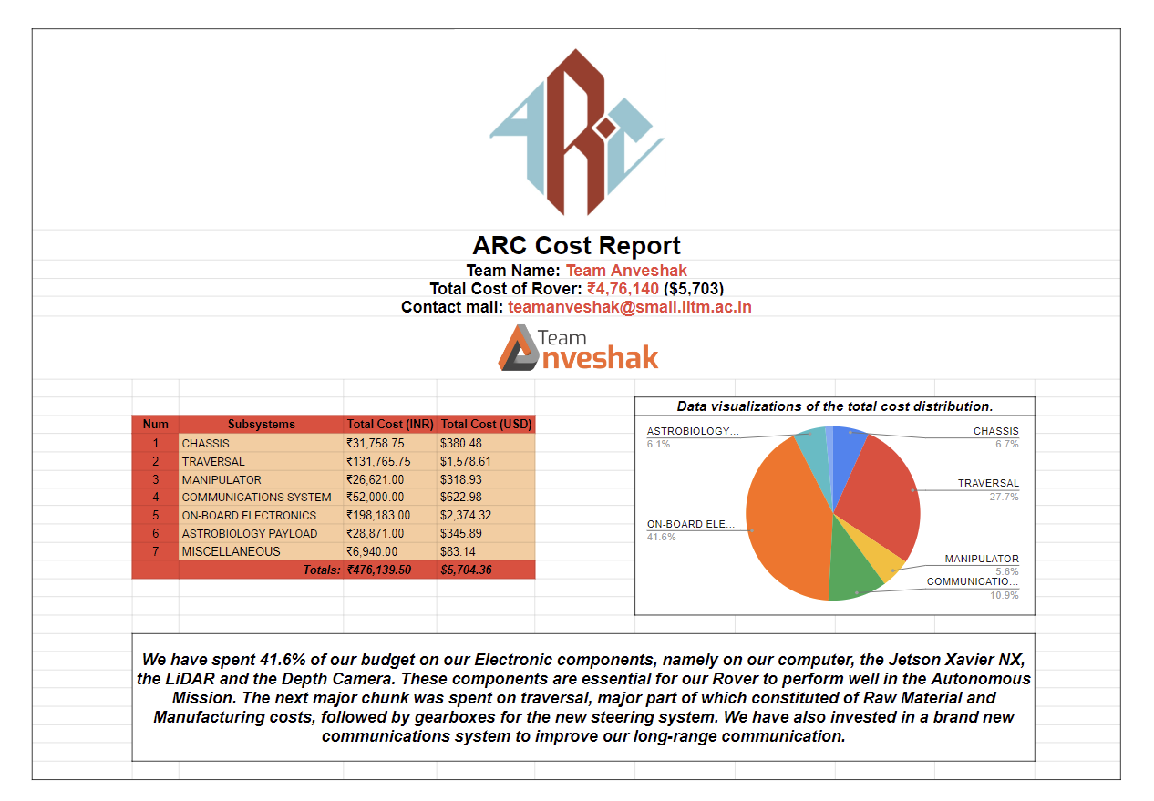
MANAGEMENT
Funding:
11

Slide 14
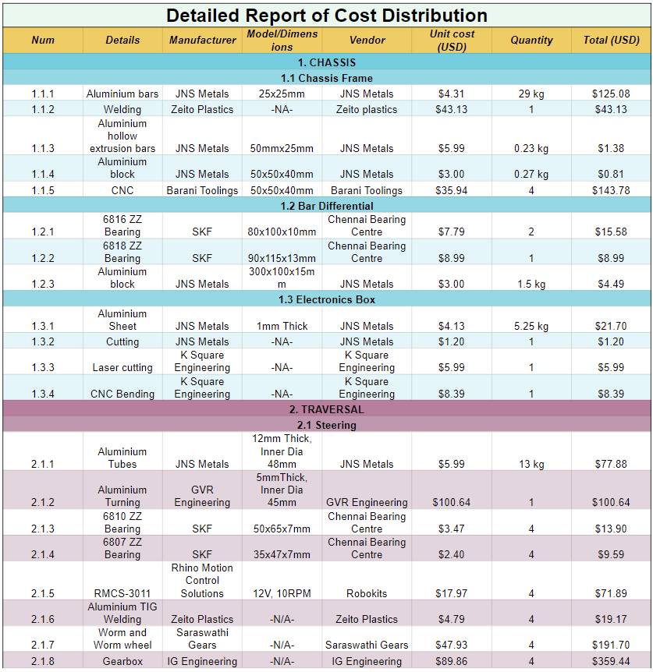
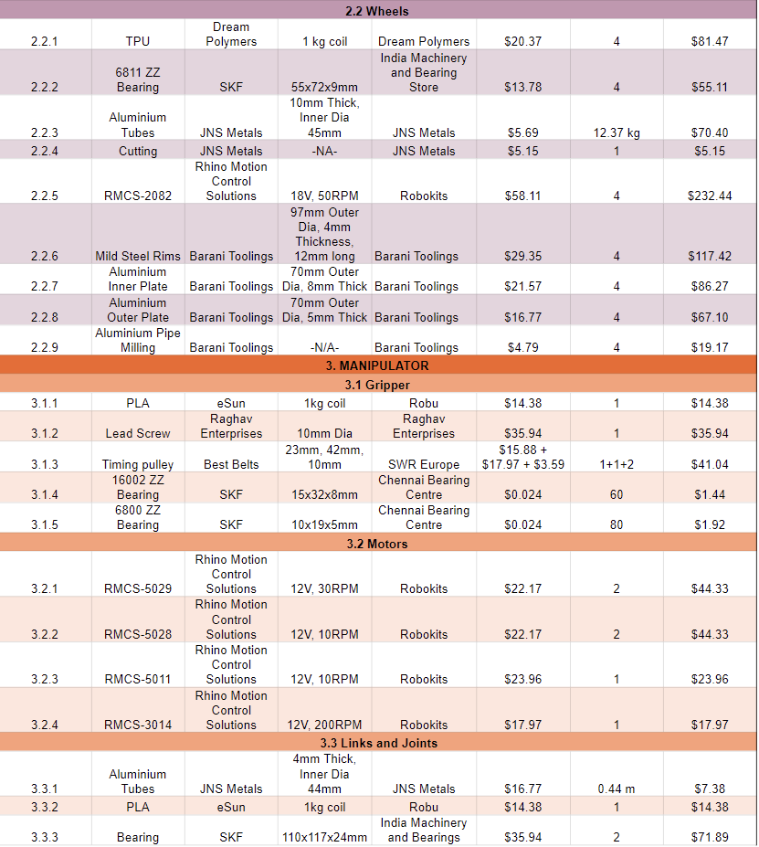
MANAGEMENT
Funding:

Slide 15
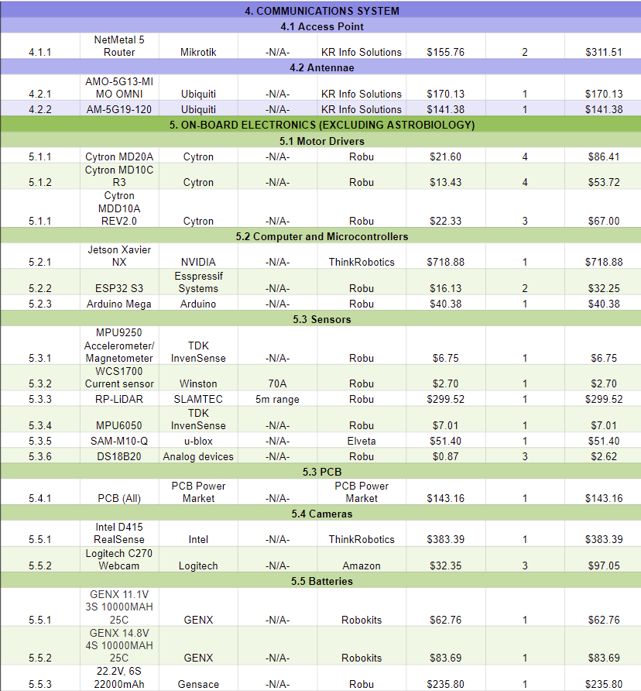
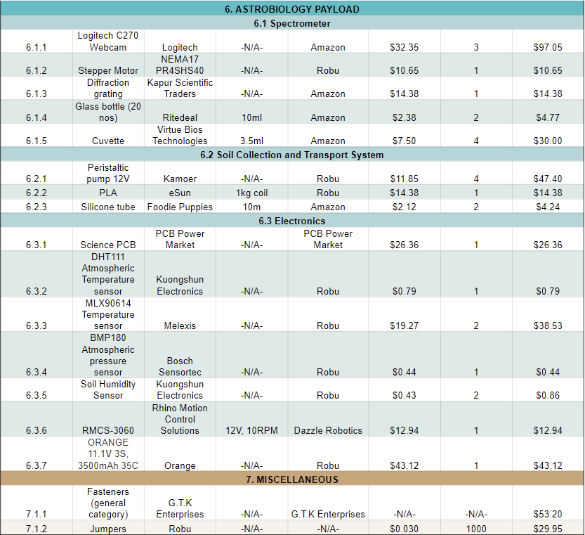
MANAGEMENT
Funding:
11

Slide 16
MANAGEMENT
Logistics:
❖ We have completed building our rover according to IRC and ARC requirements and have started operator training.
➢ Operator training will continue till 10 July 2024.
➢ We will apply for Turkish visas by 15 June 2024.
❖ We will start dismantling the rover on July 11th and pack its parts compactly to make it ready for transportation for international flight according to travel norms.
❖ We will get approvals from our institute and the competition for the same.
❖ Our rover, with all spare parts, weighs around 80 kg.
➢ It will be dismantled, put in suitcases, and checked in as luggage.
➢ This, when divided among the 15+ members of our team who will
be travelling, will fall within international flight limits.
❖ Parts forbidden on flights (Eg:- batteries with more than 100Wh capacity) will be ordered directly to our accommodation in Turkey.
12

Slide 17

ROVER DESIGN
Mobility
System:
System Description
  A rocker-bogie mechanism is being utilised for traversing rough and uneven terrain.
  The bar differential, combined with the rocker-bogie system, maintains the chassis stability and ensures contact of wheels with the ground at all times.
  A series of optimization analyses on MATLAB and FEA simulations on ANSYS were conducted with suitable safety factors in mind for all the links and joints.
  An aluminium chassis framework holds the rover together, while a detachable electronics box made of aluminium sheet houses the electronics and batteries.
  The lightweight and robust aluminium H14 series is used for fabrication.
Strengths
  Uncompromised traction in challenging rocky terrain.
  Can climb inclines of up to 40 degrees.
Weaknesses
  Play can be observed in the bar differential’s ball joint assembly.
  The wheels may slip on polished surfaces.
13

Slide 18
ROVER DESIGN
Mobility
System:
Uniqueness
  The wheel design is inspired from NASA’s Curiosity Rover.
  Cone shaped play limiters are currently being tested on the differential to try to reduce the play in the ball joints.
  While the current rover utilises a single-point bar differential, a two-point bar differential model is being tested, to be incorporated into the current design and further improve the stability of the chassis.
  The wheels, 3D printed using TPU 95-A, make the whole assembly lighter while the zig-zag grouser ensures maximum traction and traversability. The design has been optimised to ensure maximum shock absorption and load carrying capacity.
14

Slide 19
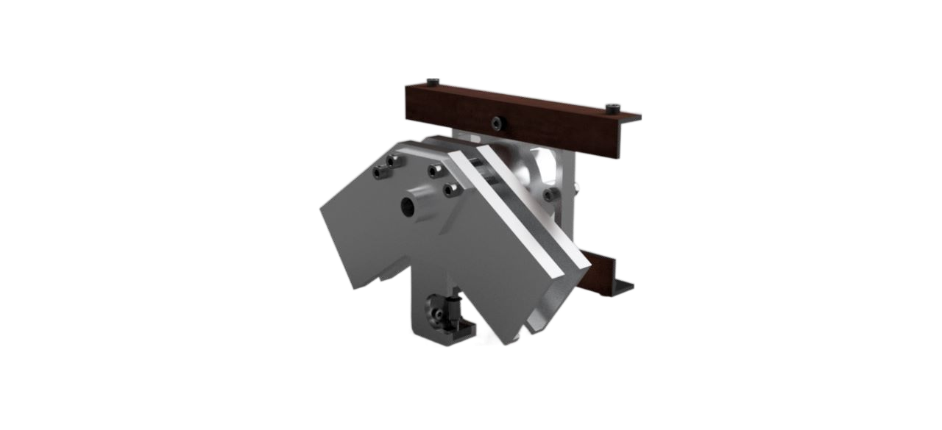
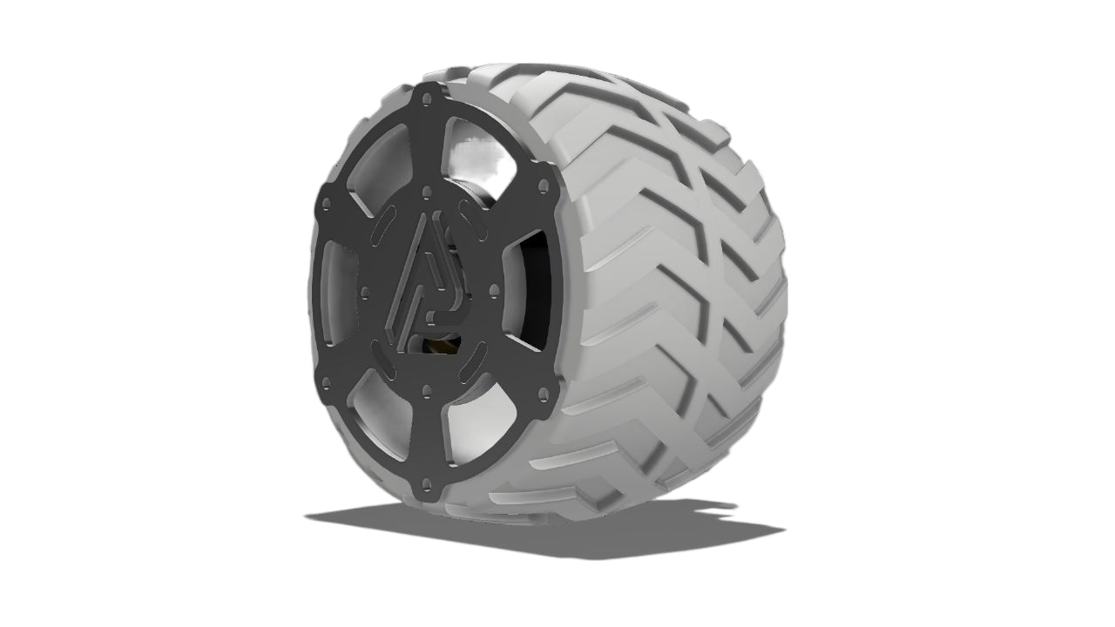
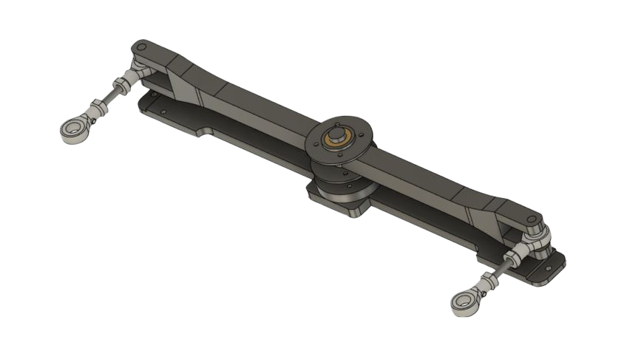
ROVER DESIGN
Current Rover
Mobility System:
Chassis couplers
Current 3D - printed Wheel
Bar Differential
15

Slide 20
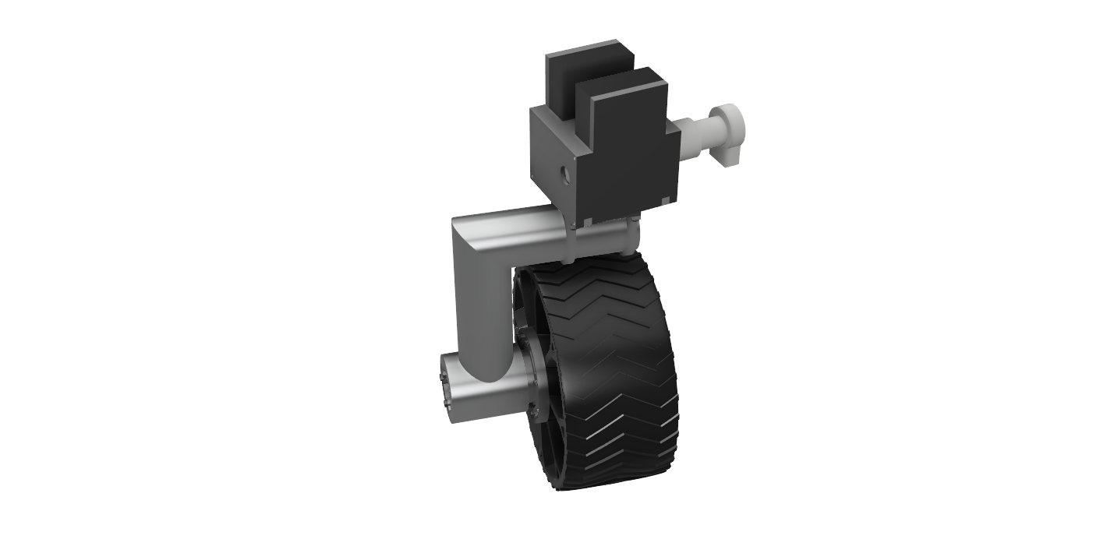
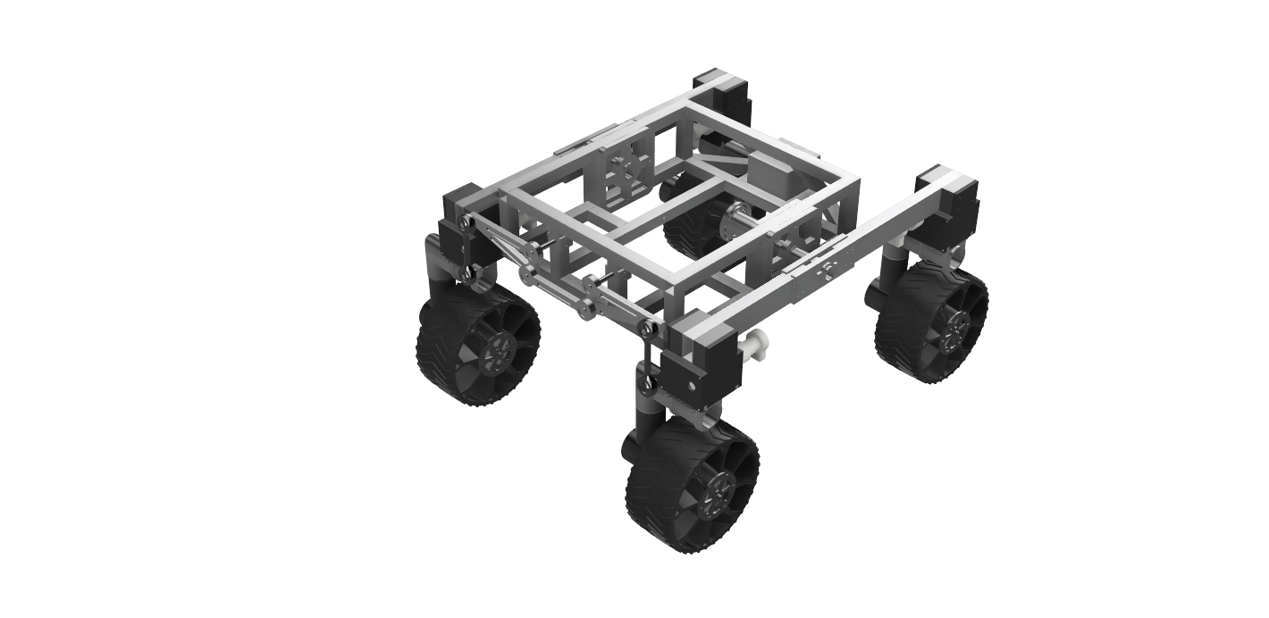
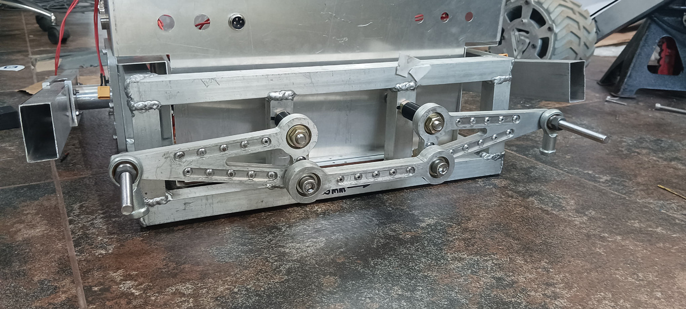
ROVER DESIGN
Next Rover
Mobility System:
Upcoming wheel + steering prototype
Upcoming 2-point bar differential
Upcoming rover assembly
15

Slide 21
ROVER DESIGN
Mobility
System:
Mass Specifications :
  Rocker bogie + Links = 19.5 kg
  Wheels(including motor) = 2.6*6 Kg = 15.6 kg
  Chassis box(including elec box, bar differential and arm base mount) = 9 kg
  Total Weight = 44.1 kg
Size specifications :
  115 cm x 92 cm x 120 cm
System adequacy :
  The traversal module is designed considering the unevenness of the terrain.
  Safety factor is maintained above 2.5 for better reliability.
  Rigorous testing has been done on various kinds of terrains, including extremely bumpy and undulating terrains.
  Keeping in mind the salient missions of the competition, special efforts are taken for night launch mission and autonomous navigation.
16

Slide 22
ROVER DESIGN
Electronics and power system:
System description
  The on-board computer used on the rover is the powerful Nvidia Jetson Xavier NX, which carries out all the necessary computations.
  The electrical system consists of a power distribution board, a PCB to control the drive and steering motors and another for control of manipulator actuators. The micro-controllers used are ESP32-S3
  The motors are all controlled by Cytron motor drivers of different rating suitable for different motors.
  The system is powered by 3 Lithium Polymer batteries with nominal voltage values of 22.2V, 14.8V and 11.1V for powering systems.
  The Intel Realsense D415 depth camera and the 2D RP-LiDAR are used for executing the autonomous mission.
Strengths:
  This entire system is modular and decentralised.
Weaknesses:
  It does not possess an active system to monitor the existing state of all the equipments.
17

Slide 23
ROVER DESIGN
Electronics and power system:
Uniqueness:
  Stacked motor drivers gives the benefit of increased spatial efficiency as well as better streamlined integration signal and power flow across system
  Custom software stack enables seamless control of the four-wheel steering system.
  4-core coaxial cables employed for encoder feedback reduces noise and electromagnetic interference.
  Additionally, a relay serves as the kill switch implementation, supported by a dedicated power distribution board.
  Optocouplers play a crucial role in mitigating reverse voltage issues, ensuring smooth and reliable operation.
18

Slide 24

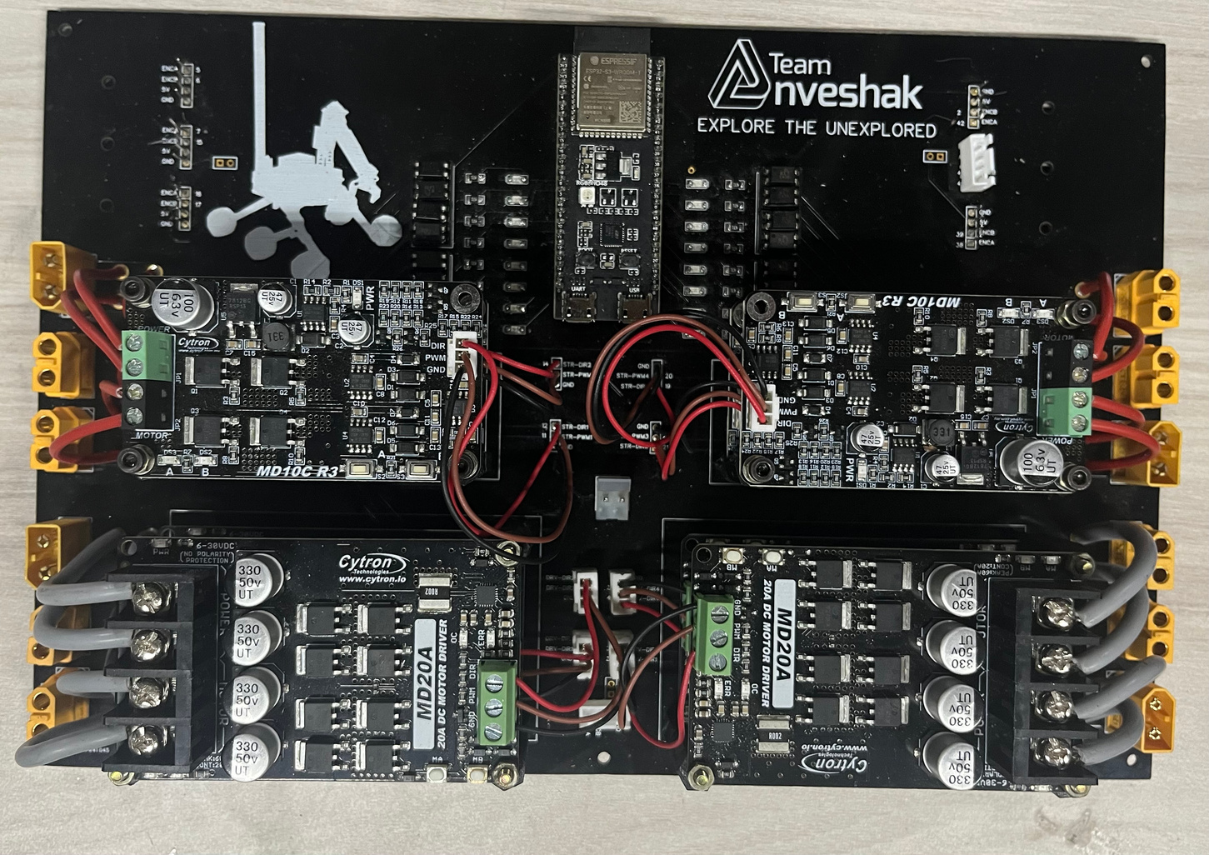
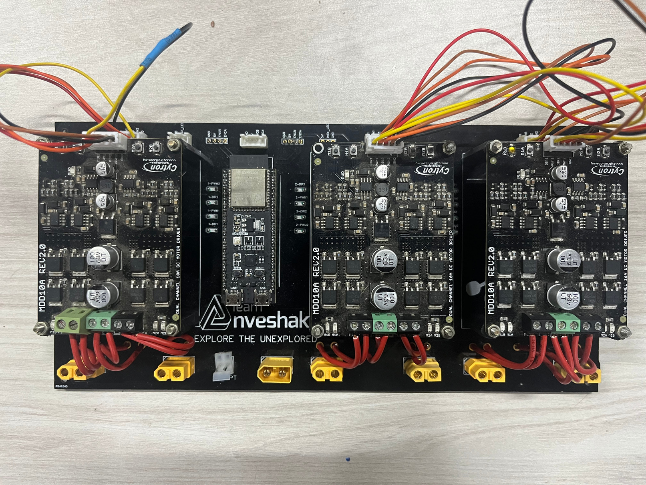
ROVER DESIGN
Electronics and power system:
Arm PCB
Drive PCB
19

Slide 25
ROVER DESIGN
Electronics and power system:
  The system employs 3 Lithium Polymer batteries with specifications of 22.2V 22000 mAh, 14.8V 10000 mAh and 11.1V 10000 mAh, collectively weighing around 5 kg.
  The rover’s battery can sustain continuous operation well over an hour satisfying power requirements for all the missions
  The PCBs offer a robust way of transmitting data and power to the motor drivers as well as receiving data from the encoders with minimal noise.
  PCBs have the option to accommodate general and mission specific requirements such as the RSC-CM for the autonomous mission and the activity light.
  Encoders, Intel RealSense, MPU6050 imu, and LiDAR are utilised for wheel odometry, visual odometry, and spatial mapping, which help to make the rover autonomous.
20

Slide 26
ROVER DESIGN
Manipulation System:
System Specification:
  The manipulator is a 5 DOF arm with a parallel grip end effector.
  The design was chosen keeping modularity in mind in order to reduce the setup time after the equipment servicing task.
  Elbow and shoulder pitch motions are actuated by worm gears.
  A pair of four bar mechanisms driven by one worm and a couple of worm gears constitutes the gripping mechanism. Worm gear drive ensures strong gripping force.
  Belt drive system enables the pitch motion of the end effector, reducing the torque requirement of the motor. The torque ratio obtained by the pulleys is 2:1.
  Expanding the workspace volume and optimizing the weight of the arm were the primary factors influencing the design process.
21

Slide 27
ROVER DESIGN
Manipulation System:
  The total length of the arm is 1.15m.
  Considering the load-carrying requirements and non-backdrivability of the joints, we decided for shoulder and elbow joints to be worm gear driven.
  We've designed our system to reach objects at a max height of 1.5m from the ground.
  The gripper can perform parallel grasp and is optimized for lower assembly and servicing times.
  We've also used encoders that relay the real-time positions of all the motors.
Weakness:
  The pitch belt slips during a few specific gripper manoeuvres.
  Manufacturing precision errors at base rotation give small play

Slide 28
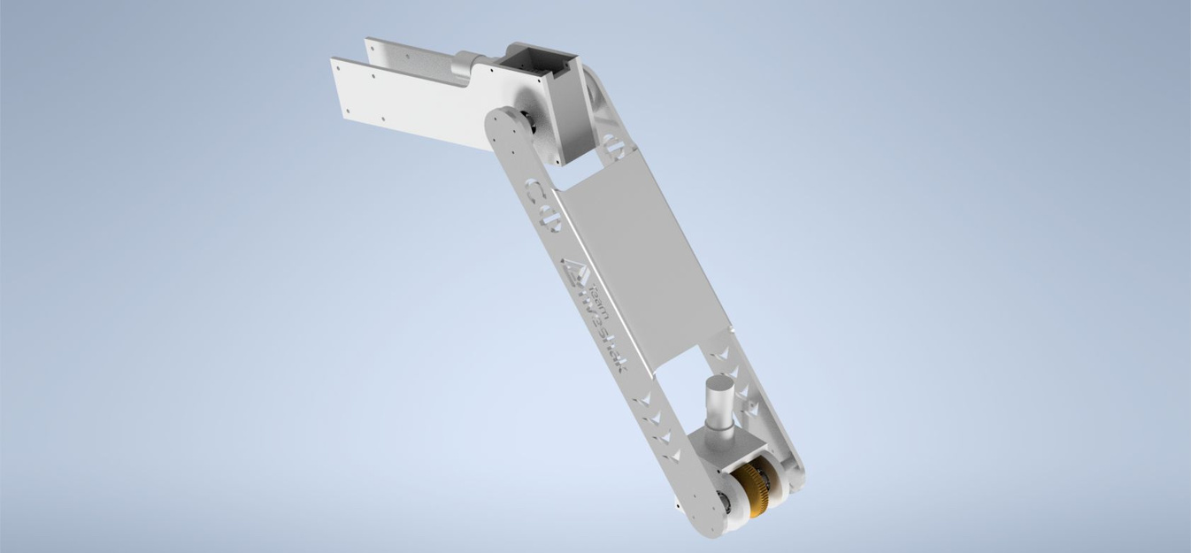
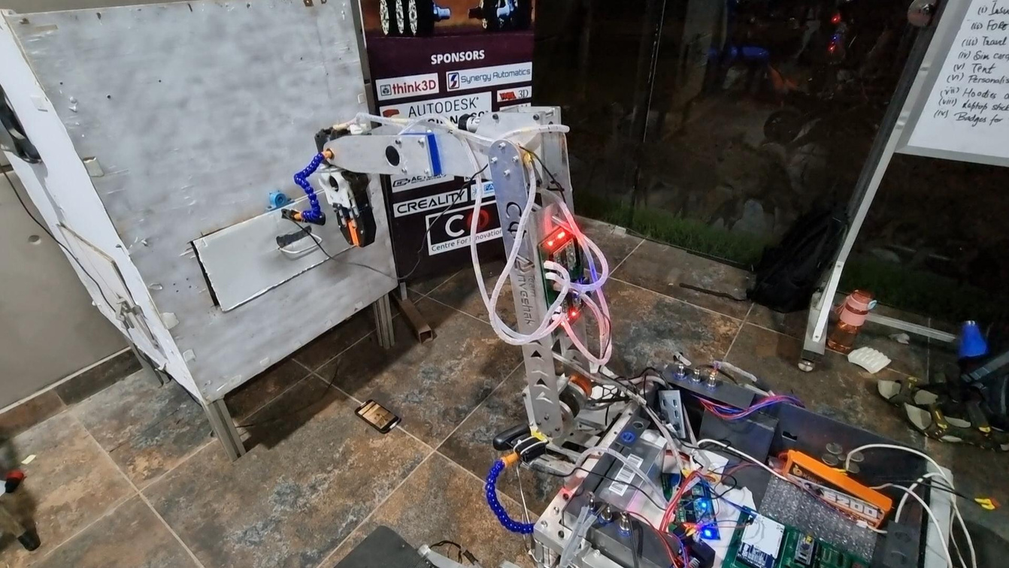
ROVER DESIGN
Current Rover
Manipulation System:
Rendered image of Manipulator
Manipulator during testing
23

Slide 29

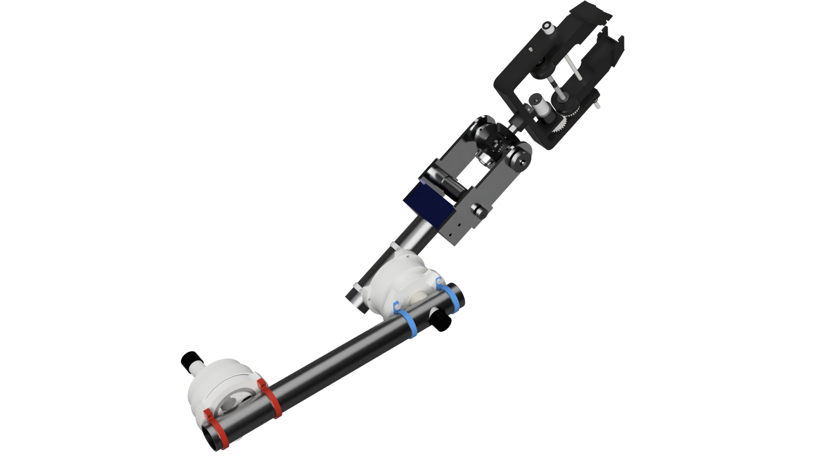
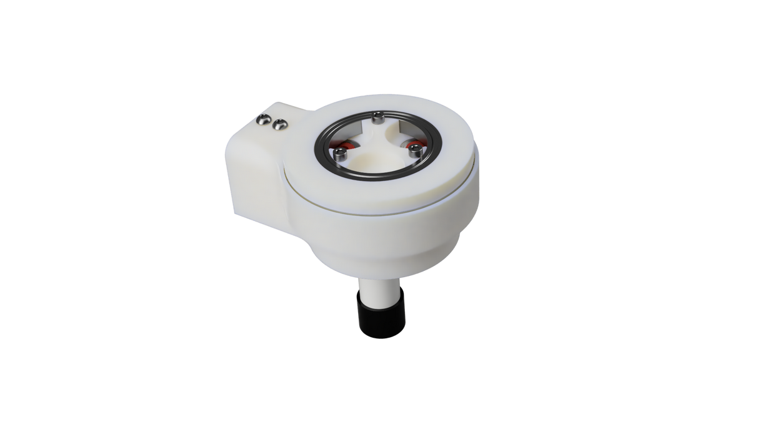
ROVER DESIGN
New Rover
Manipulation System:
Rendered Image of Manipulator
Planetary Cycloidal Gearbox
23

Slide 30
ROVER DESIGN
Manipulation System:
  The roll motion of the end effector is achieved by a pair of spur gears with a gear ratio of 8:1.
  Weight 8 kg and is capable of lifting a max payload of 10kg.
  The reach of rovers manipulator extends upto 1.5m.
  Primary material used is 6xxx series aluminium while ensuring strength and not compromising on weight.
  The gripper’s maximum opening distance is 10 cm, ensuring it can effectively grasp objects.
  This allows the rover's arm to flip switches, rotate knobs, attach fuel pipes and operate control panels.
  The rover is capable of moving around objects in its surroundings, which illustrates its readiness for any given role in the competition.
24

Slide 31
ROVER DESIGN
Science Payload:
SYSTEM DESCRIPTION
  Chemical Analysis: These tests confirm the presence of vital elements and compounds such as Nitrogen, Phosphorus, Potassium, sugars, proteins and carbonates crucial for supporting life.
  Spectrometry: Minute concentrations of biomolecules like proteins and lipids are analyzed using the spectrometer.
  Rock Analysis: Microscopic images of rocks are captured to study their texture, composition, and colour. Additionally, a machine learning model aids in classifying the rocks.
25

Slide 32
ROVER DESIGN
Science Payload:
SYSTEM CONSIDERATIONS
  Considering the required depth of collection (5cm) into the soil, our previous scooper has been improvised with a narrower aspect ratio for better penetration.
  While chemical analysis is qualitative and gives more general results, spectrometric analysis gives quantitative results and can also identify the specific biomolecules present.
  The new system prioritizes the development of new instruments such as the spectrometer and microscope for rock detection, powered by an AI algorithm, rather than relying on traditional chemical testing methods. These tools provide more accurate results and emulate what actual Mars rovers use.
  Strengths: The new instruments are developed keeping in mind the wide variety of soil textures that may be present at the task site, allowing collection and analysis of all kinds of soil thereby being versatile for the same.
  Weaknesses: Not all biosignatures are tested for; For example, detection of nucleic acids is not possible with the existing setup. Also, only three different soil samples per mission can be collected.
25

Slide 33
ROVER DESIGN
Science Payload:
UNIQUE POINTS AND INSPIRATIONS
  The Spectrometer is completely made from scratch. The housing is 3D printed with PLA and employs a carousel mechanism controlled by a stepper motor to test multiple cuvettes. The test results are analyzed using a custom Python code that can be modified based on the data required per sample.
  Rock classification is done by an AI Model. The Model has been trained on a dataset of both online images and pictures taken during competitions in MDRS, Utah, USA and Ankara, Türkiye from last year.
  The system is able to collect and store more than enough soil for onboard testing as well as return an untouched, pure soil sample for further analysis.
26

Slide 34
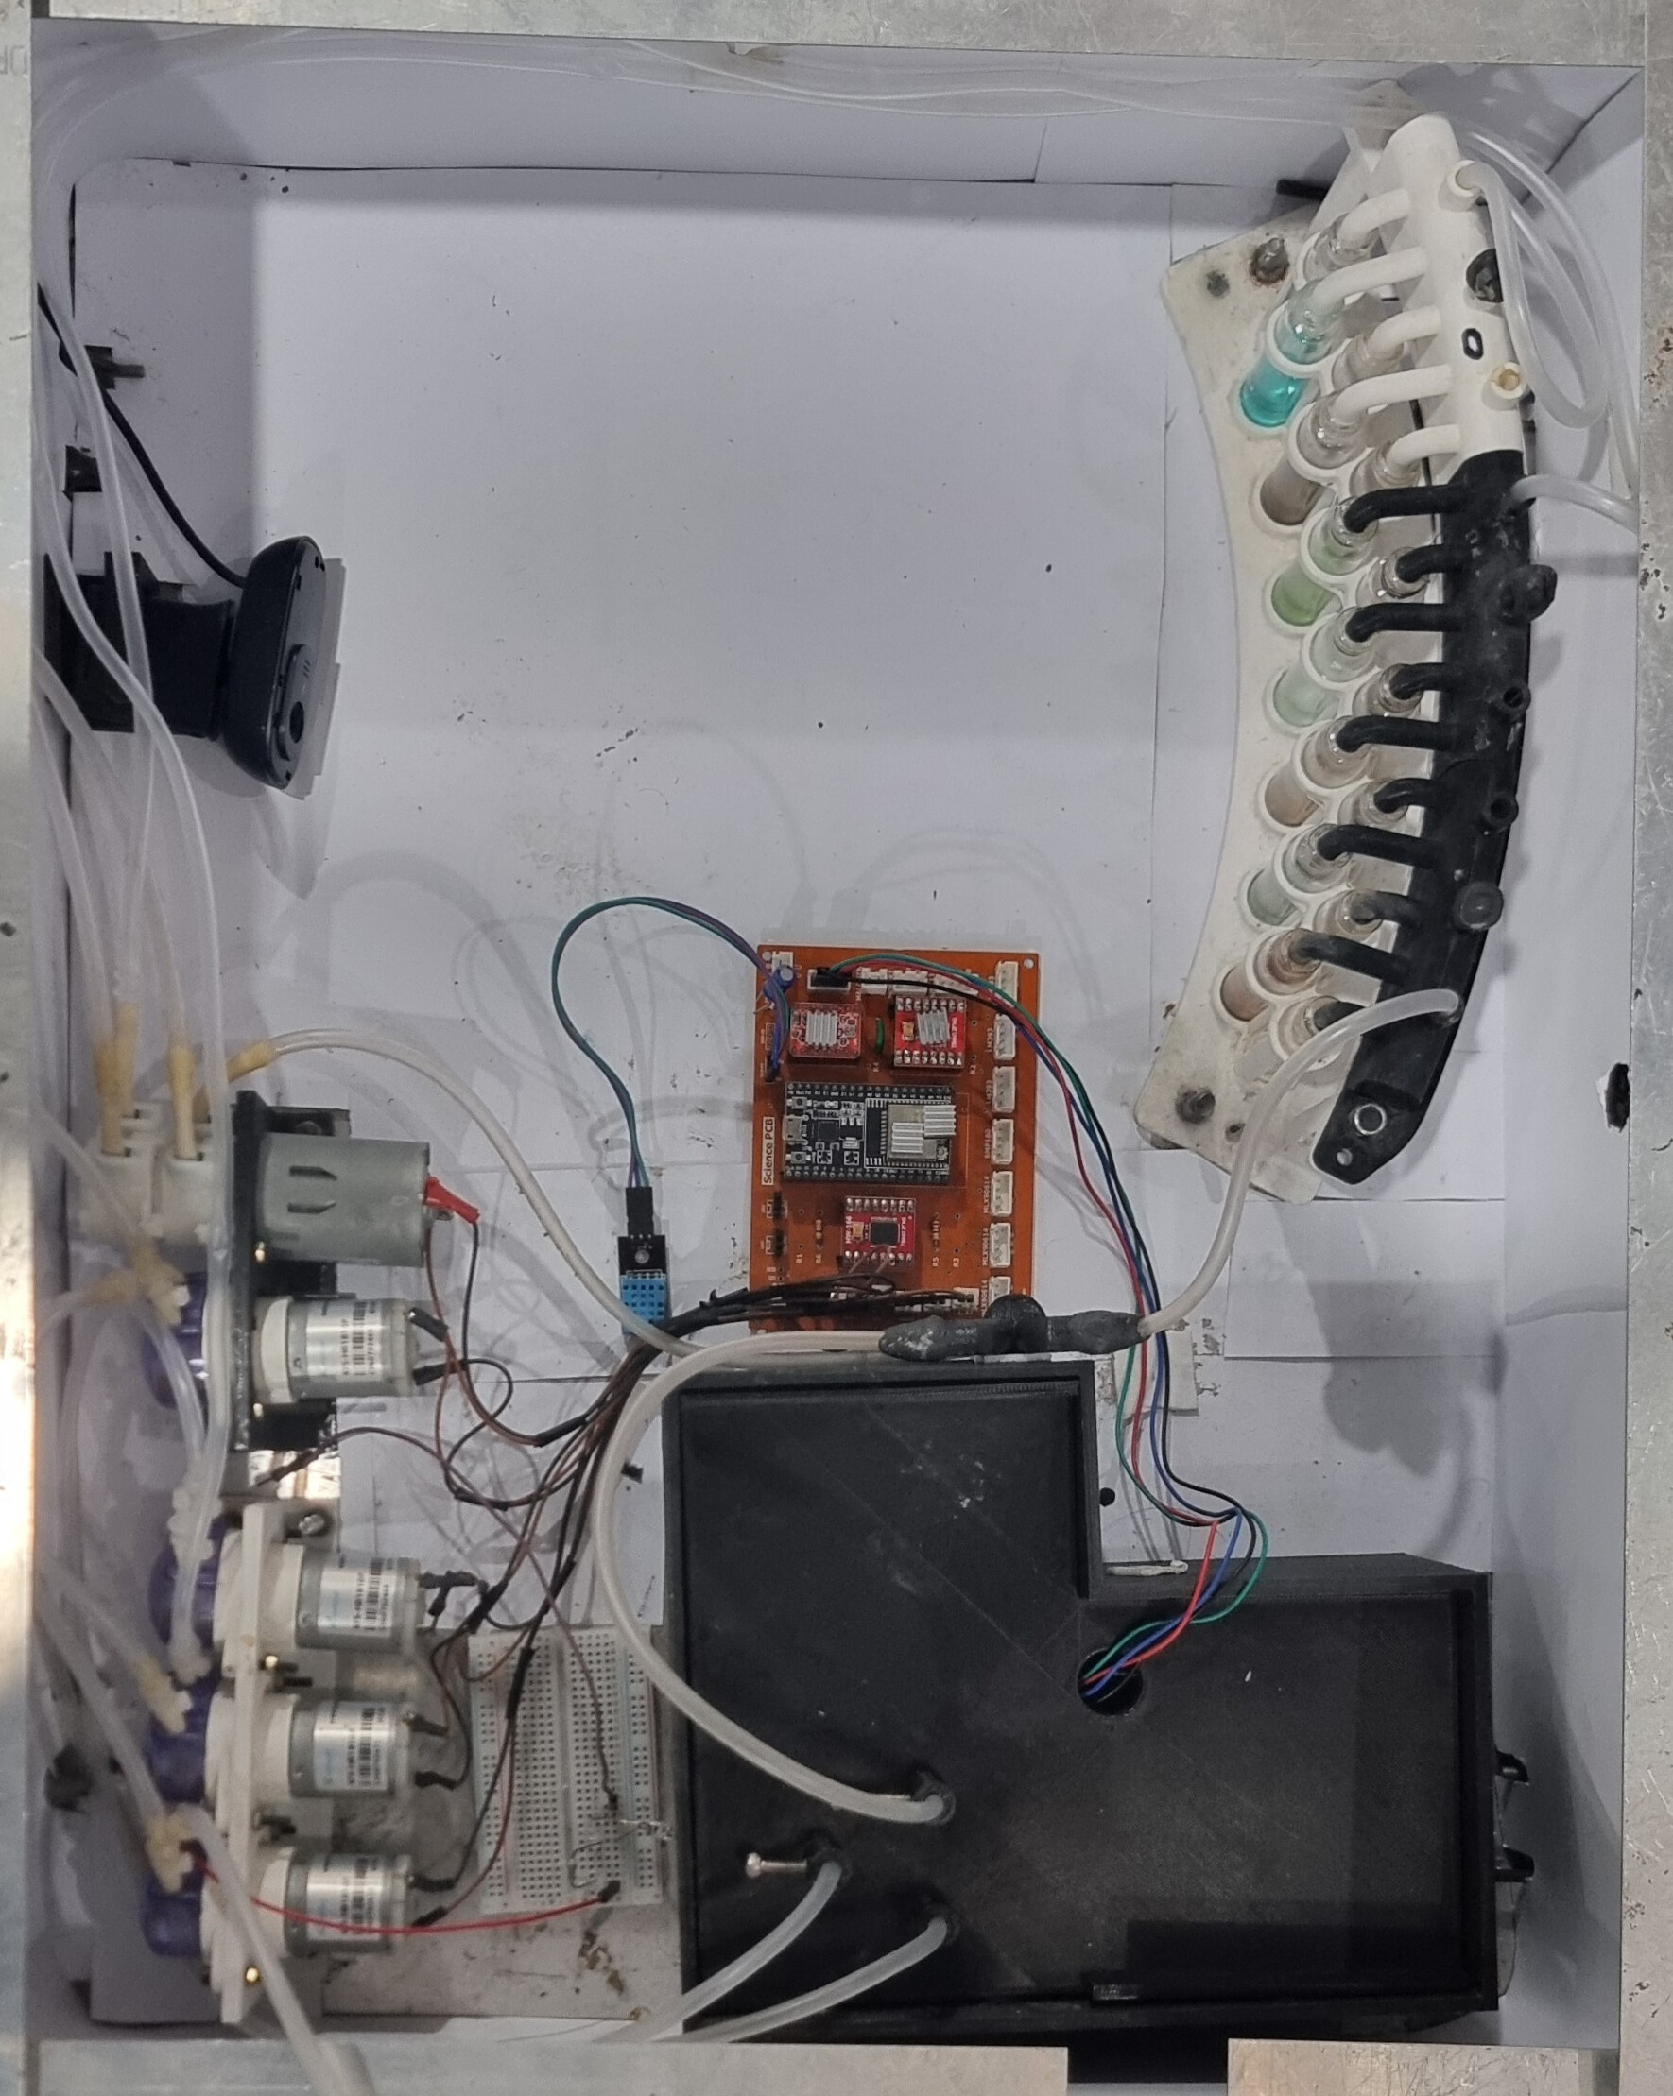
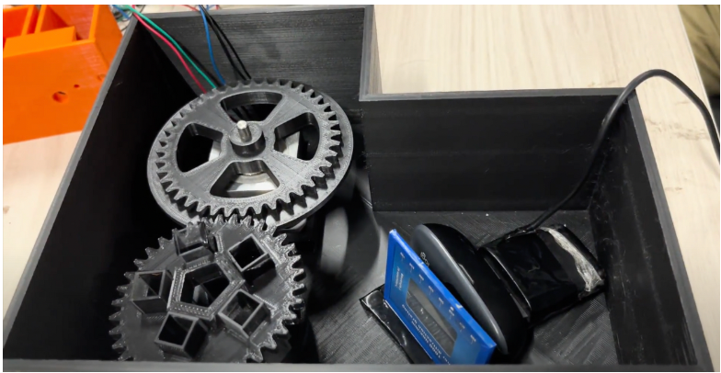
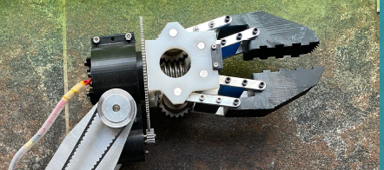
ROVER DESIGN
Science Payload:
In-House Spectrometer
On-board Science Mechanism
Current scooper design
27

Slide 35
ROVER DESIGN
TECHNICAL SPECIFICATIONS
Science Payload:
  The science set-up includes the following components: a spectrometer, sensors, microscope, pumps, collection boxes, chemical testing suite, PCB, webcams and a battery.
  The battery powering the Astrobiology module is an 11.1V 3300mAh battery.
  The entire setup weighs 4 kilograms.
  The system has a total continuous run time of over an hour.
SYSTEMS ADEQUACY
  The scooper mechanism equipped with metal claws is an efficient method to collect soil from the required depth. The scooper is also capable of picking up objects of most materials and shapes.
  The containers ensure the separation of samples and prevent environmental contamination, even during operations on a 30-degree incline.
  The spectrometer and chemical tests provide important results regarding various biomolecules present in the soil. These results and sensor data can help us test the scientific hypothesis provided.
28

Slide 36
ROVER DESIGN
Ground Station Equipment and Communication System:
SYSTEM DESCRIPTION
  In order to enable live video streaming of the rover, manipulator and surroundings we have used Logitech cameras.
  The rover and base station are both equipped with Mikrotik netmetal 5 as transceivers.
STRENGTHS
  We can switch between frequency channels according to our requirements.
  Use of TCP,UDP and SRT protocols.
WEAKNESSES
  5GHz band provides lower range when compare to 2.4GHz.
  High power requirements which results in lower battery life.
  Losses are also high due to the high frequency usage.
29

Slide 37
ROVER DESIGN
Ground Station Equipment and Communication System:
UNIQUE POINTS AND INSPIRATIONS
  The routers are configured in PTP bridge mode, so the signals are directional, making them more resistant to interference.
  Inspired by the television broadcast methods, we have employed scripts to transmit video from the rover to the base station using SRT(Secure Reliable Transport) protocol and FFmpeg, enabling us to transmit video over long distances with subzero latency.
  Control commands and telemetry data are sent using TCP protocol, which ensures lossless and error-free data transmission.
  The Mikrotik routers have a special command line interface that can be used to change router configurations with scripting.
30

Slide 38
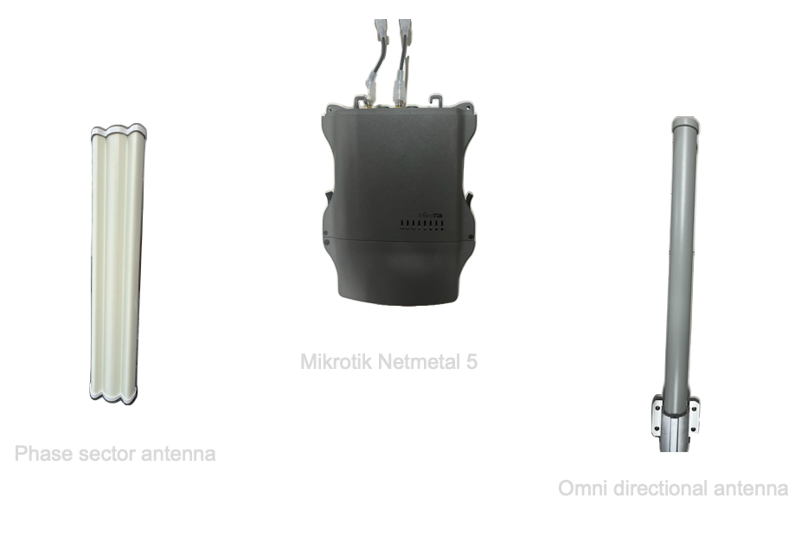
ROVER DESIGN
Ground Station Equipment and Communication System:
31

Slide 39
ROVER DESIGN
Ground Station Equipment and Communication System:
TECHNICAL SPECIFICATIONS
  The 5 Ghz band is used for communication.
  The rover is equipped with AMO-5G13 Omni directional antenna of 13dbi gain and the base station is equipped with AM-5G19-120 phase sector antenna of 19dbi gain to facilitate communication and provide resilience to noise by amplifying the signals.
SYSTEMS ADEQUACY
  Mikrotik Netmetal 5 routers are used because of their ability to transmit data effectively, even in the case of interference, such as obstacles and walls.
  The setup has provided a satisfactory range of 700m with LOS and 150m without LOS, transmitting video feed and other telemetry data along with the control commands with subzero latency.
32

