Slide 1
2024
Design Report

Slide 2
TEAM INFO
Team Name:
Projekt Scorpio; Scorpio Infinity
Name of the team and if applies,
name of the rover.
Contact:
E-mail: projekt@scorpio.pwr.edu.pl
Instagram: https://www.instagram.com/projektscorpio
Facebook: https://www.facebook.com/ProjektScorpio
LinkedIn: https://www.linkedin.com/company/projekt-scorpio/
Contact information and
social media links of the team.

Slide 3
TEAM INFO
Academic
Institution:
Wroclaw University of Science and Technology;
(Wybrzeże Wyspiańskiego 27, 50-370 Wrocław )
Name and address of the affiliated academic institution.
Academic
Consultant:
Mariusz Kosobudzki, PHD, WUST, mariusz.kosobudzki@pwr.edu.pl
Name, affiliated academic institution and contact information of academic consultant.

Slide 4
TEAM INFO
History of
the Team:
Student’s Association OFF-ROAD has been founded in 2009, but we are more commonly known as Project Scorpio, which is the name of our main project. During that time, we have been working on projects such as Project Eagle (Martian lander) and Twardovsky Colony (Martian colony), but mostly we focus on Martian rovers. Up to this point, we have constructed 8 rovers, with Scorpio Infinity being the latest. As one of best-known associations in Poland, we are a part of dozens of events every year, including international competitions, such as Australian Rover Challenge, Anatolian Rover Challenge and University Rover Challenge.
Last year, we competed with our previous rover and successfully won the challenge. Therefore, we are hoping to prove ourselves with our new rover during variety of missions.
A paragraph of teams history including foundation date, attended competitions and experience.

Slide 5
TEAM INFO
History of
the Team:
We are mostly proud of:
1st place at Australian Rover Challenge 2024
1st place in Freestyle category at XV Robotic Arena 2024
laureate of Dolnośląski Klucz Sukcesu 2024
2nd place at Australian Rover Challenge 2023
1st place at Anatolian Rover Challenge 2023
1st place in Freestyle category at the xChallenge 2022
1st place at Anatolian Rover Challenge 2022
finalist at University Rover Challenge 2021 - competition cancelled
3rd place in Smart Robots category at Students Construction Competition 2021
finalist at University Rover Challenge 2020 - competition cancelled
1st place in the Freestyle category at XII Robotic Arena 2020
2nd place at Mars Colony Prize 2019 | Twardovsky Colony
5th place at Canadian International Rover Challenge 2019
A paragraph of teams history including foundation date, attended competitions and experience.

Slide 6
TEAM INFO
History of
the Team:
We are mostly proud of:
1st place in Smart Robots category at Students Construction Competition 2019
1st place at RobotShow during XII Innovation Forum in Tarnów
2nd place in the Red Eagle 2018 | Eagle Mars Lander
As first in Poland we tested 5G technology, in cooperation with NOKIA, during plenary session BEREC in Sopot, Poland 2018
1st place in Entrepreneur category at Robotex International 2018
2nd place in Freestyle category and Audience Award at Robotic Arena 2017
3rd place in Phobos finals at University Rover Challenge 2016
3rd place at University Rover Challenge 2015
1st place at European Rover Challenge 2014
Scientific Project of the Year at ProJuvenes 2014
2nd place at University Rover Challenge 2013
A paragraph of teams history including foundation date, attended competitions and experience.

Slide 7
TEAM INFO
Name and Surname | University | Department | Duty in Team
Zofia Stypułkowska | Wroclaw University of Science and Technology | W4N - Faculty of Information and Communication Technology; W8 -Faculty of Management | Team Leader
Michał Wnuk | Wroclaw University of Science and Technology | W3 - Faculty of Chemistry | Team Leader
Jan Odrobiński | Wroclaw University of Science and Technology | W10 - Faculty of Mechanical Engineering | Leader of Mechanical Department
Tomasz Płóciennik | Wroclaw University of Science and Technology | W4N - Faculty of Information and Communication Technology | Leader of Electronics Department
Jan Hernas | Wroclaw University of Science and Technology | W4N - Faculty of Information and Communication Technology | Leader of Software Department
Weronika Torończak | Wroclaw University of Science and Technology | W11 - Faculty of Fundamental Problems of Technology | Leader of Science Department
Maksymilian Piwowar | Wroclaw University of Science and Technology | W12N - Faculty of Electronics, Photonics and Microsystems | Leader of Marketing Department
Active
Members List:
A table of active members including following information: Name, University Major*, and duty in the team.
* University majors should be written without abbreviations.

Slide 8
TEAM INFO
Name and Surname | University | Department | Duty in Team
Adam Nowak | Wroclaw University of Science and Technology | W12N - Faculty of Electronics, Photonics and Microsystems | Vice-leader of Electronics Department
Agata Piasecka | Wroclaw University of Science and Technology | W4N - Faculty of Information and Communication Technology | Software Department
Agnieszka Czekan | Wroclaw University of Science and Technology | W10 - Faculty of Mechanical Engineering | Mechanical Department
Aleksander Wąsek | Wroclaw University of Science and Technology | W9 - Faculty of Mechanical and Power Engineering | Mechanical Department
Alicja Lange | Wroclaw University of Science and Technology | W3 - Faculty of Chemistry | Science Department
Amelia Krysa | Wroclaw University of Science and Technology | W8 -Faculty of Management | Vice-leader of Marketing Department
Arkadiusz Biały | Wroclaw University of Science and Technology | W12N - Faculty of Electronics, Photonics and Microsystems | Electronics Department
Armin Ernst | Wroclaw University of Science and Technology | W1 - Faculty of Architecture | Marketing Department
Active
Members List:
A table of active members including following information: Name, University Major*, and duty in the team.
* University majors should be written without abbreviations.

Slide 9
TEAM INFO
Name and Surname | University | Department | Duty in Team
Bartłomiej Lorek | Wroclaw University of Science and Technology | W10 - Faculty of Mechanical Engineering | Mechanical Department
Dominik Jamer | Wroclaw University of Science and Technology | W3 - Faculty of Chemistry | Science Department
Dominik Kołodziej | Wroclaw University of Science and Technology | W4N - Faculty of Information and Communication Technology | Software Department
Dominik Pawliszewski | Wroclaw University of Science and Technology | W6 - Faculty of Geoengineering, Mining and Geology | Science Department
Igor Rak | Wroclaw University of Science and Technology | W12N - Faculty of Electronics, Photonics and Microsystems | Software Department
Igor Zaworski | Wroclaw University of Science and Technology | W4N - Faculty of Information and Communication Technology | Software Department
Jacek Glapiński | Wroclaw University of Science and Technology | W4N - Faculty of Information and Communication Technology | Electronics Department
Active
Members List:
A table of active members including following information: Name, University Major*, and duty in the team.
* University majors should be written without abbreviations.

Slide 10
TEAM INFO
Name and Surname | University | Department | Duty in Team
Jakub Górski | Wroclaw University of Science and Technology | W12N - Faculty of Electronics, Photonics and Microsystems | Electronics Department
Jakub Opyrchał | Wroclaw University of Science and Technology | W6 - Faculty of Geoengineering, Mining and Geology | Vice-leader of Science Department
Jeremi Suchecki | Wroclaw University of Science and Technology | W10 - Faculty of Mechanical Engineering | Mechanical Department
Julia Tyburczy | Wroclaw University of Science and Technology | W1 - Faculty of Architecture | Marketing Department
Kacper Klasen | Wroclaw University of Science and Technology | W4N - Faculty of Information and Communication Technology | Software Department
Kamil Sudoł | Wroclaw University of Science and Technology | W10 - Faculty of Mechanical Engineering | Mechanical Department
Karolina Ossuch | Wroclaw University of Science and Technology | W4N - Faculty of Information and Communication Technology | Marketing Department
Krzysztof Miler | Wroclaw University of Science and Technology | W12N - Faculty of Electronics, Photonics and Microsystems | Marketing Department
Active
Members List:
A table of active members including following information: Name, University Major*, and duty in the team.
* University majors should be written without abbreviations.

Slide 11
TEAM INFO
Name and Surname | University | Department | Duty in Team
Krzysztof Piechota | Wroclaw University of Science and Technology | W12N - Faculty of Electronics, Photonics and Microsystems | Mechanical Department
Lena Pielech | Wroclaw University of Science and Technology | W1 - Faculty of Architecture | Marketing Department
Łukasz Gołębiowski | Wroclaw University of Science and Technology | W10 - Faculty of Mechanical Engineering | Mechanical Department
Łukasz Kuś | Wroclaw University of Science and Technology | W4N - Faculty of Information and Communication Technology | Software Department
Maciej Calik | Wroclaw University of Science and Technology | W10 - Faculty of Mechanical Engineering | Mechanical Department
Maciej Józefkowicz | Wroclaw University of Science and Technology | W4N - Faculty of Information and Communication Technology | Vice-leader of Software Department
Magdalena Biernat | Wroclaw University of Science and Technology | W4N - Faculty of Information and Communication Technology | Software Department
Maksymilian Wiśniewski | Wroclaw University of Science and Technology | W4N - Faculty of Information and Communication Technology | Mechanical Department
Active
Members List:
A table of active members including following information: Name, University Major*, and duty in the team.
* University majors should be written without abbreviations.

Slide 12
TEAM INFO
Name and Surname | University | Department | Duty in Team
Marta Szewczyk | Wroclaw University of Science and Technology | W1 - Faculty of Architecture | Marketing Department
Mateusz Wójcik | Wroclaw University of Science and Technology | W10 - Faculty of Mechanical Engineering | Vice-leader of Mechanics Department
Michał Banaszkiewicz | Wroclaw University of Science and Technology | W4N - Faculty of Information and Communication Technology | Software Department
Michał Grzesiak | Wroclaw University of Science and Technology | W6 - Faculty of Geoengineering, Mining and Geology | Science Department
Michał Skowronek | Wroclaw University of Science and Technology | W10 - Faculty of Mechanical Engineering | Mechanical Department
Natalia Wilczyńska | Wroclaw University of Science and Technology | W9 - Faculty of Mechanical and Power Engineering | Marketing Department
Olaf Wojcieszonek | Wroclaw University of Science and Technology | W8 -Faculty of Management | Marketing Department
Patrycja Lazarowska | Wroclaw University of Science and Technology | W1 - Faculty of Architecture | Marketing Department
Active
Members List:
A table of active members including following information: Name, University Major*, and duty in the team.
* University majors should be written without abbreviations.

Slide 13
TEAM INFO
Name and Surname | University | Department | Duty in Team
Patryk Gzik | Wroclaw University of Science and Technology | W6 - Faculty of Geoengineering, Mining and Geology | Science Department
Paweł Skrzyński | Wroclaw University of Science and Technology | W4N - Faculty of Information and Communication Technology | Science Department
Robert Boral | Wroclaw University of Science and Technology | W10 - Faculty of Mechanical Engineering | Mechanical Department
Samuil Aleksin | Wroclaw University of Science and Technology | W9 - Faculty of Mechanical and Power Engineering | Mechanical Department
Weronika Stanisławek | Wroclaw University of Science and Technology | W8 -Faculty of Management | Marketing Department
Active
Members List:
A table of active members including following information: Name, University Major*, and duty in the team.
* University majors should be written without abbreviations.

Slide 14
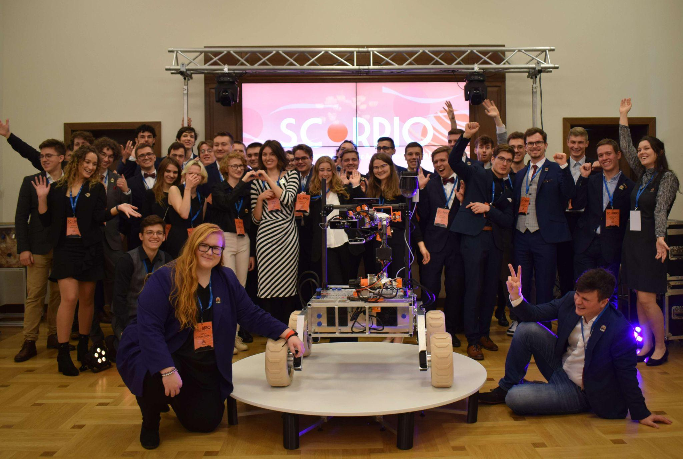
TEAM INFO
Team Photo
A photo/screenshot of the whole or part of the team.

Slide 15
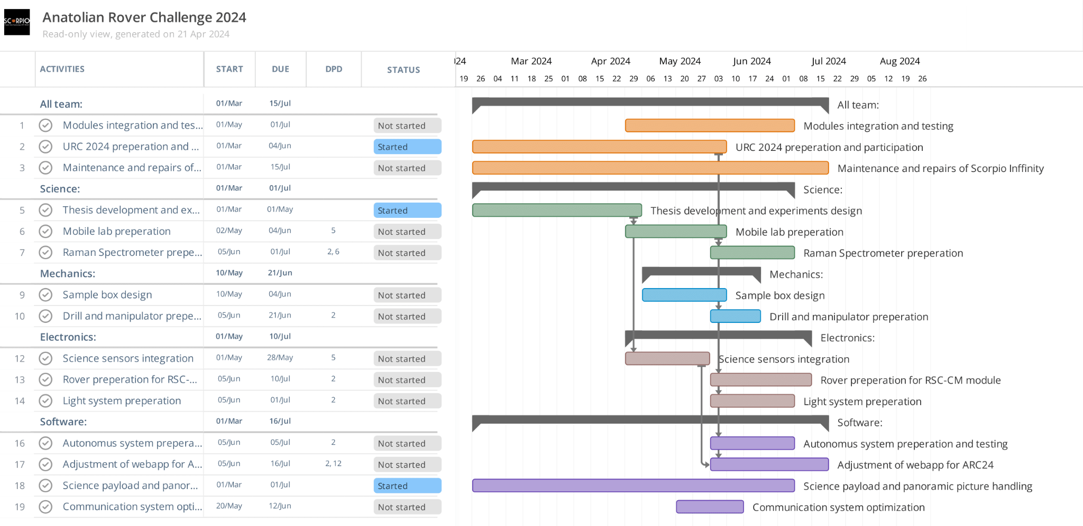
MANAGEMENT
Work
Calendar:

Slide 16
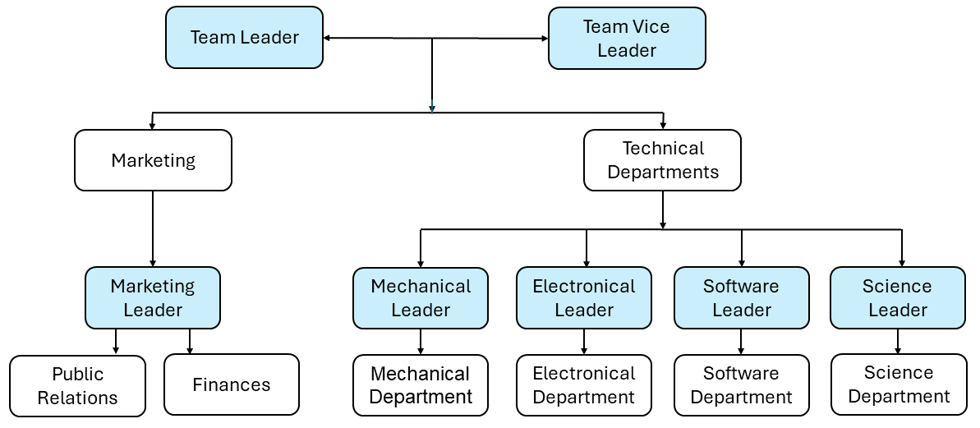
MANAGEMENT
Team
Formation:
Our team consists of 52 members actively working on our project. In our structure (shown in the picture below) we have: team leader, team vice-leader and 5 departments (Marketing and 4 Technical Departments) with leaders and vice-leaders responsible for each.
How is the team workforce structured? (2-3 sentences) Include a graphic to explain the structure as well.

Slide 17
MANAGEMENT
Workplace:
Thanks to our University, we have access to two workplaces, where we keep all essential tools and materials, such as soldering irons, digital oscilloscopes, screwdrivers or 3D printers. To bring more sophisticated components to our lives, we ask external contractors, sponsors or a university technician to support us with those elements.
While basic tests are performed at the workshops, the more demanding need much more space, like range or autonomy tests. That is why, they are held at a nearby parking lot, a park or an abandoned airfield.
How the team design, build and test the rover physically? Explain the workplace. (2-4 sentences) Include a photo/screenshot of the workplace.

Slide 18
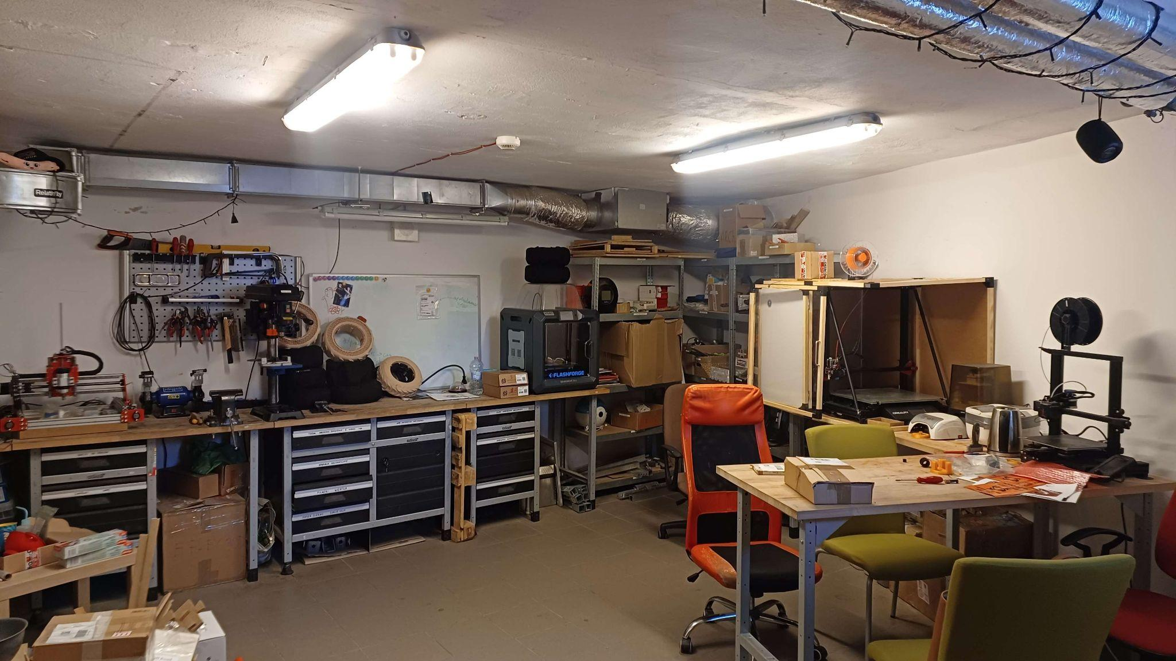
MANAGEMENT
Workplace:
How the team design, build and test the rover physically? Explain the workplace. (2-4 sentences) Include a photo/screenshot of the workplace.
We use 2 separate workshops for mechanical and electrical work to protect sensitive components. During the offseason we have storage provided to us by our university to store our travel equipment.

Slide 19
MANAGEMENT
Funding :
Our funds can be divided into three categories. Wrocław University of Science and Technology provides us with the biggest support of all. This year, yet again, we have received a status of Strategic Association from our University as one of the groups with most potential and prospects. Thanks to that, we are able to travel to many competitions all around the world. Another thing worth mentioning is the grants that we constantly apply for. Our Marketing department keeps looking for new sponsors and new ways to guarantee us that money will not run out. Sponsors not only support us financially, but also by providing us with their goods and services, most and foremost, parts to our rover. At this moment, our overall funds are about $20 000. We predict that the funds will be sufficient by the competition date.
Based on our previous experience and expected value of flight tickets, we expect sum of about $7300 (price for 10 members to go). First, we take into a consideration cost of flight tickets from Poland to Turkey which is about $230 for each. Secondly, we have cost of accommodation which we expect to be around $2500. Then, we will be renting car which is about $400 Also because our project is almost done, we plan to spend about $500 for our development.
Present the funds of the project at the time of submission of this document? (In dollar currency)
How much spending is expected for the development costs? How much spending is expected for the travel costs?
What is the team's plan in an insufficient funding situation by the competition date?

Slide 20
MANAGEMENT
Logistics:
Based on our experience earned by transporting our rover to the various events, we have reliable strategy on packing. To bring Scorpio Infinity to the competition, we plan to pack all of the electronic in packages and other parts of our rover in boxes prepared by us. To make it as safe as possible we will wrap each of parts in bubble wrap. In case to transport these boxes and packages, some of our team will be going by cars to reach the destination. Other part of our team will be flying to the destination.
What is the team's plan to package and bring the rover to competition site by July? (4-6 sentences)

Slide 21
ROVER DESIGN
Mobility
System:
Scorpio Infinity is equipped with four-wheel rocker suspension system. Two triangular levers linked by a beam are used to connect the rockers. Drivetrain consists of four BLDC motors which enables all-wheel drive. To ensure efficient movement on the diverse terrain of Mars and Moon, we use specially designed, 3D printed tires with gyroid structure based on TPU filament. Our mobility system is equipped with heavy wheels and light chassis, ensuring low center of gravity.
Due to low center of gravity, our rover is capable of handling steep angles over 30 degrees and obstacles up to the diameter of the wheels (~28 cm).
Additionally, the combination of dependent rocker suspension and all-wheel drive system with adaptive tires provides us the capability of traversing a variety of different terrains, such as loose soil, hard soil and rocks.
What is used? Describe the system
(3-5 sentences)
Why the system is chosen? What are the considerations? What are weaknesses and strengths?
(3-5 sentences)

Slide 22
ROVER DESIGN
Mobility
System:
Our rocker suspension system is designed to be compact, lightweight and reliable. This was achieved by utilization of custom made triangle shaped lever system linking the pushrods with the differential bar.
We delved into several analyses of airless tires, which sparked the inspiration for incorporating a gyroidal fill pattern into our own tires. This innovative approach draws from the efficiencies observed in airless tire designs, enhancing both performance and resilience in our rover's mobility system.
Unique points and inspirations
(3-5 sentences)

Slide 23
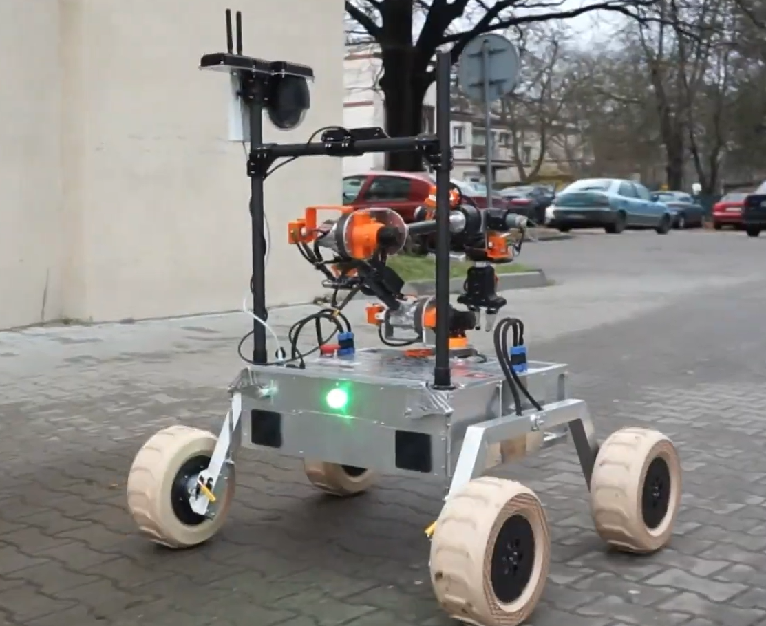
ROVER DESIGN
Mobility
System:
Visuals of the system
(2 photos/screenshots)

Slide 24
ROVER DESIGN
Mobility
System:
In order to comply with regulations, our rover is designed to fit within a 1,2 m cube. Our rover’s width is 100 cm, length is 102 cm and it’s height is 118 cm. The Scorpio Infinity suspension system is based on aluminum components. The entire mobility system weighs 37 kg.
Our rover’s driving module is constructed to be both lightweight and reliable. Thanks to 350 W BLDC motors combined with planetary gearboxes located in each wheel, our rover can generate enough torque to traverse challenging terrain on both martian and lunar landscapes without difficulty. That includes loose soil, hard soil and rocks.
Overall, our mobility system is suitable for participating in competition missions.
Technical Specifications including mass and size (3-5 sentences)
Discuss the system's adequacy for its role in competition missions. (3-5 sentences)

Slide 25
ROVER DESIGN
Electronics and power system:
Jetson AGX with a Raspberry Pi 4 enables comprehensive control over the entire rover. Data within the rover flows through two channels: high-speed Ethernet for cameras and the CAN bus, the backbone for internal communication. To handle various basic tasks within our rover, we designed universal control boards. These boards feature a microcontroller, protected power supply, EEPROM memory for storage of settings, and CAN bus communication module.
Using universal boards allows us to quickly replace damaged components; however, the disadvantage of this solution is the limitation of circuit applications. While selected computers allow us to process images efficiently, the trade-off is their increased power requirements. Although using CAN gives us reliable communication, it requires a special boards design and has a bandwidth 100 times lower than Ethernet.
What is used? Describe the system
(3-5 sentences)
Why the system is chosen? What are the considerations? What are weaknesses and strengths?
(3-5 sentences)

Slide 26
ROVER DESIGN
Electronics and power system:
When designing our electronics, we place great emphasis on protection, each board designed by us is protected against surges and reverse polarity. Taking a cue from Arduino's user-friendly approach, our custom boards are designed as modular "hats" that seamlessly integrate with the universal boards. This approach streamlines code integration and offers effortless replacement options in the event of a malfunction, enhancing overall system flexibility and maintenance efficiency. The control system for each manipulator component mirrors servo mechanisms in functionality. We define the desired position or speed, and joint autonomously adjusts to achieve it, continually monitoring and transmitting its current position to computers for precise control.
Unique points and inspirations
(3-5 sentences)

Slide 27
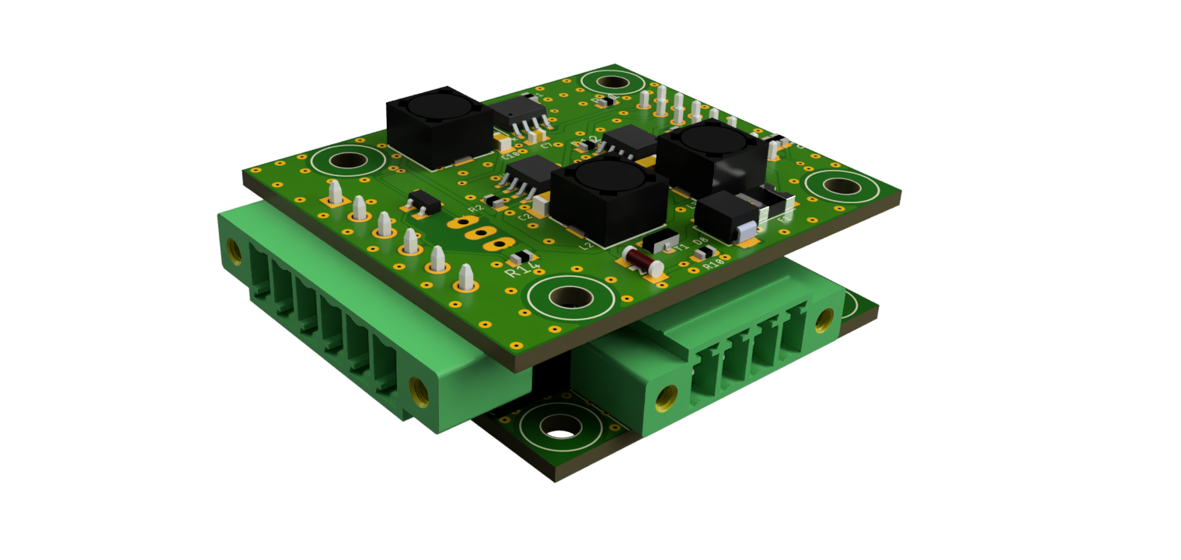
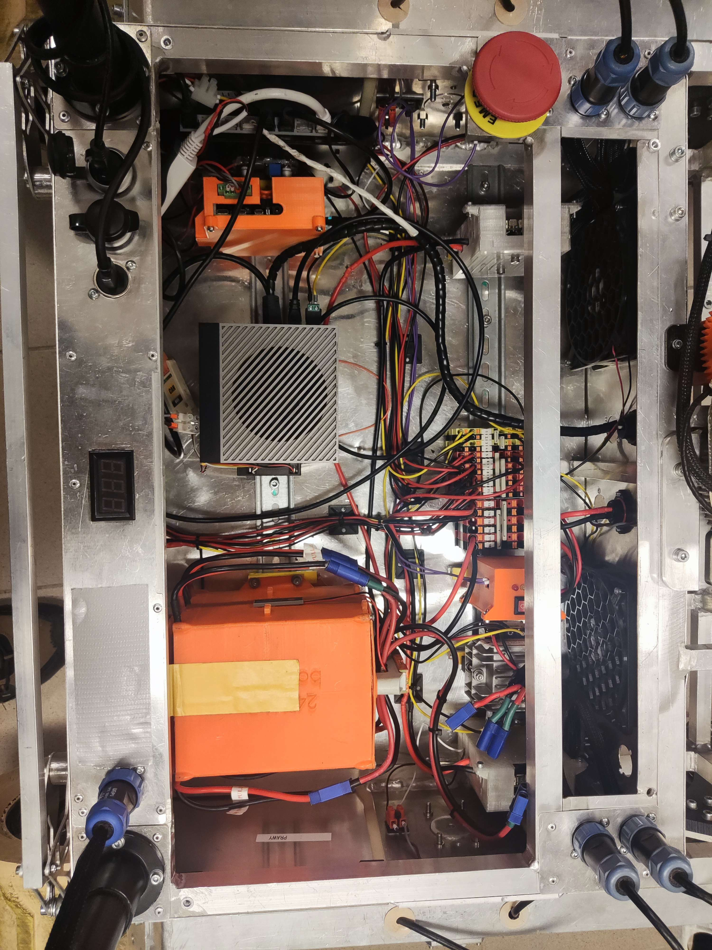
ROVER DESIGN
Electronics and power system:
Visuals of the system
(2 photos/screenshots)
Activity light control board
Rover interior

Slide 28
ROVER DESIGN
Electronics and power system:
The rover will be powered by four lithium-polymer 6S batteries connected in parallel, providing an overall capacity of 18000 mAh with a total weight of 2.8 kg. The majority of our rover's systems operate on a 24V bus, while we have allocated a separate 12V bus specifically for the cameras and Jetson computer. Batteries are linked to the primary power bus through our power control board. Positioned conveniently on the rover is a red button that instantly disconnects the power when pressed.
Our batteries enable rover operation for over 3 hours. High energy density characteristic of LiPo batteries compared to alternative technologies. LiPo batteries provide high energy density compared to other technologies Additionally, the power control board can handle over 200A, fulfilling our power demands while safeguarding the batteries against over-discharge.
Technical Specifications including mass and battery duration (3-5 sentences)
Discuss the system's adequacy for its role in competition missions. (3-5 sentences)

Slide 29
ROVER DESIGN
Manipulation system:
Scorpio Infinity is equipped with 6 DoF robotic arm. The joints are equipped with a combination of BLDC and DC motors, with harmonic gearboxes and custom-built planetary gearboxes specifically for the BLDC motors. Our gripper follows a modular design, with multiple mountings points for additional equipment, such as video camera, and wide range of sensors. Our robotic arm have absolute encoders installed on each joint to provide precise position readings. Leveraging these readings, we calculate joint velocities, enabling the implementation of PID controllers in a closed-loop system.
This solution was chosen to ensure the high payload lift to manipulator weight ratio, while providing a high degree of precision. The main considerations were high precision of operations and modularity. The big strength of our system is velocity-based control mechanism significantly enhancing the precision and accuracy of our robotic arm's operations. One major weakness of our manipulator is high mass of the end effector.
What is used? Describe the system
(3-5 sentences)
Why the system is chosen? What are the considerations? What are weaknesses and strengths?
(3-5 sentences)

Slide 30
ROVER DESIGN
Manipulation system:
The planetary gearboxes on our robotic arm are a distinctive feature as they are custom-made using 3D printing. In addition to being lightweight, they are also cost-effective to produce when compared to alternatives offered in the market. Our manipulation system employs an interchangeable end-effector with quick coupling mechanism, featuring a gripper with trapezoidal screw kinematic layout and excavator options.
Unique points and inspirations
(3-5 sentences)

Slide 31
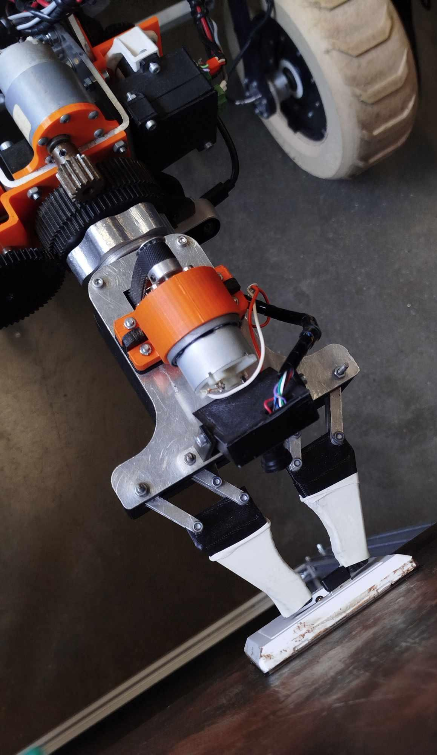
ROVER DESIGN
Manipulation system:
Visuals of the system
(2 photos/screenshots)

Slide 32
ROVER DESIGN
Manipulation system:
The weight of our robotic arm is around 9 kg. It’s primarily built using carbon fiber tubes, aluminum and 3D printed components. With a maximum range of 1,2 m, it can lift up to 5 kg when fully extended.
Thanks to precise gripper, that was optimized for operating various switches and levers that will be present on the Mining Cart, and two cameras with distance measuring system we can overcome various tasks as requiring high degree of precision such as operating the switches.
Technical Specifications including mass, max payload and size
(3-5 sentences)
Discuss the system's adequacy for its role in competition missions. (3-5 sentences)

Slide 33
ROVER DESIGN
Science Payload:
Our research methodology primarily involves analyzing samples using a Raman spectrometer, microscope, and chemical analysis. Ramans spectroscope gives us precise information about structure of the minerals and their spectra. Microscope and chemical analysis may confirm and expand the information given by Ramans spectroscope.
We chose Raman spectroscopy because it is able to scan minerals non invasively. We chose specific chemical reactions to identify potential organic origin of the sample. The main downside is chemical analysis dependance on external environment and Raman’s measurement problems with dark and reflective minerals.
What is used? Describe the system
(3-5 sentences)
Why the system is chosen? What are the considerations? What are weaknesses and strengths?
(3-5 sentences)

Slide 34
ROVER DESIGN
Science Payload:
The most advanced and unique research instrument of our analytical system is a Raman spectrometer. The installation of this instrument was inspired by the currently operational Mars rover missions Curiosity and Perseverance. They showed that it is possible to conduct precise analyses of the chemical composition of minerals and regolith with non-invasive spectral methods, without prior preparation. These advantages make Raman spectrometry ideal for conducting remote and precise analyses, a key feature in any space exploration mission.
A unique feature of our Raman spectrometer is its housing, which is made of powder 3D printing technology. This allows us to create an enclosure with a geometry that is not achievable with classical material processing methods.
Unique points and inspirations
(3-5 sentences)

Slide 35
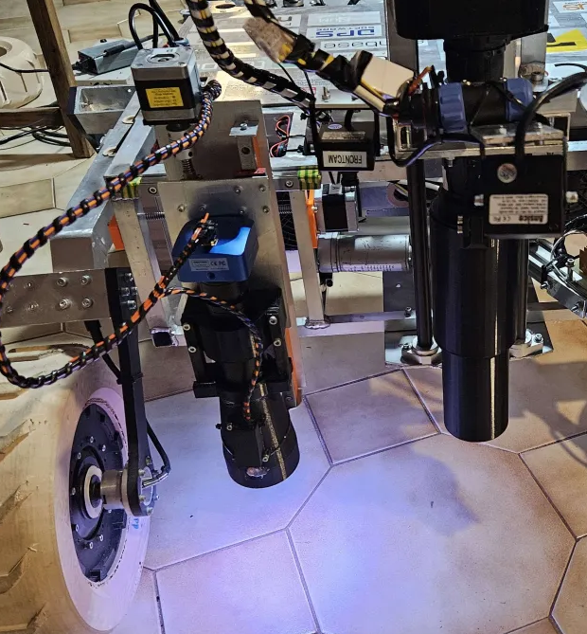
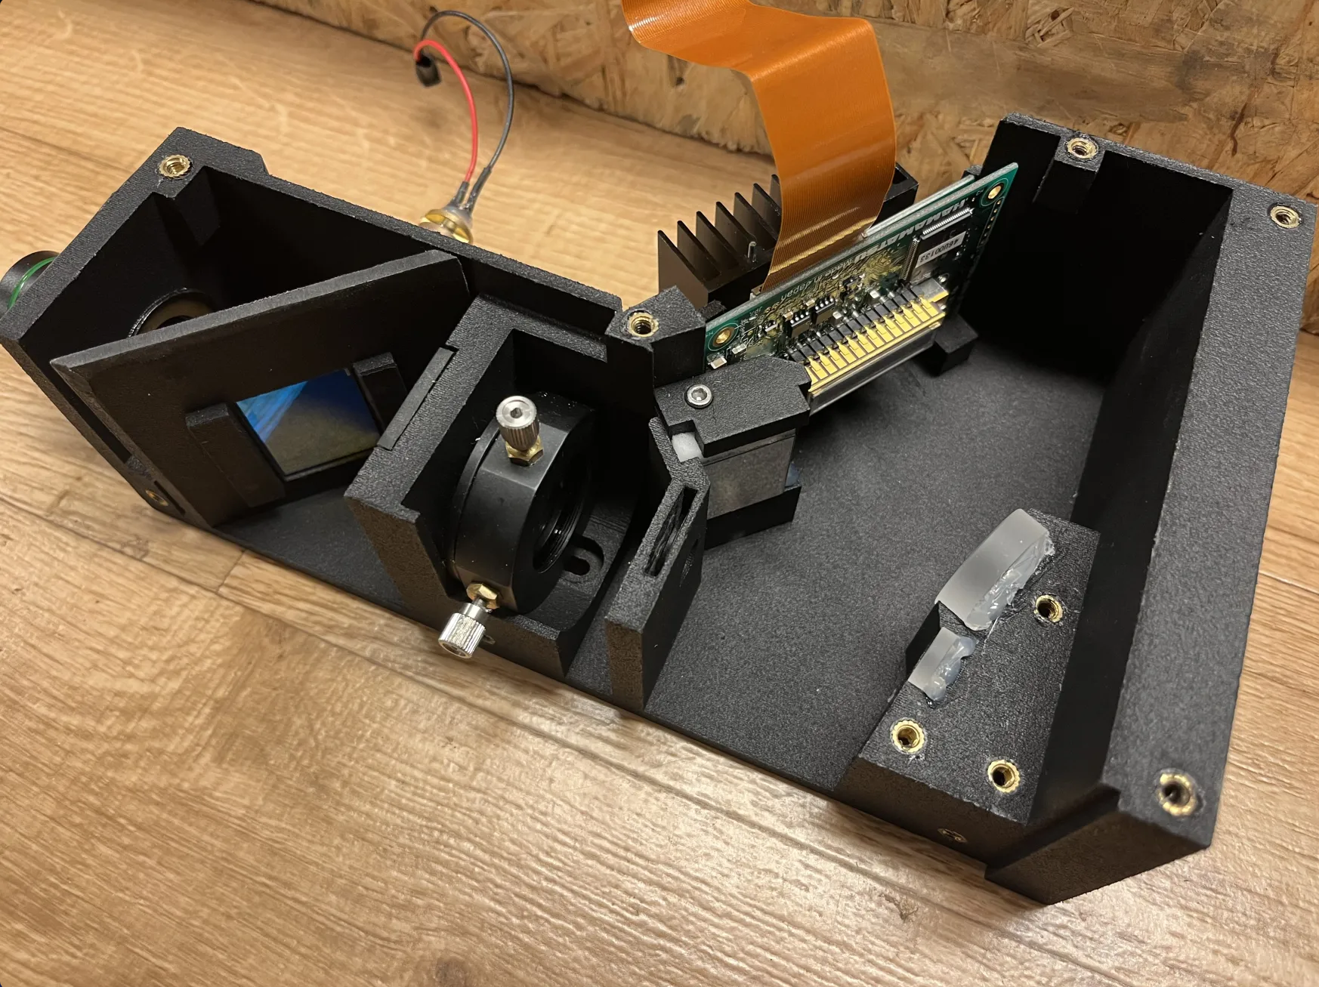
ROVER DESIGN
Science Payload:
Visuals of the system
(2 photo/screenshots)

Slide 36
ROVER DESIGN
Science Payload:
The rover-mounted science payload consists of a sensor array and, a microscope and a drill. The mass of the sensor array along with the microscope is 1.2 kg. The drill’s mass is 5.5 kg. In the standard configuration the rover has an average battery life of 3 hours, which varies depending on factors such as working conditions and modules used.
The sensor set we use is capable of measuring temperature and humidity of the soil. This can potentially lead us to finding areas more likely to host hydrated minerals. The drill allows our rover to collect samples. This configuration allows us to conduct crucial measurements quickly and effectively, which will enable us to perform a thorough analysis.
Technical Specifications including mass and battery duration (3-5 sentences)
Discuss the system's adequacy for its role in competition missions. (3-5 sentences)

Slide 37
ROVER DESIGN
Ground station equipment and communication system:
Our communication system consists of an omnidirectional antenna - on rover and base station - and base box which contains a computer that hosts a website used to control our rover and a network switch that allows us to connect operators’ computers. Both Scorpio Rover and base station are equipped with two Ubiquiti Rocket radios (M2 and M5). In order to communicate with the robot we utilize Wi-Fi.
The biggest weakness of our communication system is the base station antenna losing line of sight to our rover - which can cause troubles with data transmission. The second weakness is potential disturbance from other WiFi networks. On the other hand, the fact of using an omnidirectional antenna assures good enough signal on the whole field while minimizing the number of single points of failure, unlike a rotating directional antenna. Usage of two radios gives us ability to easily change frequency bands depending on the conditions.
What is used? Describe the system.
(3-5 sentences)
Why the system is chosen? What are the considerations? What are weaknesses and strengths?
(3-5 sentences)

Slide 38
ROVER DESIGN
Ground station equipment and communication system:
In the past, we’ve been using a directional antenna but we’ve found out that it does not provide a significant gain on a field of this size - therefore this year we are committing to an omnidirectional antenna. The option to change between 2.4GHz radio and 5GHz radio allows us to remain flexible in our choice to maximize the quality of communication. The signal quality is constantly monitored in our app at the base station, and it provides information about potential delays.
The base station is designed to minimize communication - the computer at our base station is the only device that is directly communicating with the rover, which allows us to significantly minimize network traffic.
In order to control the rover no other devices than a laptop with a browser are needed - the web application is hosted on a base station computer and all control is done using a keyboard and a mouse.
Unique points and inspirations
(3-5 sentences)

Slide 39
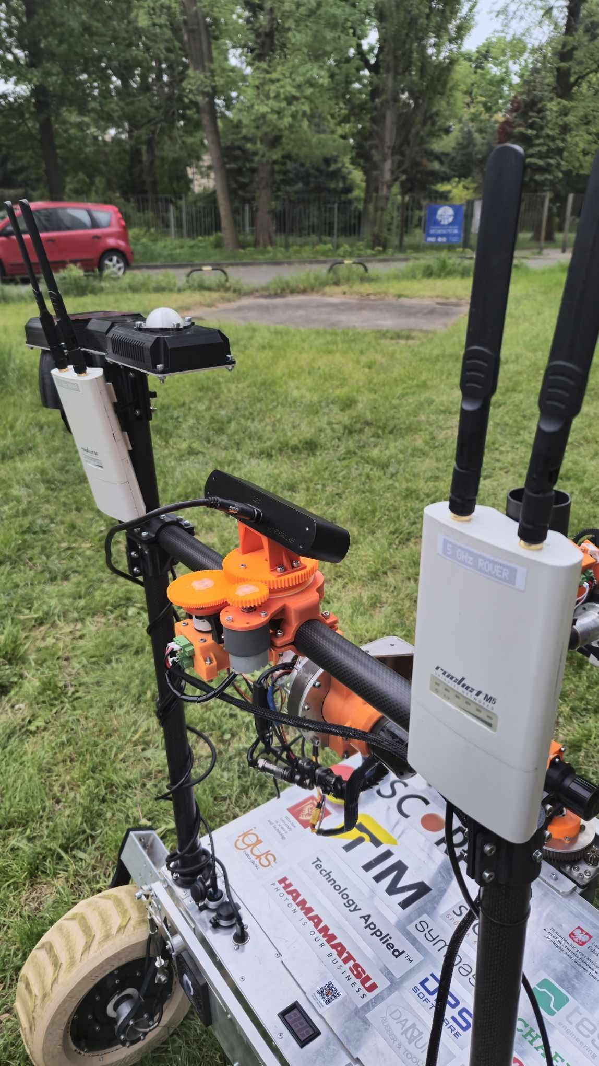
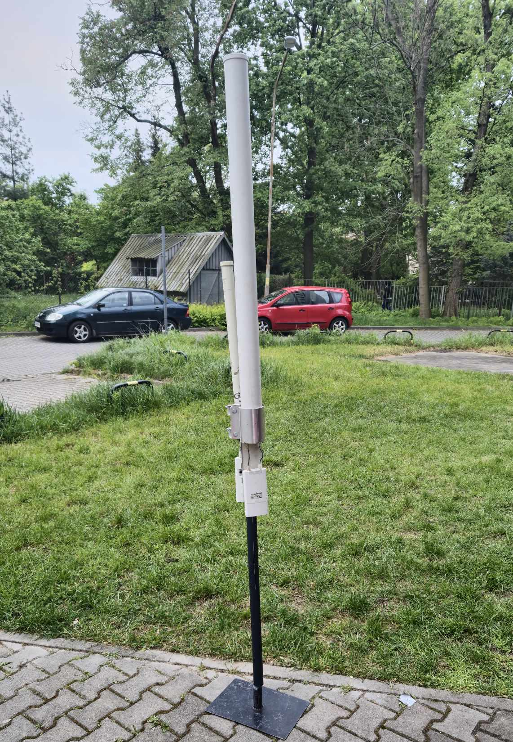
ROVER DESIGN
Ground station equipment and communication system:
Visuals of the system
(2 photos/screenshots)
Rover communication system - Rocket M2 & Rocket M5
Base station communication system - Rocket M2 & Rocket M5 with high-gain omni-directional antennas

Slide 40
ROVER DESIGN
Ground station equipment and communication system:
The communication system between rover and base station consists of:
2 x 2.4 GHz Ubiquiti Rocket M2 WiFi radio,
2 x 5.0 Ghz Ubiquiti Rocket M5 WiFi radio,
AMO-2G13 omnidirectional antenna,
AMO-5G13 omnidirectional antenna
Both radios are capable of securing a stable PtMP connection with signal strength as low as -96dBm and SINR as low as 8dBm with the maximum bandwidth of 150Mb/s. Before any given task of the competition we can decide which frequency band to use, as the system is designed around quickly exchanging radios. Additionally we are able to choose between different channels on each band to establish a stable connection from the base station to the rover whenever interferences are detected. This system allows us to achieve up to 400m of range, which is more than enough for all competition missions.
Technical Specifications including resilience to noise and communication range (3-5 sentences)
Discuss the system's adequacy for its role in competition missions. (3-5 sentences)

