Slide 1
2024
Design Report

Slide 2
TEAM INFO
Team Name:
TEAM VYADH
Contact:
+91-8249963669

Slide 3
TEAM INFO
Academic
Institution:
Vellore Institute of Technology,
Thiruvalam Road, Katpadi,
Vellore, Tamil Nadu 632014
Academic
Consultant:
Benedict Thomas
Vellore Institute of Technology,
+91-9938188794

Slide 4
TEAM INFO
History of
the Team:
We were founded in 2015, Team Vyadh embarked on a journey marked by innovation and excellence in various international competitions. With over 8 years of experience, their inaugural appearance in CanSAT in 2015 placed them at rank 38. Subsequent years saw remarkable progress, including a notable rank 2 in Asia at ERC in 2016 and a commendable rank 2 in AIAA UG Engine Design alongside rank 3 in CanSAT in 2017. Continuing their upward trajectory, they secured rank 2 in Asia at ERC in 2018. In 2020, they made their mark globally, placing amongst the top 33 teams at URC. The following years witnessed further success, with notable rankings including 9th worldwide at IRDC in 2021, 13th globally at IRDC in 2023, and 19th internationally at IRC in 2024, showcasing their consistent performance and competitiveness on the international stage.

Slide 5
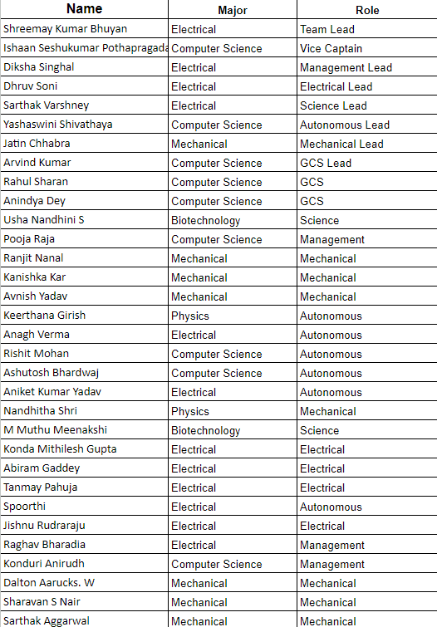
TEAM INFO
Active
Members List:

Slide 6
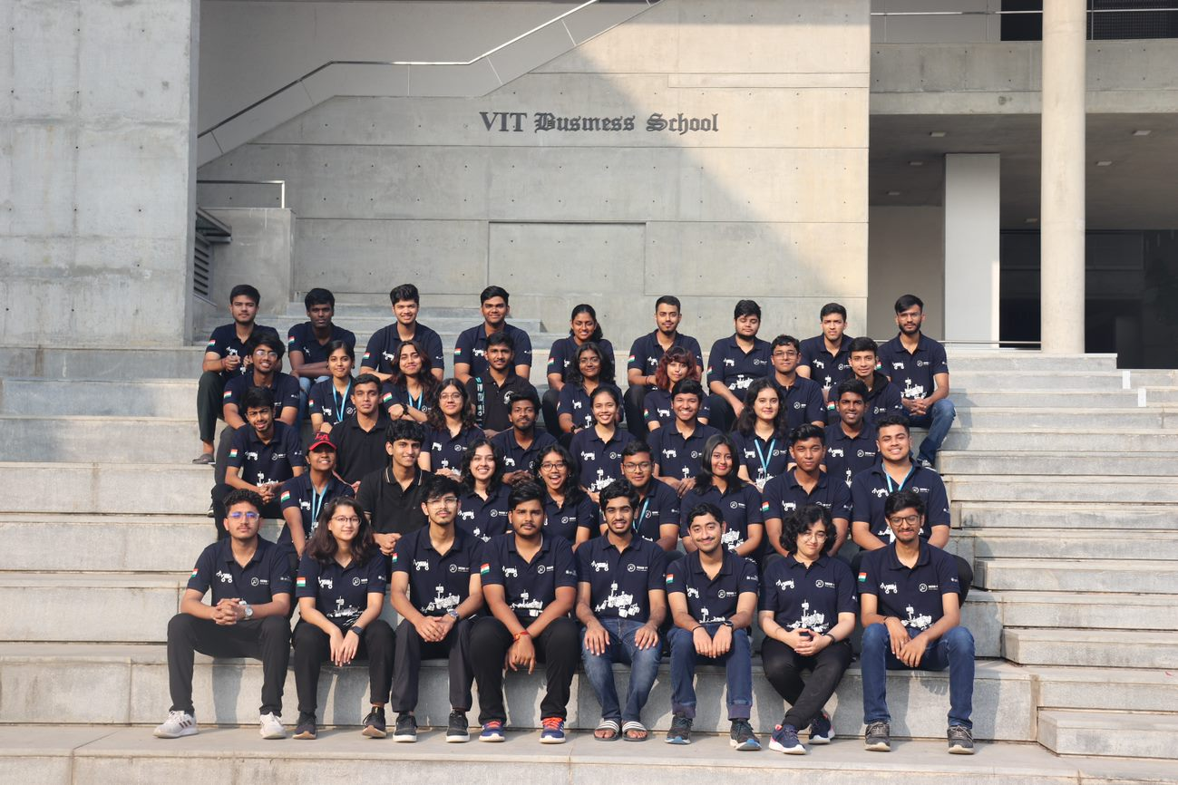
TEAM INFO
Team Photo

Slide 7
MANAGEMENT
Work
Calendar:

Slide 8
MANAGEMENT
Team Vyadh comprises 32 team members. Our team has been divided into six different domains composed of undergraduate students from different disciplines. Each domain has its respective domain lead who is responsible for assigning tasks to the members of their respective domain and ensuring that everything in their domain goes well without any issues.
Team
Formation:

Slide 9
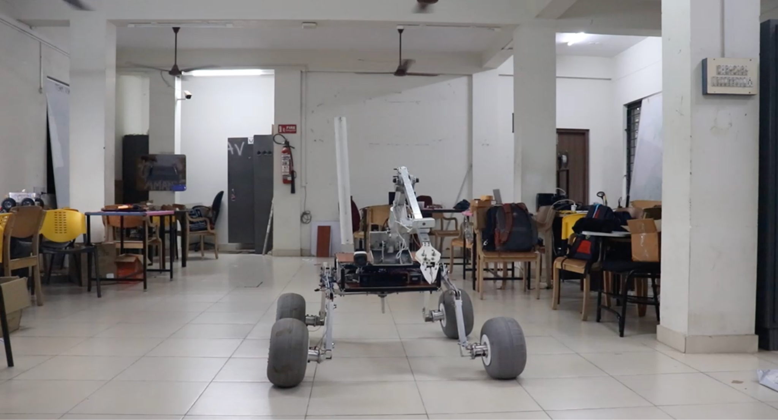
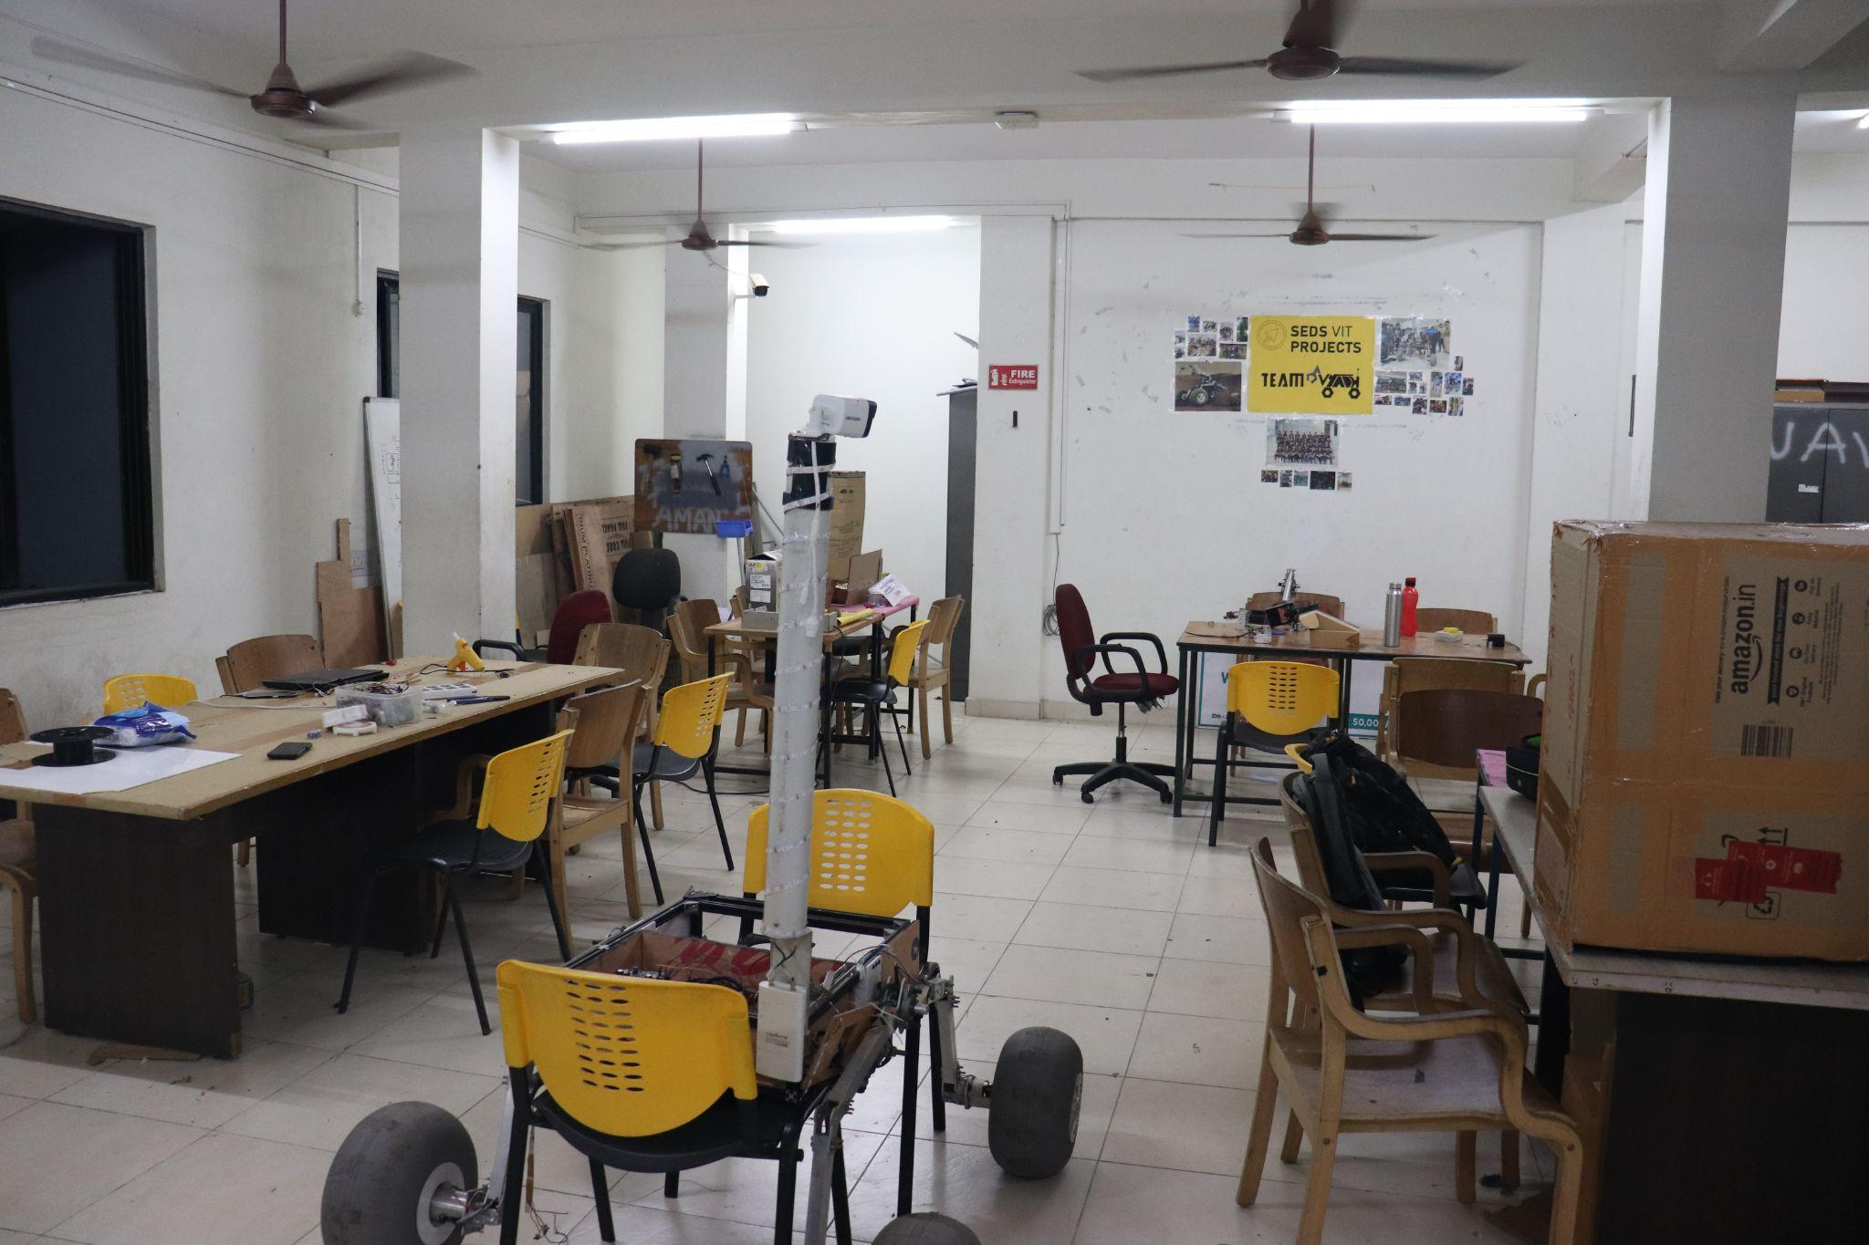
MANAGEMENT
Workplace:
We have a dedicated lab for Team Vyadh. We also use our campus field for various types of field tests. Additionally, there are spacious construction sites near our campus too, where we occasionally conduct our field tests.

Slide 10
MANAGEMENT
Funding :
The total budget for this year is $7,570.
Our rover is expected to cost less than $5,000.
So far this year, we have spent $4,085.
Travel to ARC is expected to cost at most $24,000 for 20 members.
Individual team members will bear the traveling expenses.
We have been allocated a sufficient budget, so budget constraints are unlikely.
In case of constraints, individual team members will pool in to bear the costs.

Slide 11
MANAGEMENT
Logistics:
❖We will apply for Turkish visas by June 10.
❖We will start dismantling the rover on July 9th and pack its parts compactly to make it ready for transportation for international flight according to travel norms
❖We will get approvals from our institute and the competition for the same
❖Our rover, with all spare parts, weighs around 80 kg
❖It will be dismantled, put in suitcases, and checked in as luggage
❖This, when divided among the 20 members of our team who will be travelling, will fall within international flight limits
❖Parts forbidden on flights (like batteries) will be ordered directly to our accommodation in Turkey.

Slide 12
ROVER DESIGN
Our rover features a 4-wheel modified double rocker suspension system, utilising hollow rectangular cross-sections of 38x25 mm² Aluminum 6061 grade rods. These rods, measuring 230 and 310 mm long, create a sturdy framework for the suspension. The strategic use of 120 and 150-degree connectors shapes the suspension into an upside-down U, significantly enhancing its load-bearing capacity and structural rigidity.
Our suspension system maintains a consistent pitch angle for the chassis throughout the rover's journey. Connected to the suspension system, the differential responds to the seamless rotations of the suspensions, executing coordinated movements in opposite directions. Considering the segue transfer of load from the chassis to the wheels facilitating smooth rotations of the suspensions, FL004 flange bearings have been used.
This mechanism not only maintains structural balance but also enables the rover to withstand vibrations encountered during traversal across rocky and uneven terrains in the mission. This design methodology prioritises stability over speed, so the rover can traverse difficult terrain without compromising its structural integrity maintaining a steady but lower speed.
We have selected lightweight polyurethane beach wheels due to their shock absorbing capabilities. These ensure seamless traversal through challenging terrain. Their circular rubber treads provide consistent traction and greatly increase the rover's stability by efficiently gripping loose surfaces and expelling debris. To further enhance our wheel design, we upgraded the rim to a custom 3D-printed Polylactic Acid (PLA) subassembly. Each wheel is powered by four IG52 motors, providing a stall torque of 94.14384 Nm. These four motors are kept securely inside a custom-built CNC enclosure..
Mobility
System:

Slide 13
ROVER DESIGN
Mobility
System:
Chassis: A veristic suitcase impelled us to ideate and estimate the mass and design of our chassis. This idea was brought to life by using fully adjustable t-slots for an effective and modifiable assembly.
Suspension: The modified double rocker suspension is modeled after the anatomy of a quadruped mammal which is mobile and sturdy to use simultaneously.

Slide 14
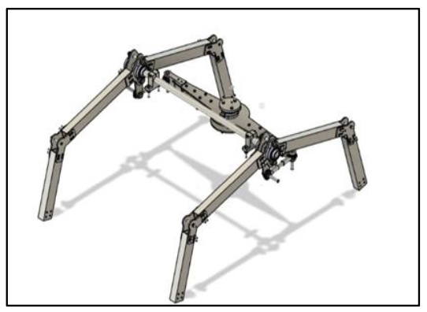
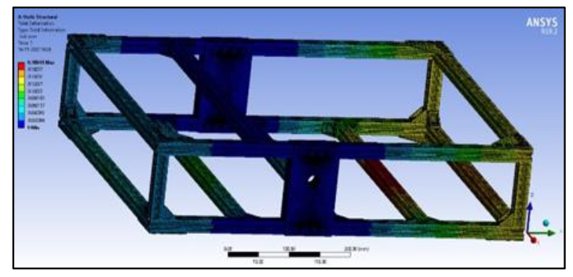
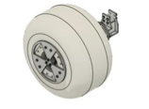
ROVER DESIGN
Mobility
System:
Suspension
Chassis
CAD Model of a Balloon Wheel

Slide 15
ROVER DESIGN
Mobility
System:
Chassis
Size: 640x520x140 mm³
Material: Aluminium 6061
Ground Clearance: 450 mm
Suspension
Name: Modified Double-Rocker Suspension
Dimensions: 38x25 mm² cross-section rods of 230 and 310 mm length
Material: Aluminium 6061
Wheels
Diameter: 300mm
Pressure: 20684.3 Pa
Rim Material: Poly lactic acid (PLA)
Tyre Material: Polyurethane
Motor: IG52

Slide 16
ROVER DESIGN
Electronics and Power System:
Power System: -
The onboard electrical and electronic components of the rover are powered by two 16000 mAh 22.2 V Li-Po batteries. The robotic arm is equipped with a dedicated 16000mAh 22.2 V Li-Po battery to account for its independent operation. The second 16000 mAh battery is used to power the motors of the wheel, all the onboard sensors, camera, router, and cooling fan.
Each battery can support the rover for about 90 minutes which is sufficient for the completion of the tasks. Power distribution boards are built with multiple buck converters to provide the various voltages such as 5V, 12V, 19V, 22V are needed for the components.
Due to its high energy density, low maintenance, reasonably good charge-discharge behaviour and suitable load characteristics, Li-Po batteries are preferred over Ni-Cd. A kill switch is connected to the rover which is connected to the main battery system in series which can be used to kill power immediately in case of emergency.

Slide 17
ROVER DESIGN
Electronics and Power System:
Strengths:
For our rover model, we have selected IG52 industry-grade motors, known for their efficient drive and smooth operation during traversal. To drive these motors, we have incorporated Cytron MD30C single-channel motor drivers.
Our rover is equipped with custom PCB designs, each serving a specific purpose like traversal, science kit, robotic arm, probe, and chassis which contribute towards enhancing the overall functionality and workability of the rover.
For power management, we have incorporated Lithium Polymer batteries with a kill switch, ensuring the safety and efficient distribution of power, thereby preventing any potential hazards during the rover's operation.
Weakness:
The cpu fans used for the cooling system consume more power which in turn drains out battery quickly and the wooden box used for the components, being an insulator of heat gives us a disadvantage

Slide 18
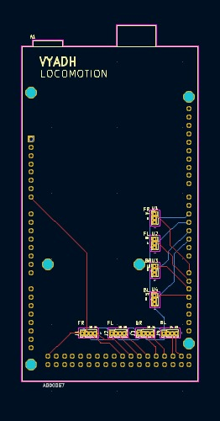
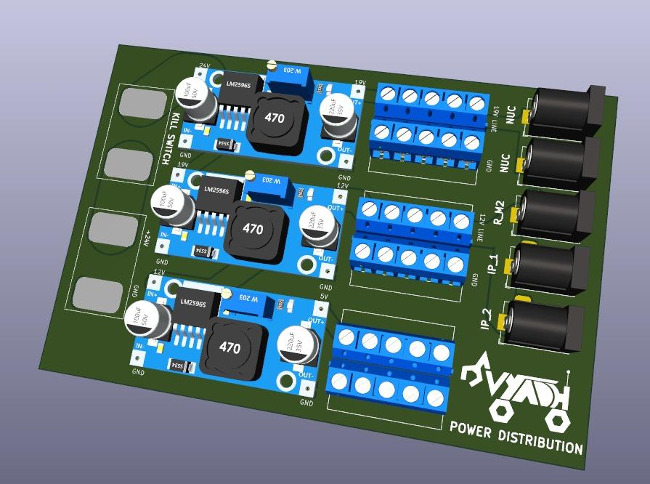
ROVER DESIGN
Electronics and Power System:
Buck Converter 19V
Screw Terminal 19V
Intel NUC
Kill switch
Rocket M2
22.2v
IP Cameras
Buck Converter 12V
Buck Converter 5V
Screw Terminal 5V
Screw Terminal 12V
Power Distribution PCB 3D View
Locomotion PCB Schematic

Slide 19
ROVER DESIGN
Specifications and System Adequacy:
The use of MD30C motor drivers, IG52 industry-grade motors, and high-torque planetary gear DC motors ensures smooth and powerful operation, allowing the rover to navigate diverse terrains and carry out tasks with precision and agility.
The Rover's Components comprising of motors, motor drivers, batteries, and sensors, collectively weigh a total of 12 kg
Each battery can support the rover for about 90 minutes which is sufficient for the completion of the tasks. Power distribution boards are built with multiple buck converters to provide the various voltages such as 5V, 12V, 19V, 22V are needed for the components.
A variety of sensors, including those for humidity, temperature, gas, soil moisture, acceleration, gyroscope, pressure, magnetometer, and GPS, give the rover a comprehensive understanding of its surroundings. This enhances its ability to perform scientific tasks and navigate accurately.
The use of motor drivers and encoders provides precise control over the motors, enabling accurate movements and tasks such as navigation and manipulation.
Electronics and Power System:

Slide 20
ROVER DESIGN
The robotic arm features 5 degrees of freedom (DOF) and is powered by dual electronic linear actuators. It also includes a worm and spur gear combination operated by an IG45 motor for turntable rotation, along with two servo motors for the end effector. The arms are constructed using hollow Aluminium 6061 rods of square cross-section, simplifying the manufacturing process while providing high rigidity and low vibrations during operations. With a combined force capability of up to 800 N and a radius coverage of 650 mm, the arm is suitable for tasks such as picking and placing operations required for the mission.
The robotic arm, which is mounted on the chassis close to the turntable, uses a worm gear and a series of spur gears to convert a high-speed, low-torque configuration into a low-speed, high-torque configuration. This setup is ideal for rotating the robotic arm and evenly distributing its load to the chassis. An axial deep groove thrust bearing is used to bear and transfer the load from the entire robotic arm to the turntable and chassis, providing unrestricted rotation of the arm. The robotic arm shoulder and elbow linkages transform the linear motion of the actuators into a circular motion.
The end effector consists of a geared beetle claw driven by a single NEMA 17 stepper motor, delivering an effective torque of 1 Nm. This torque is sufficient to lift and carry loads up to 5 kg with ease. Additionally, a set of 2 NEMA 17 motors are employed to rotate the gripper in horizontal and vertical planes, providing a wrist-like configuration. This configuration enables the end effector to execute actions such as turning a knob or flipping a switch.
Manipulation System:

Slide 21
ROVER DESIGN
Manipulation System:
Robotic Arm and End Effector:
The 5 D.O.F. robotic arm was forged by analysing a bonobo’s muscular arm and wrist. All the different relative motions in its arm were mimicked and implemented in this ergonomic design.

Slide 22
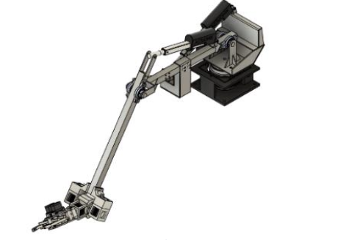
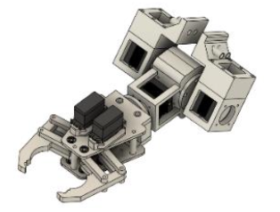
ROVER DESIGN
Manipulation System:
Robotic Arm
End Effector

Slide 23
ROVER DESIGN
Manipulation System:
Arm
Mass: 13kg
Material: Aluminium 6061
Motor (for turntable): IG45
Rod cross-section: 30x30 mm²
Radius of coverage: 650 mm
Total load carrying capacity: 800N
End Effector
Motor: NEMA 17
Effective Torque: 1Nm
Load Carrying Capacity: 5kg

Slide 24
ROVER DESIGN
The 5-DOF robotic arm provides flexibility and precision in handling the gripper for sample collection. The use of an auger allows for efficient soil collection by drilling into the Martian surface. Additionally, the science kit with detachable clips offers a convenient and organized way to store the collected samples. Overall, this system is likely chosen for its ability to reliably and effectively collect samples in the challenging Martian environment.
Strengths:
1. Precision: The 5-DOF robotic arm allows for precise movements, enabling accurate sample collection.
2. Efficiency: The use of an auger speeds up the soil collection process compared to manual methods.
3. Versatility: The system can be adapted to collect various types of samples from different locations on Mars.
4. Convenience: The science kit with detachable clips provides a convenient and organized way to store samples.
Weaknesses:
1. Complexity: The system may be complex to design, build, and operate, requiring specialized knowledge and skills.
2. Maintenance: The robotic arm and auger may require regular maintenance and calibration to ensure optimal performance.
3. Environmental Limitations: The system may be affected by the harsh Martian environment, such as dust storms or extreme temperatures.
4. Sample Contamination: There is a risk of contaminating samples collected using robotic systems, which may impact the scientific integrity of the samples.
Science Payload:

Slide 25
ROVER DESIGN
Curiosity is equipped with a "hand" located at the end of its articulated robotic arm, known as a turret. This turret houses a drill that inspired the development of the auger mechanism currently used in the soil collection process.
Augers are inspired by natural drilling mechanisms found in various organisms, such as certain species of worms and insects. This biomimicry can lead to innovative designs that improve the efficiency and effectiveness of auger systems.
One unique aspect of the sensor array is its ability to capture a comprehensive set of environmental data crucial for understanding Martian soil and atmosphere. By combining measurements from the DHT22, soil moisture sensor, CO2 sensor, MQ4 gas sensor, and BMP280, the system provides a holistic view of Mars' environmental conditions, offering insights into potential habitability and past geological processes.
Containers in the science payload for collecting soil samples are designed to be insulated and sealed to eliminate contamination and spillage of contents.
A microscope mounted on the rover aimed at studying soil texture and grain size is a crucial factor in determining the geology of the Martian terrain.
Science Payload:

Slide 26
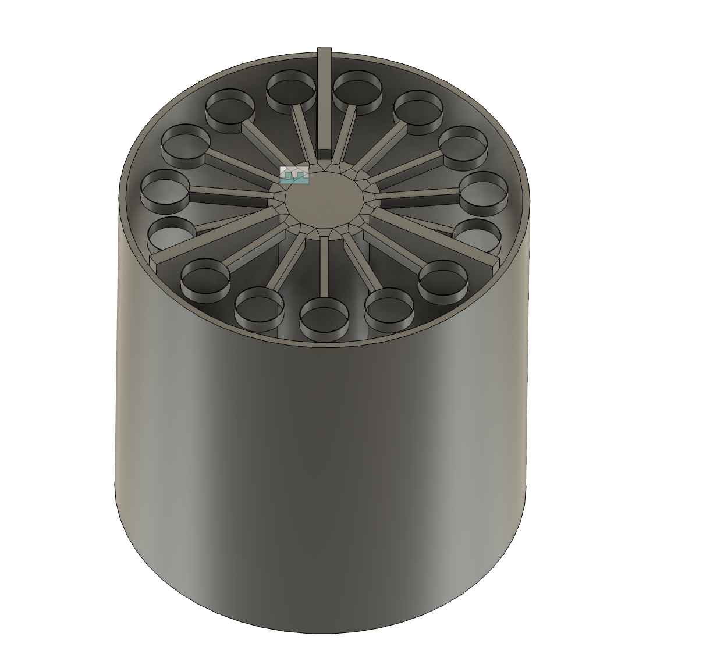
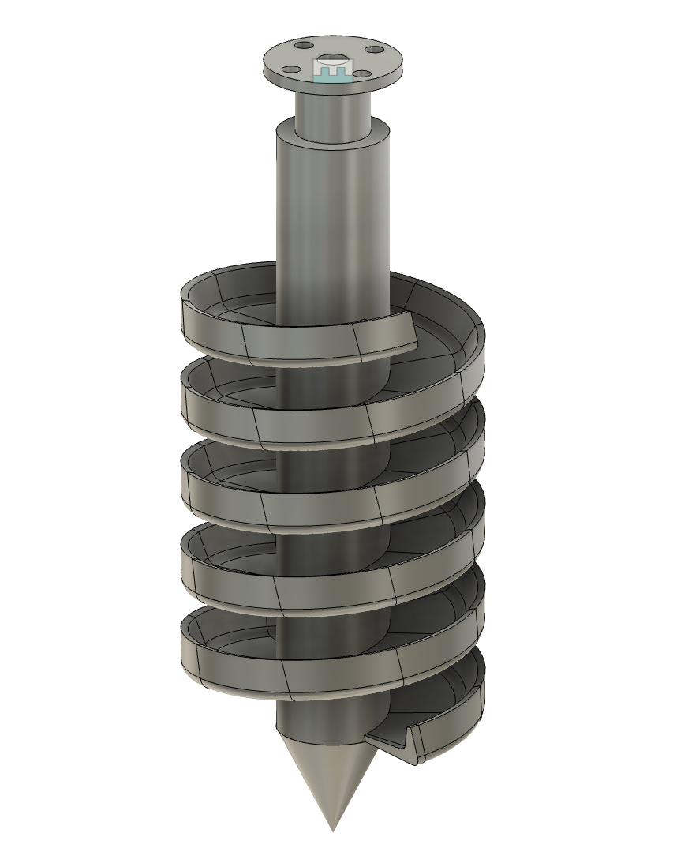
ROVER DESIGN
Science Payload:
Life Analyzer kit
Auger

Slide 27
ROVER DESIGN
Science Payload:
The environment and soil condition monitoring on the rover are executed by a sensor array which offers continuous monitoring:
For measuring the temperature and humidity of the environment, we are using the DHT22 sensor. Soil moisture sensor measures the volumetric water content. This can determine the moisture of soil. The CO2 sensor is used for the measurement of carbon dioxide gas in the environment. To detect the content of methane present in the environment we use the MQ-4 gas sensor. The BMP280 sensor is used to detect atmospheric pressure.
The system's adequacy is well managed through the design and application aspects of conducting the scientific mission, which involves collecting soil for further analysis and using a sensor array to monitor atmospheric conditions. These conclusions are then used to further examine the hypothesis.

Slide 28
ROVER DESIGN
Ground station equipment and communication system:
2.4GHz has been finalized as our communication frequency. For our communication setup, we have placed a Ubiquiti Omnidirectional antenna along with a Rocket M2 on the Rover, and a Nanostation Loco M2 is used as the receiver at the Ground Control Station (GCS).
A custom-built GUI using Foxglove is hosted on our onboard computer (Intel NUC) and is used to remotely control the rover’s traversal.
The live camera feed from the IP cameras is captured and streamed directly through their IP addresses at the GCS.
Real-time data from the sensors is monitored and visualized on our React+Flask based web application.
Strengths:
Using an omni-directional antenna on the rover ensures connectivity irrespective of the rover’s positional angle with respect to the Nanostation.
The system provides a dedicated interface for each functionality, ensuring a smooth operating experience.
Weakness:
Signal strength may weaken without a direct line of sight due to the Nanostation Loco M2, which is unidirectional.

Slide 29
ROVER DESIGN
Ground station equipment and communication system:
We use the SSH protocol to remotely operate the NUC.
Our custom GUI on Foxglove Studio, utilizing a Rosbridge socket, helps us integrate all of the rover’s functionalities for traversal control into a single unit. This allows us to oversee the working of the rover smoothly.

Slide 30
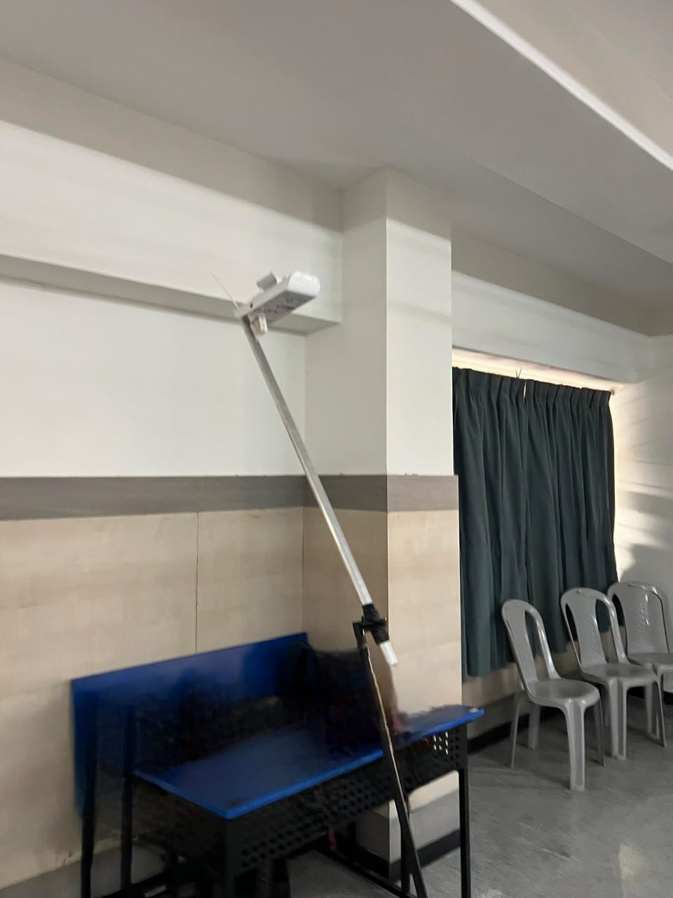
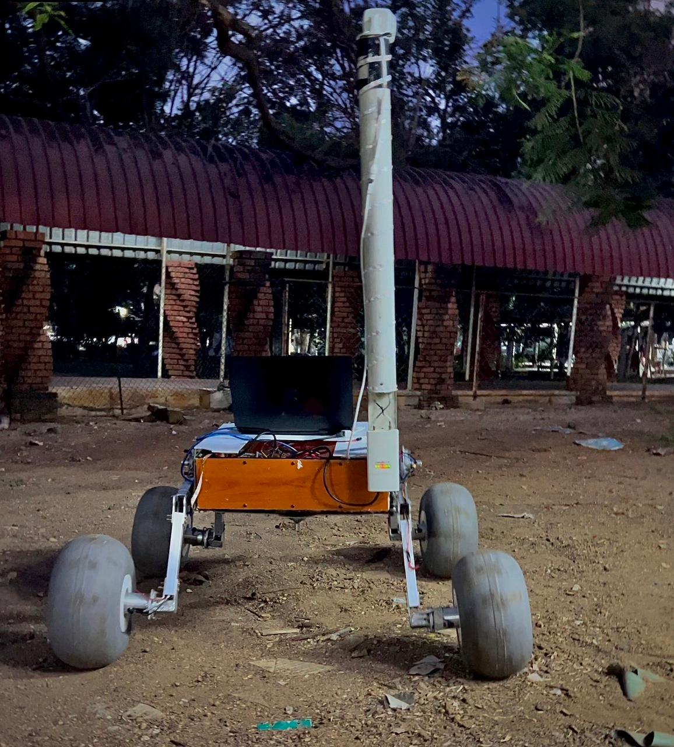
ROVER DESIGN
Ground station equipment and communication system:
Nanostation
Rocket M2

Slide 31
ROVER DESIGN
Ground station equipment and communication system:
The Intel NUC 8i7BEH, featuring an expandable memory of 32 GB RAM, 256 GB SSD, and an 8th Gen Intel Core i7 processor with Iris Plus Graphics 655, works as the brain of our rover.
Ubiquiti Omnidirectional Antenna specifications:
Model Name: AirMAX Omni AMO-2G10
Frequency Range: 2.35-2.55 GHz
Channel Width: 20MHz
RF transmit power: 50 mW EIRP configurable up to 1.4W
Gain: 10dBi (decibels relative to isotropic)
Ubiquiti NanoStation specifications:
Model Name: NanoStation Loco M2
Frequency Range: 2.412-2.462 GHz
Channel Width: 20MHz
RF transmit power: 100 mW EIRP configurable up to 1.4W
Gain: 8dBi (decibels relative to isotropic)
2.4GHz Frequency band was chosen after careful consideration of its throughput, range and the team’s budget. Using an omni-directional antenna on the rover ensures connectivity irrespective of the rover’s positional angle with respect to the Nanostation.

