Slide 1
2024
Design Report

Slide 2
TEAM INFO
Team Name:
OzU Rover Team
Name of the team and if applies,
name of the rover.
Our website: https://rover.ozyegin.edu.tr/
E-mail: doruk.celik@ozu.edu.tr E-mail: ozurover@gmail.com
Mobile: +90 531 362 64 36
Instagram: ozurover
Facebook: https://www.facebook.com/OzURover?locale=tr_TR
Twitter: @ozurover
YouTube: https://www.youtube.com/@OzuRover
Contact:
Contact information and
social media links of the team.

Slide 3
TEAM INFO
Academic
Institution:
Ozyegin University (Özyeğin Üniversitesi)
Çekmeköy Kampüsü Nişantepe Mah.
Orman Sk. 34794 Çekmeköy - İstanbul, Türkiye
Name and address of the affiliated academic institution.
Academic
Consultant:
Academic Consultant: Dr. Özkan Bebek (Ozyegin University) E-mail: Ozkan.bebek@ozyegin.edu.tr
Phone: +90 533 386 67 27
Name, affiliated academic institution and contact information of academic consultant.

Slide 4
TEAM INFO
History of
the Team:
OzU Rover was founded in November 2014 by undergraduate students from different fields as a research and development project under the supervision of Dr. Özkan Bebek. This year marks our 10th year anniversary, similar to ERC! Every year since 2014, the team has been actively working to develop a new and more performant rover. The team's mission expands to inspire future generations, participate in engineering competitions to gain valuable insights, and provide a stimulating learning environment. The team's vision is to enhance enthusiasm for space robotics and promote interest in the field within Türkiye. OzU Rover Team competed in the last 9 ERC (on-site and 1 remote due to COVID) and URC competitions in 2020,2021,2022 and 2023. Team won a spot to participate in finals in each one of the URC competitions and competed in 2023 on-site, due to COVID and visa issues team couldn’t compete on-site in 2020,2021 and 2022. The team consists of undergraduate students from different departments of Ozyegin University who are passionate about robotics.
A paragraph of teams history including foundation date, attended competitions and experience.

Slide 5
TEAM INFO
Name | Major | Duty in the team
Doruk Fetin Çelik | Mechanical Engineering and Business Minor | Team Leader (Mechanical design, financial accounting)
Toprak Efe Akkılıç | Double Major in Computer Science and Electrical and Electronic Engineering | Computer Science Sub-Team Leader (Programming, sensors)
Alper Kağan Öksüz | Mechanical Engineering and Business Minor | Mechanical Sub-Team Leader (Mechanical design, manufacturing, robotic arm)
Yunus Pulatoğlu | Mechanical Engineering | Science Sub-Team Leader (Science payload, scientific research)
Alp Gökalp | Electrical and Electronic Engineering | Electrical and Electronic Sub-Team Leader
Yusuf Adam | Civil Engineering | Public Relations and Organization Sub-Team Leader
Haluk Devrim Hamaratlar | Electrical and Electronic Engineering | Electrical and Electronic Sub-Team
Uraz Duray | Mechanical Engineering | Mechanical Sub-Team
Hidayet Eren Uludağ | Electrical and Electronic Engineering | Electrical and Electronic Sub-Team
Saadet Süeda Öz | Electrical and Electronic Engineering | Electrical and Electronic Sub-Team
Rüzgar Erik | Electrical and Electronic Engineering | Electrical and Electronic Sub-Team
Active
Members List:
A table of active members including following information: Name, University Major*, and duty in the team.
* University majors should be written without abbreviations.

Slide 6
TEAM INFO
Name | Major | Duty in the team
Tarık Çil | Mechanical Engineering | Mechanical Sub-Team
Kerem Şahin | Mechanical Engineering | Mechanical Sub-Team
Emre Özcan | Mechanical Engineering | Mechanical Sub-Team
Ayberk Kolay | Mechanical Engineering | Mechanical Sub-Team
Alp Demirci | Mechanical Engineering | Mechanical Sub-Team
Kaan Alioğlu | Mechanical Engineering | Mechanical Sub-Team
Elif Şişman | Mechanical Engineering | Mechanical Sub-Team
Elif Duyum | Mechanical Engineering | Mechanical Sub-Team
Umut Aras Aydin | Mechanical Engineering | Mechanical Sub-Team
Emrehan Çetin | Computer Science | Computer Science Sub-Team
Ömer Faruk Avcı | Industrial Engineering | Computer Science Sub-Team
Deniz Nal | Computer Science | Computer Science Sub-Team
Active
Members List:
A table of active members including following information: Name, University Major*, and duty in the team.
* University majors should be written without abbreviations.

Slide 7
TEAM INFO
Name | Major | Duty in the team
Emre Kolbakır | Computer Science | Computer Science Sub-Team
Orkun Acar | Computer Science | Computer Science Sub-Team
Seden Mutaf | Computer Science | Computer Science Sub-Team
Tanay Alpkonur | Computer Science | Computer Science Sub-Team
Active
Members List:
A table of active members including following information: Name, University Major*, and duty in the team.
* University majors should be written without abbreviations.

Slide 8
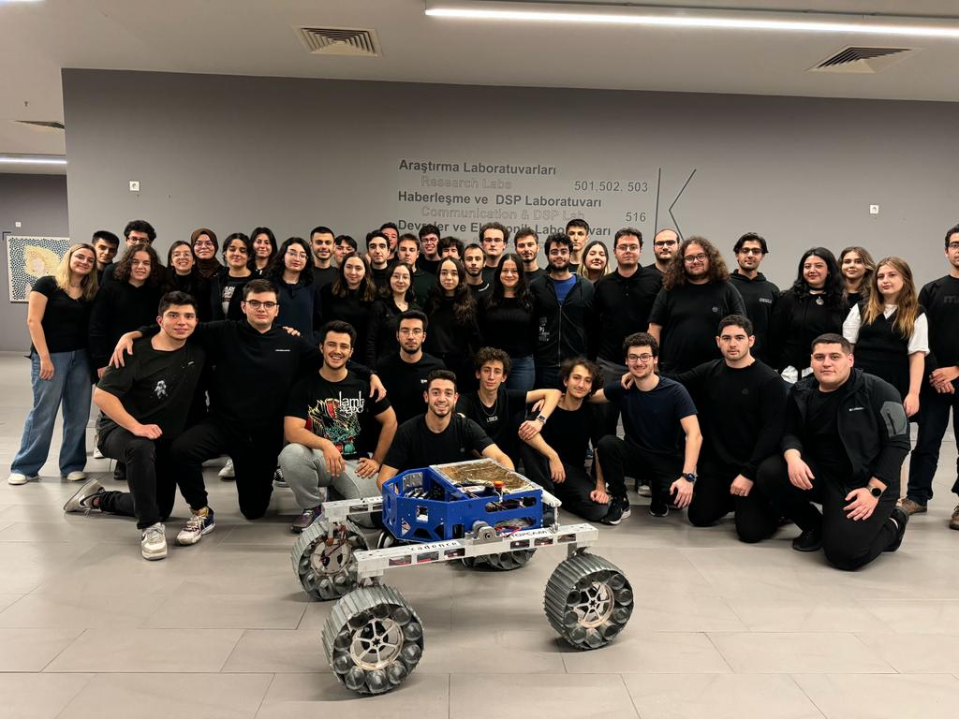
TEAM INFO
Team Photo
A photo/screenshot of the whole or part of the team.

Slide 9
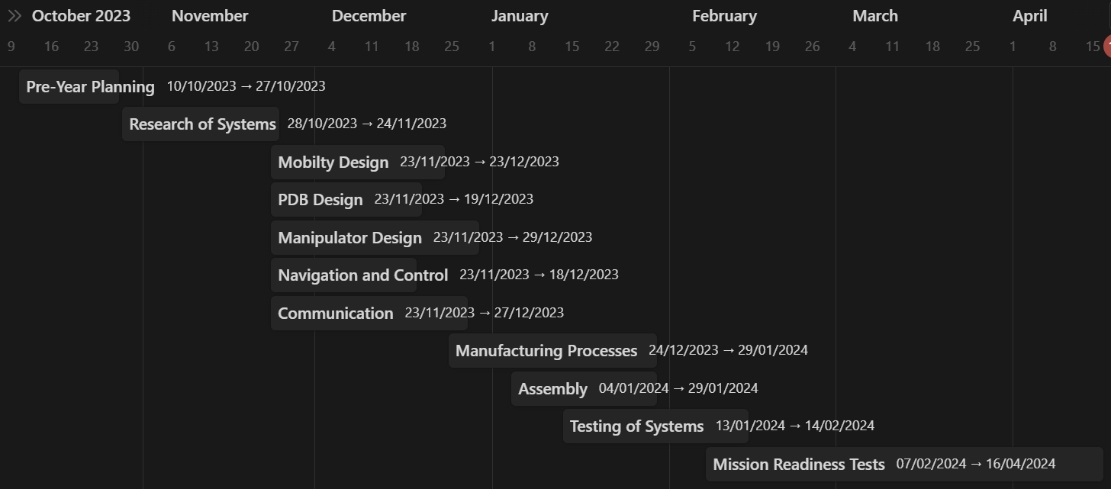
MANAGEMENT
Work Calendar:
Explain the work on the project by a Gantt chart. Include 10-15 items in the Gantt chart.

Slide 10
MANAGEMENT
Team is structured on a field sub-team basis. Sub-teams are continuously working on systems together to design and operate the rover. Sub-team members tend to specialize in a specific are without compromising from flexibility.The span of control of the sub-team leaders is minimized with eight people at maximum, which was tested to be an optimum number in the performance vs span-of-control curve. Decision-making is centralized without hindering the agency of members in their area. This process helps members' decision-making skills without compromising team structure and sustainability.
Team
Formation:
How is the team workforce structured? (2-3 sentences) Include a graphic to explain the structure as well.

Slide 11
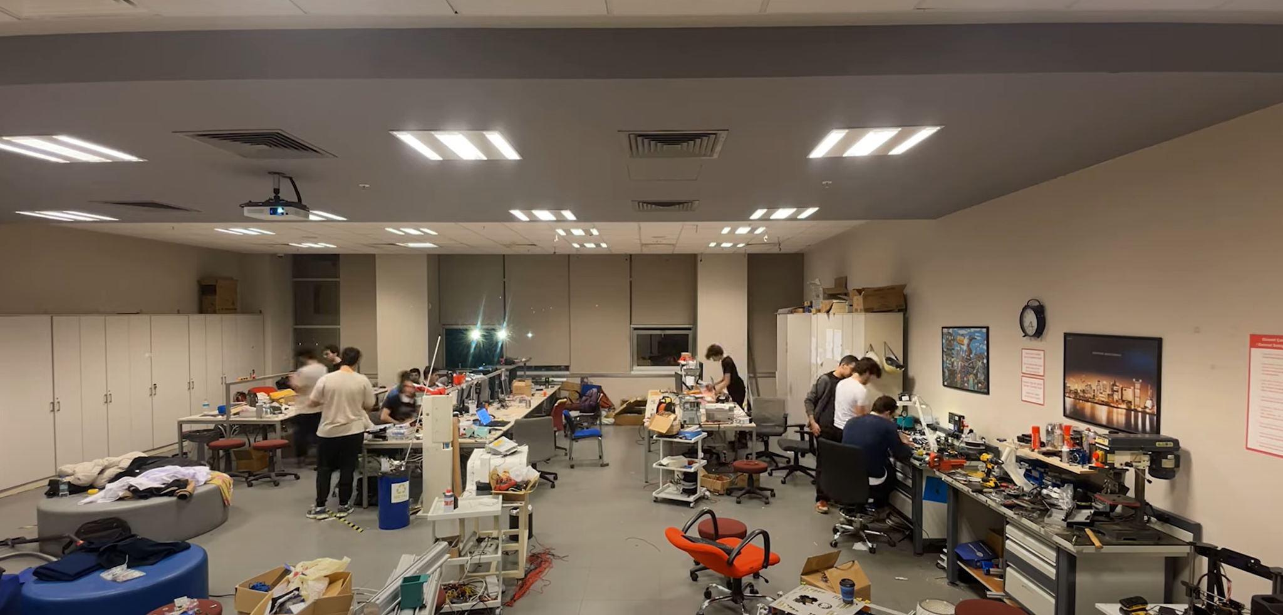
Workplace:
How the team design, build and test the rover physically? Explain the workplace. (2-4 sentences) Include a photo/screenshot of the workplace.
MANAGEMENT
The team is currently working in Planetary Robotics Lab in Ozyegin University. Our laboratory advisor is Dr. Özkan Bebek. Planetary Robotics Lab is home to cutting-edge faculty research in robotics, ambitious engineering student designs for national and international robot competitions, and engaged learning for all students who like robots. Workplace has its own budget from university and its equipped with various equipments like power supplies, 3D printers, drills, computers, robotics hardware to work on like sensors, controllers and motors.

Slide 12
MANAGEMENT
Funding :
Team primarily uses hardware and software that was purchased in previous years, this year approximately 1000 USD was used for robotic arm manufacturing processes,material cost and hardware but 20% of them was covered by the sponsors. Ozyegin University directly funds the project. There are several sponsors whose gifts hardware and software to the team.
Team plans and expects to spend at least 1000 USD in upcoming days before the competition for research and development costs.
Rover equipment costs about 12000 USD, there were no operation costs and manufacturing costs which are covered by the sponsors. An extra expense could be travel expenses which is guaranteed to be covered by Ozyegin University. There can’t be insufficient funding situation because Ozyegin University guarantees to cover any deficit.
Present the funds of the project at the time of submission of this document? (In dollar currency)
How much spending is expected for the development costs? How much spending is expected for the travel costs?
What is the team's plan in an insufficient funding situation by the competition date?

Slide 13
MANAGEMENT
Logistics:
There are two options for logistics: mailing the rover or disassembling it for transport in suitcases. Due to bureaucratic delays associated with mailing and the rover's modularity, we've decided to transport each system disassembled in our suitcases.
With a budget allowing approximately 15 people to attend the competition, we're considering using a combination of plane and train. The plan is to fly from Turkey to Poland and then take a train from Poland to Kielce. This route is currently favored by both our advisors and us.
What is the team's plan to package and bring the rover to competition site by July? (4-6 sentences)

Slide 14
ROVER DESIGN
Mobility
System:
Rover uses rocker shaft suspension system, which is made of two aluminium profiles connected to each other via polyamide rod and connected to the chassis from castamide components. Wheels of the rover is made of Aluminium hub and steel grooves in order to keep rovers weight without deforming. Each wheel is powered by Ak-70 Brushless DC actuators.
Rocker shaft suspension system is used to keep surface connection of each wheel, regardless of surface shape thanks to the opposite movement of each aluminium profile. This suspension system is used due to being simpler and effective than previous rovers. Steel grooves on wheel is used to improve traction in soft and inclined terrain. With this wheel design rover has good ground clearance while moving around obstacles. Also, it helps rover maneuverability, making tank like movement smoother.
What is used? Describe the system
(3-5 sentences)
Why the system is chosen? What are the considerations? What are weaknesses and strengths?
(3-5 sentences)

Slide 15
ROVER DESIGN
Mobility
System:
The mobility system features four wheels made from a combination of aluminum and steel. Each wheel has an outer core with steel treads for maximum traction and optimum sinkage, while the inner core is aluminum with cavity-shaped inner parts to balance flexibility and stiffness.
The design was tested in Utah to ensure its performance under various conditions. Inspired by the rovers of JPL (Jet Propulsion Laboratory), the system includes a rocker shaft suspension system that is adjusted and designed uniquely to enhance the traction of the rear wheels. Its uniqueness comes from its orientation.
Unique points and inspirations
(3-5 sentences)

Slide 16
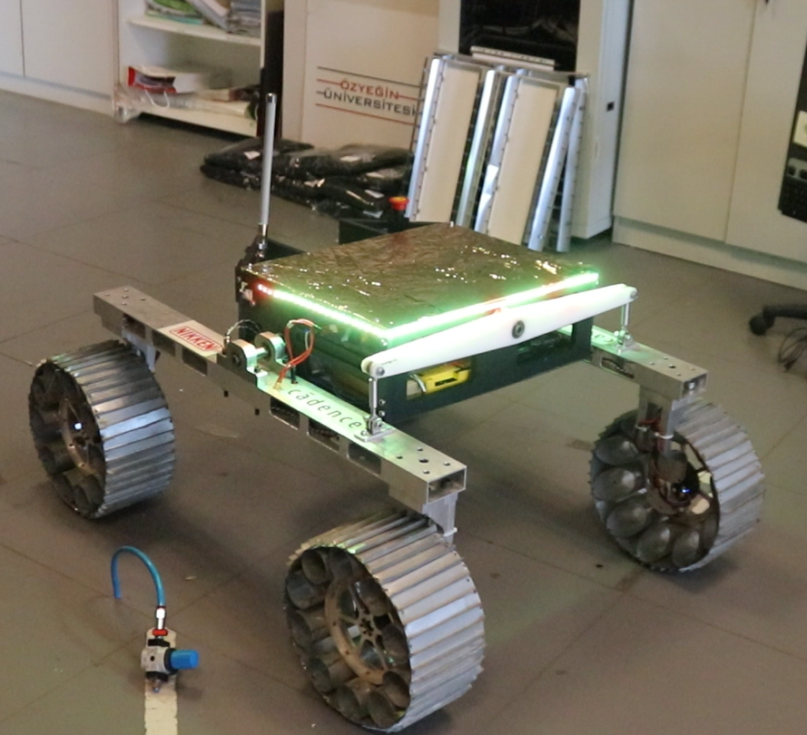
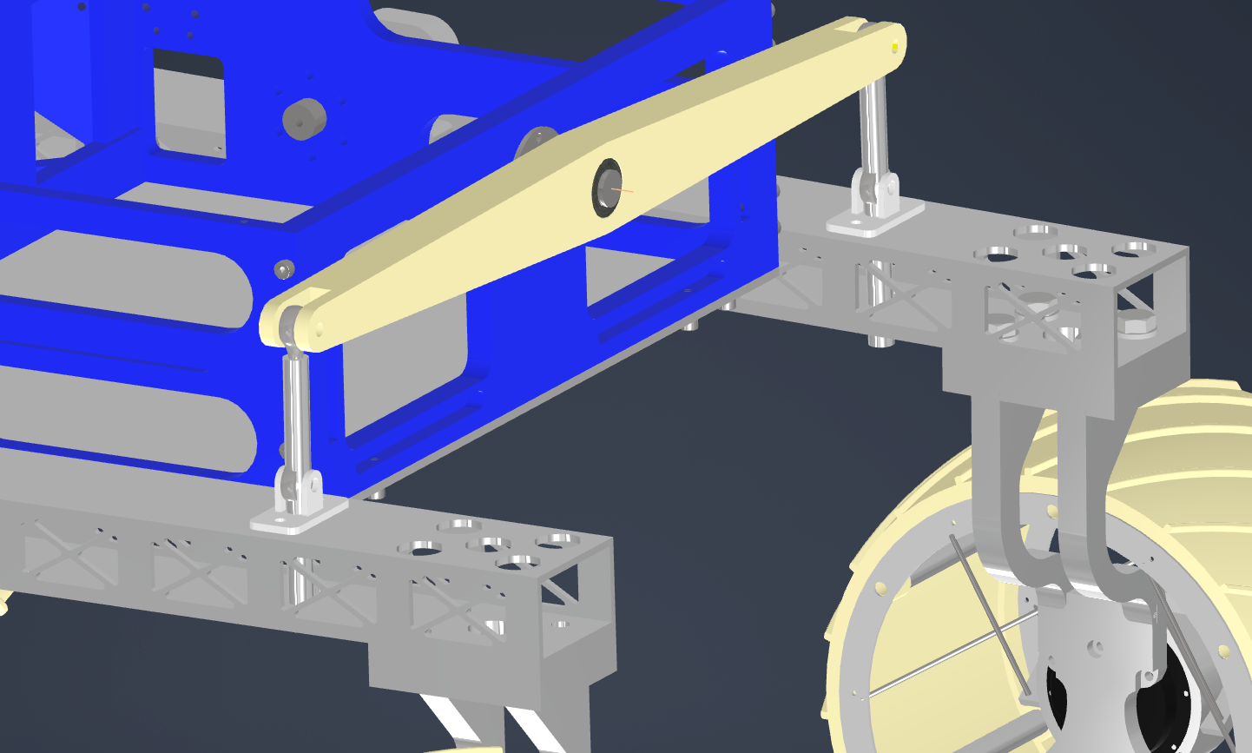
ROVER DESIGN
Mobility
System:
Rod
Ends
Visuals of the system
(2 photos/screenshots)
Rocket Shaft
Suspension

Slide 17
ROVER DESIGN
The mobility system weighs 42 kilograms, and with the addition of modules, it is expected not to exceed 52 kilograms. This ensures that the rover meets or exceeds the maximum weight requirement of 60 kilograms. The overall dimensions of the rover are within 1.2 meters by 1.2 meters by 1.2 meters, and it has a clearance of 28 centimeters.During testing, the rover has successfully navigated various terrains. Rover was tested that it is capable of reaching speeds of up to 3 meters per second.
The chassis contains a frontal mount to emplace robotic platforms upon, allowing for a modular approach to missions; where specialized equipment may be designed in advance and used circumstantially. A robotic manipulator, a spectrophotometry module and an advanced stereo-camera modules are available. With the latest module, the rover has a network interface that accepts target GNSS or local XYZ coordinates to autonomously navigate towards, thus in mutual exclusion with other modules the rover possesses autonomous navigation capabilities using visuo-inertial SLAM.
Mobility
System:
Technical Specifications including mass and size (3-5 sentences)
Discuss the system's adequacy for its role in competition missions. (3-5 sentences)

Slide 18
ROVER DESIGN
Electronics and power system:
Ares's energy system comprises Li-ion battery packs, comprising six series and eight parallels (744Wh), selected for a high energy-to-weight ratio. Each series is modular, resulting in one series and eight parallel battery packs. To ensure the safe operation of the batteries, the batteries are controlled by a BMS with an implemented CAN line. The rover has an emergency button, which cuts off the system's connection to the batteries. It has a custom-developed distribution board named Perfidia, which consists of 20 Buck Converters with a modular design approach. The board's output voltage levels can be adjusted using the power module's specified rating. It has Nvidia jetson TX2 as a mainframe. As for cameras, ZED2 Stereo and Pirhana Camera are used. For communication with base TL-WA7210N with Omni directional antenna that is 6dBi at 2.4GHz.
What is used? Describe the system
(3-5 sentences)
Why the system is chosen? What are the considerations? What are weaknesses and strengths?
(3-5 sentences)

Slide 19
ROVER DESIGN
Electronics and power system:
Electronics and power systems stand out for being designed around modularity. Inspiration for this project came from Legos. This approach provides customization while reducing unnecessary systems to create a more robust energy system. A modular approach is also adopted in power distribution, allowing the configuration of the power distribution board to be changed according to requirements, enabling quick fault-checking and creating a more straightforward energy system. We simulated and tested our boards to their extremes and complied with IPC standards.
Unique points and inspirations
(3-5 sentences)

Slide 20
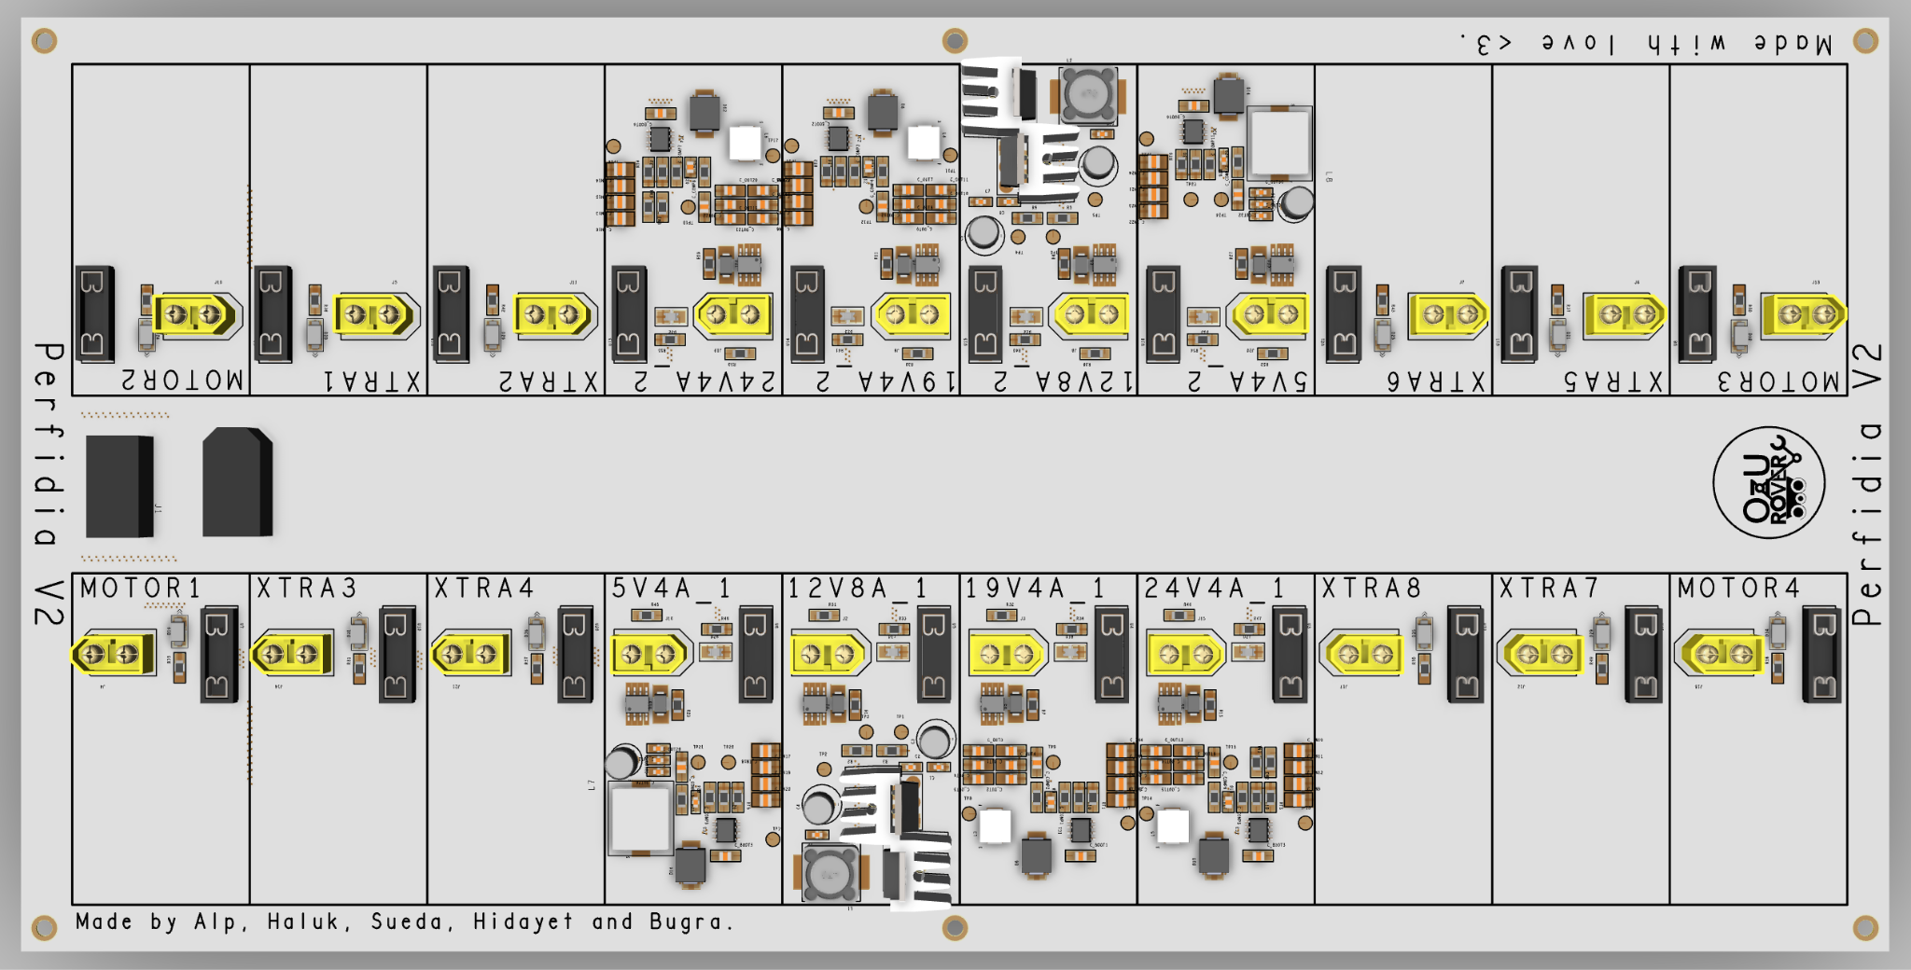
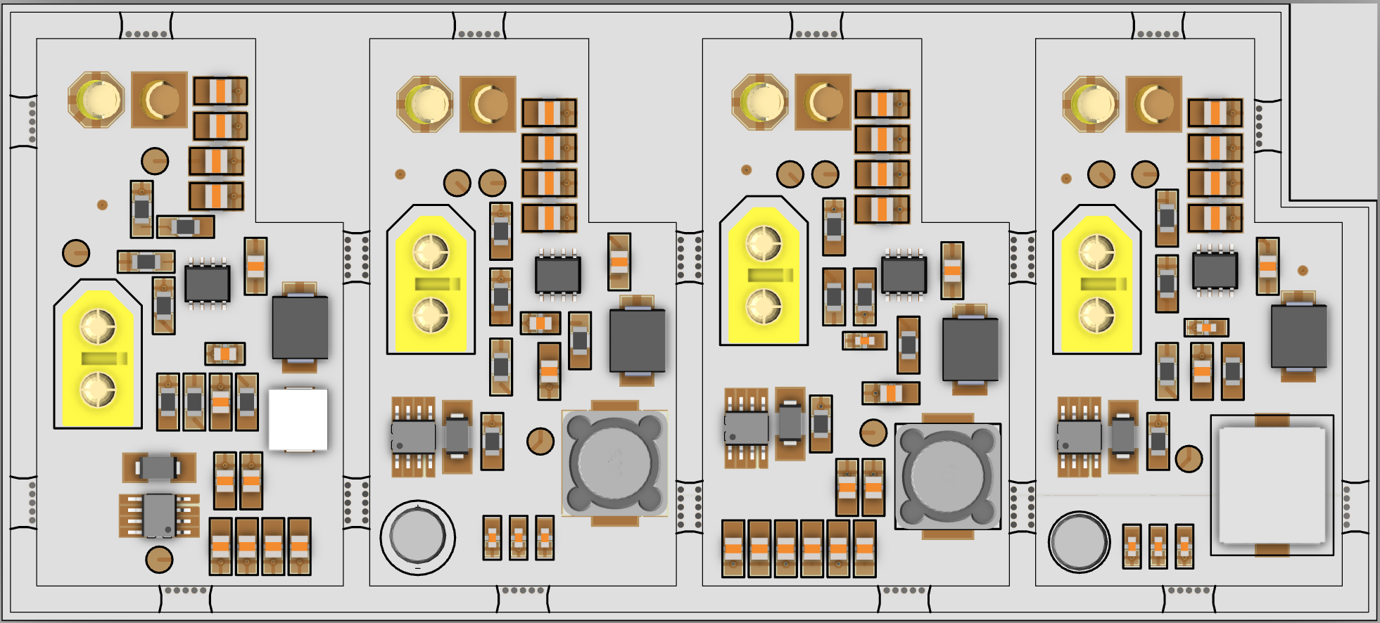
ROVER DESIGN
Electronics and power system:
Visuals of the system
(2 photos/screenshots)

Slide 21
ROVER DESIGN
Batteries roughly adds up to 33.6 Ah and that makes our rover operate up to 2 hours that being highly dependent on motor usage. This duration is sufficient for the longest mission time. The batteries roughly weighs 5.2kgs.The improvements made to the energy systems this year significantly enhance the rover's efficiency. The new Li-ion battery packs, with a total capacity of 495Wh, offer increased energy density compared to previous models. With a modular design comprising 6 series and 8 parallels, these batteries provide ample power for the rover's operations, lasting up to 2 hours depending on motor usage. The integration of a Battery Management System with a CAN line ensures safe battery operation, with an emergency button for quick disconnection if needed. Additionally, the Perfidia power distribution board, featuring 20 Buck Converters with modular design, provides precise control over power usage with real-time monitoring and safety features. With these upgrades, the rover's energy systems are well-suited for competition missions, offering reliability, safety, and improved efficiency, crucial for extended operation in challenging environments.
Electronics and power system:
Technical Specifications including mass and battery duration (3-5 sentences)
Discuss the system's adequacy for its role in competition missions. (3-5 sentences)

Slide 22
ROVER DESIGN
Manipulation system:
Our five DOF robotic manipulator uses brushless DC, DC and custom designed cycloidal gearboxes for maneuverability. Materials are specially selected for weight reduction and manufacturability, joints are produced by 3D printing using carbon-fiber based filament and composite carbon fiber tubes are used as links. Manipulator features end effector with parallel gripping system with TPU printed jaws.
We selected this design for simplicity since five degrees of freedom is enough for manipulator to fulfill the required task objectives. Also, thanks to the simplicity, we can implement inverse kinematic to control movement of rover.
End effector jaws are specially designed and tested using analysis programs in order to deform and increase the surface area when force applied. With this design, we can effectively use olur parallel gripping mechanism since holding force is significantly increased while gripping.
What is used? Describe the system
(3-5 sentences)
Why the system is chosen? What are the considerations? What are weaknesses and strengths?
(3-5 sentences)

Slide 23
ROVER DESIGN
Manipulation system:
Our end effector is connected to the manipulator with a slip ring mechanism. With it we can achieve infinite rotation movement of end effector. This greatly improves manipulators ability to fulfill the challenges on mars missions.Gripper system is somewhat unique because of its modularity and ease of change in design. New end effectors can be easily implemented to the gripping system. The joints and connectors are printed from PAHT CF15 which is a carbon fiber filament which the team used this year firstly. It has very high strength-weight ratio. Links are from carbon fiber 4K tubes.
Unique points and inspirations
(3-5 sentences)

Slide 24
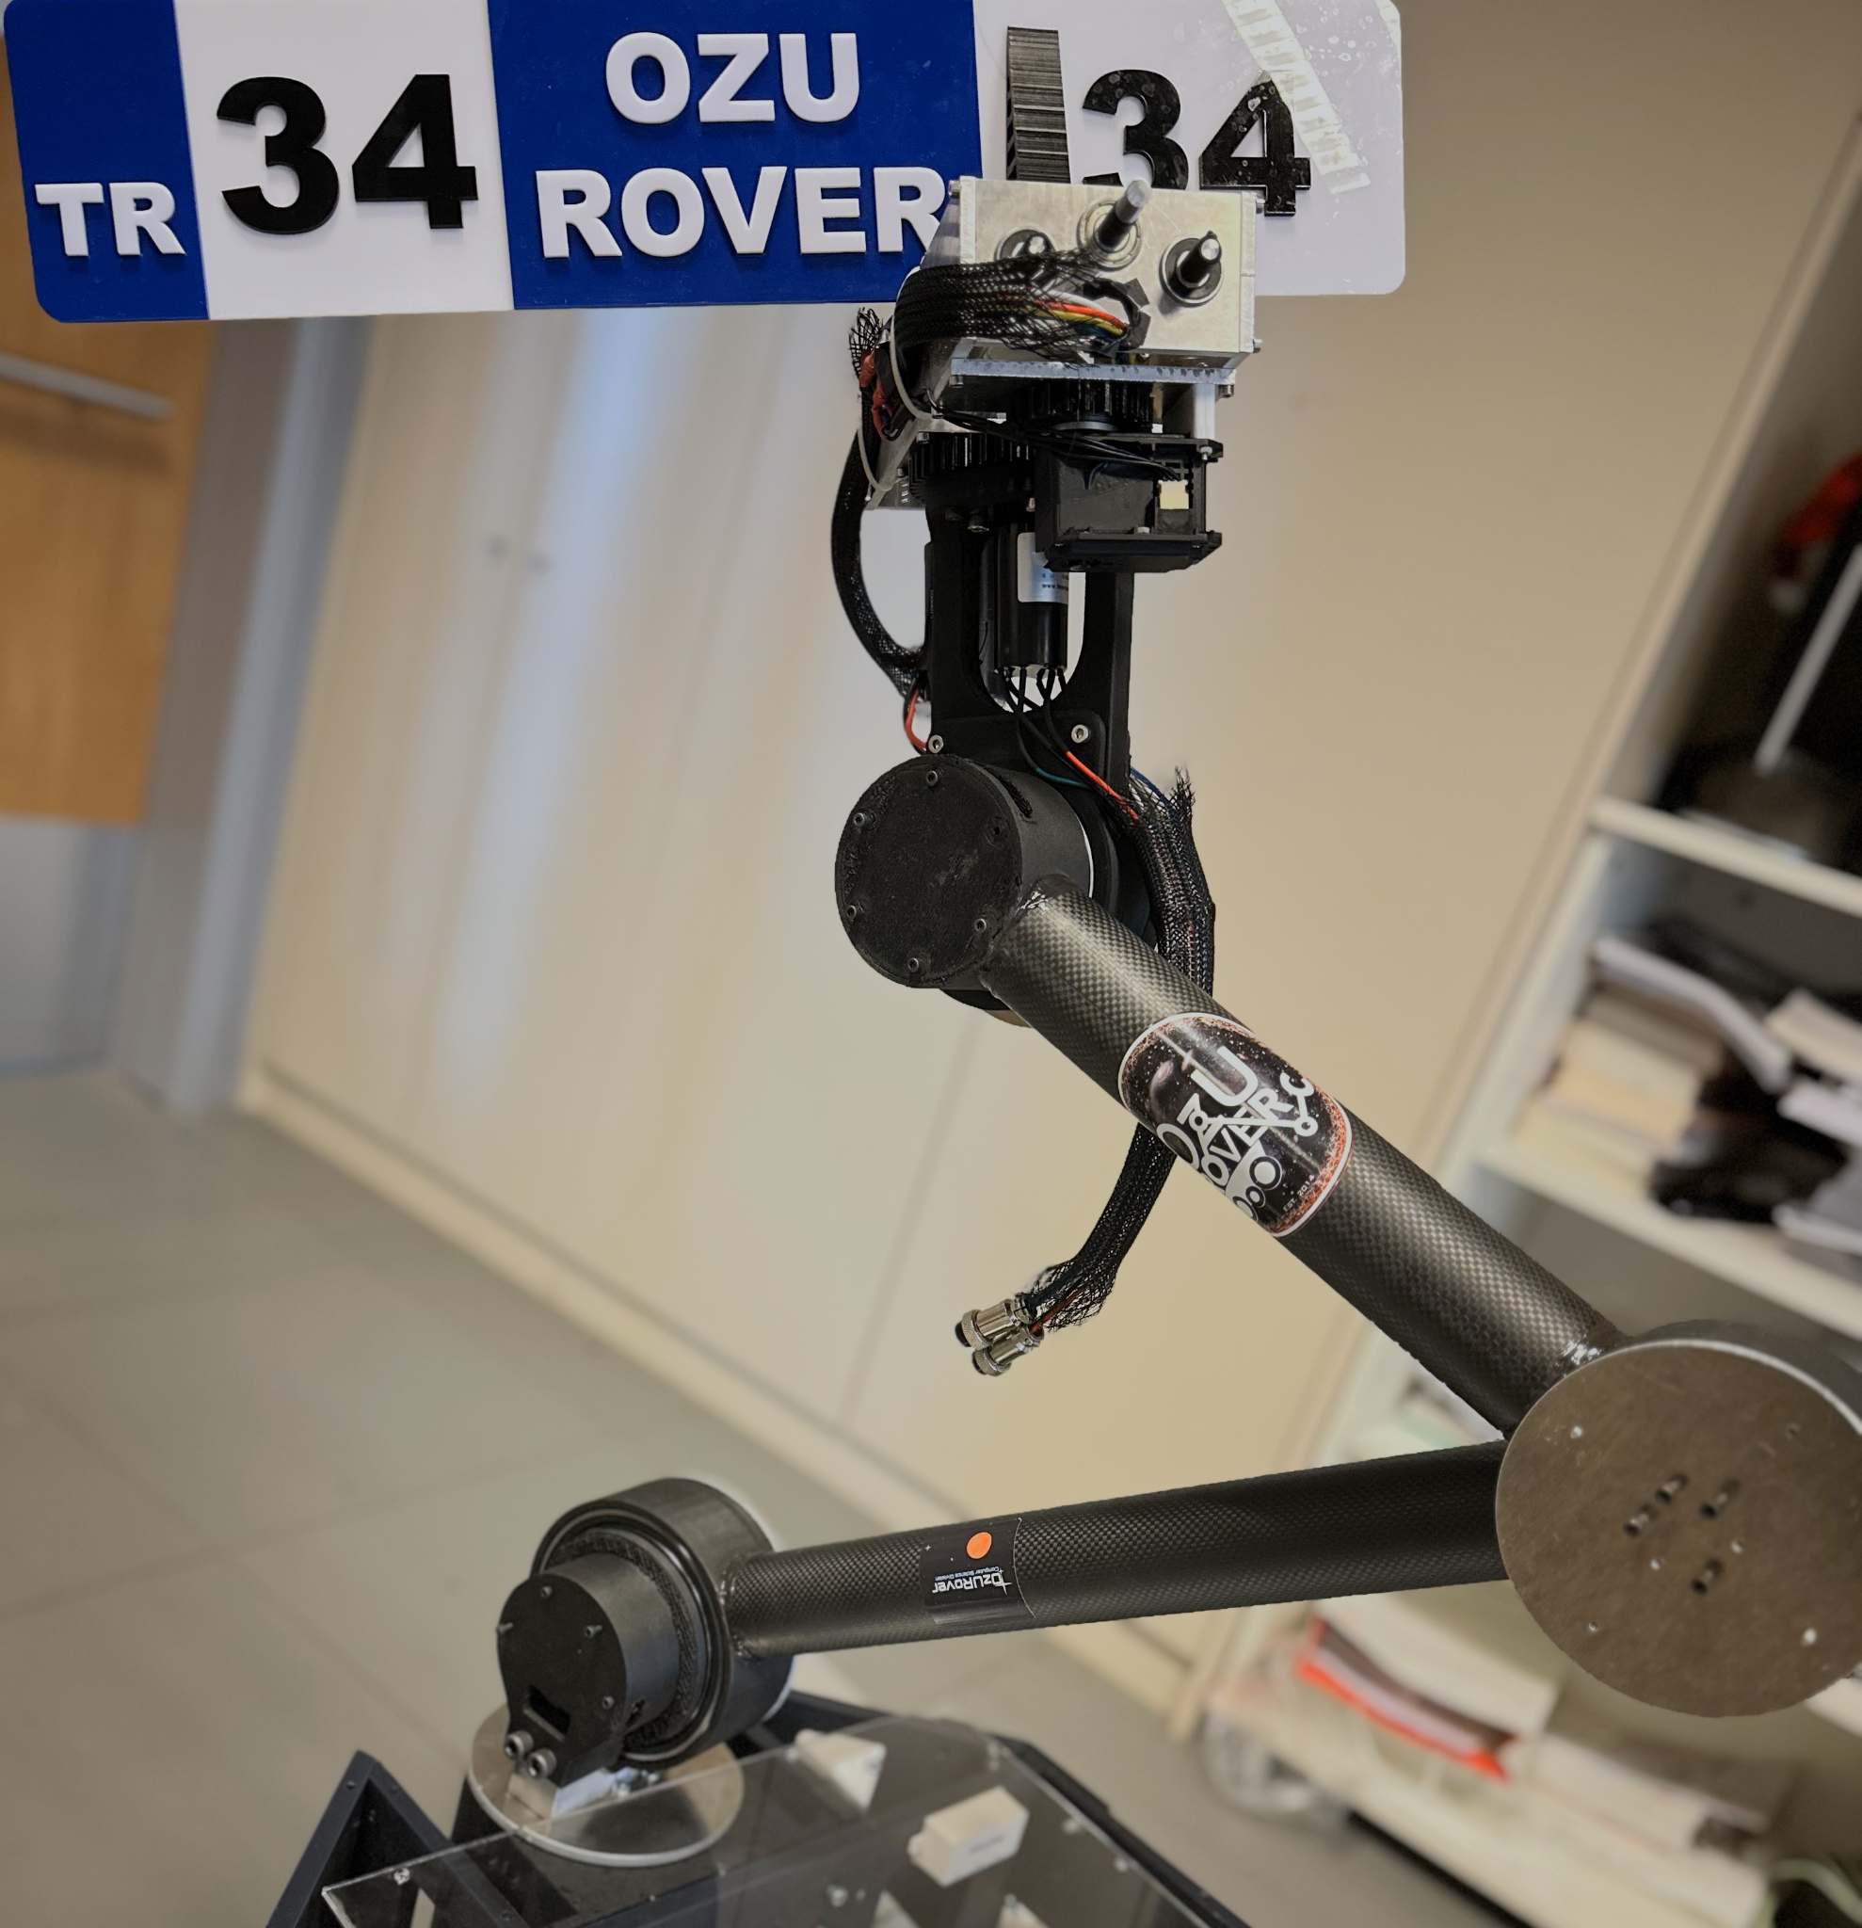
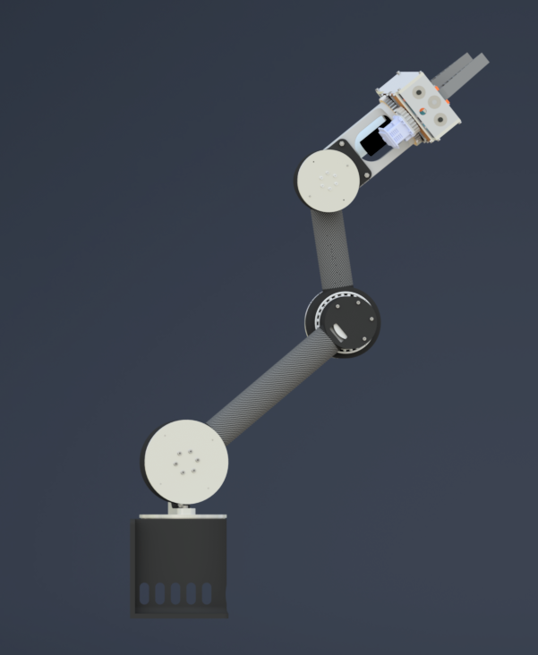
ROVER DESIGN
Manipulation system:
Visuals of the system
(2 photos/screenshots)

Slide 25
ROVER DESIGN
Manipulation system:
Robotic manipulator consist of two links, 400mm and 250mm, reaching maximum of 1200mm with end effector installed. Can reach to ground from each side and back of rover with ease. Manipulator weights total of 10 kg, which can be decreased with further optimizations and carry up to 6 kg of load.
The redesigned 5-DOF manipulator is particularly adept for the competition tasks, featuring precision actuators and adaptable gripping mechanisms that excel in pulling cards and operating switches. The integration of TPU-printed fingers in the gripper allows for nuanced control and effective grasping, crucial for delicately pulling cards without slippage. Moreover, the robust configuration of the joints and custom-designed gearboxes provide the necessary force and accuracy for carry weights reliably with precision.
Technical Specifications including mass, max payload and size
(3-5 sentences)
Discuss the system's adequacy for its role in competition missions. (3-5 sentences)

Slide 26
ROVER DESIGN
The rover system designed for Arc'24 includes a sophisticated instrument suite designed for Mars-like exploration. At the heart of its operation is a custom-made drill for soil collection and a multifunctional robotic arm that collects both stone and surface soil. This is supported by a range of sensors including 1080p cameras for high-resolution imaging, as well as temperature, humidity and atmospheric composition monitors. It is supported by a robust communication setup for real-time data transmission.
Strengths of the system lie in its precision and reliability in hostile environments, supported by its ability to gather a broad spectrum of scientific data. However, weaknesses include the potential for high power consumption and system complexity, which could complicate maintenance and troubleshooting during field operations.
Science Payload:
What is used? Describe the system
(3-5 sentences)
Why the system is chosen? What are the considerations? What are weaknesses and strengths?
(3-5 sentences)

Slide 27
ROVER DESIGN
Science Payload:
The design of the science payload is inspired by cutting-edge planetary exploration technologies used in Mars rovers, adapted for competitive rover challenges. Unique features include a modular sensor array for adaptable mission profiles and an automated sample handling system to prevent cross-contamination, enhancing the fidelity of scientific analysis. These innovations aim to mirror the versatility and scientific rigor of professional space missions.
Unique points and inspirations
(3-5 sentences)

Slide 28
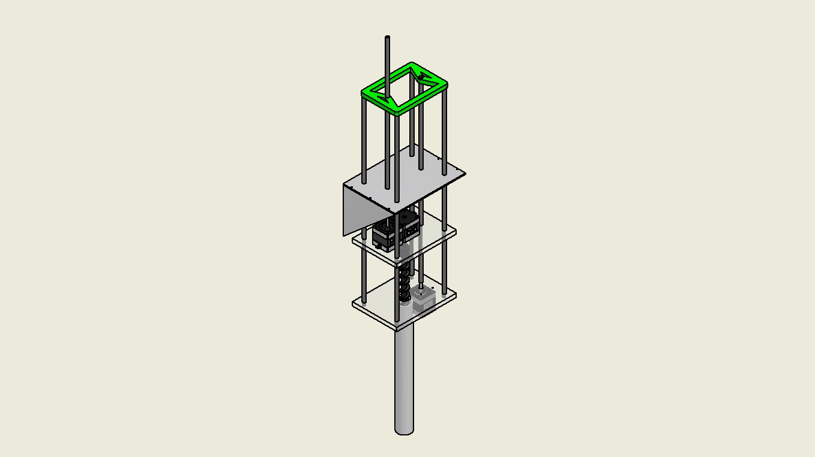
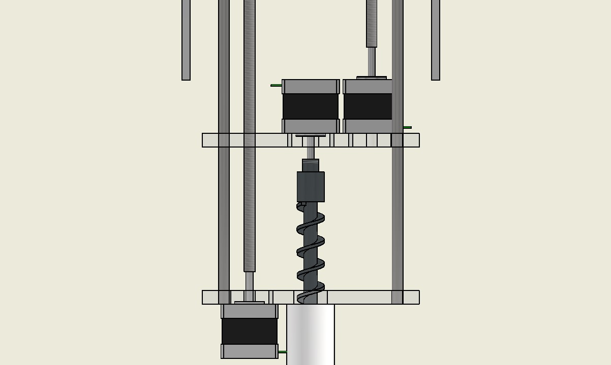
ROVER DESIGN
Science Payload:
Visuals of the system
(2 photo/screenshots)

Slide 29
ROVER DESIGN
Science Payload:
The science payload weighs approximately 10 kilograms, optimized to balance the rover's total mass distribution. It includes environmental sensors for temperature, humidity, and atmospheric composition, alongside geological sensors for soil composition analysis. These specifications are engineered to ensure the payload's effectiveness without compromising the rover's operational capabilities.
The science payload is adequately designed for its role in the competition, capable of executing all required tasks with high accuracy and efficiency. Its comprehensive sensor suite allows for detailed environmental and geological surveys, critical for mission success. The system's design aligns with the competition’s objectives, ensuring it can withstand the rigorous demands of simulated planetary exploration.
Technical Specifications including mass and battery duration (3-5 sentences)
Discuss the system's adequacy for its role in competition missions. (3-5 sentences)

Slide 30
ROVER DESIGN
Ground station equipment and communication system:
Despite the fact that Wi-Fi networks are not robust in complex outdoor environments that accommodate many multipath interference sources, we elected to create an RSSI signal tracking system on our base station and went out with the risky decision to use a 2.4 GHz Wi-Fi protocol. We have a directional antenna on a pan-tiltable mount controlled by an onboard computer connected to the local network. The antenna is connected to a router which we use as an access point to bridge the mobile robotic platform with.
Avoiding the risk of environmental interference implies lower data relay speeds at longer wavelengths, which was undesirable; though using 5 GHz network with less reliability in dynamic outdoor settings forwarded us back to a middle ground, which was our final decision to use 2.4 GHz.
What is used? Describe the system.
(3-5 sentences)
Why the system is chosen? What are the considerations? What are weaknesses and strengths?
(3-5 sentences)

Slide 31
ROVER DESIGN
Ground station equipment and communication system:
Our system depends on directional transmissions with an antenna from the base station. Though we are currently working with rudimentary algorithms to track the rover in real-time, there is a lot of potential in smart signal tracking. Our current pan-tilt system will be a basis for future developments that we intend to employ in later competitions.
We also found the fidelity of wireless network systems designed for aerial use very inspirational for our designs.
Unique points and inspirations
(3-5 sentences)

Slide 32
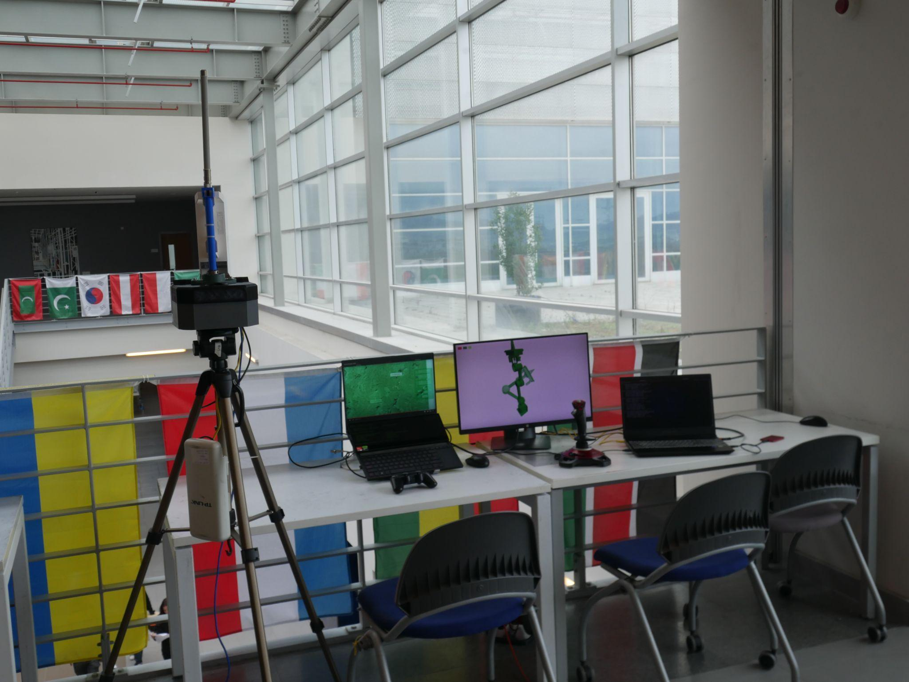
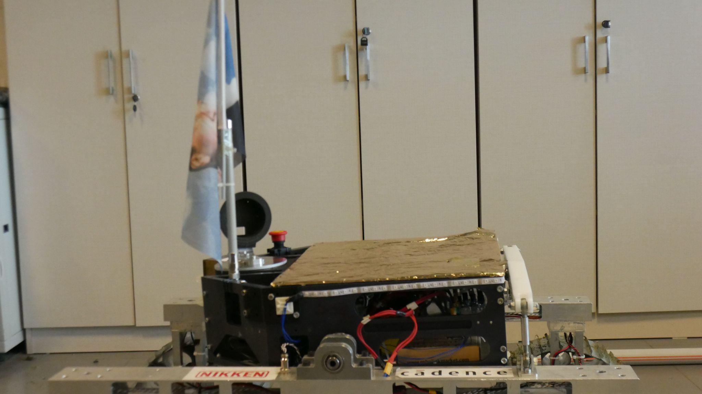
ROVER DESIGN
Ground station equipment and communication system:
Visuals of the system
(2 photos/screenshots)

Slide 33
ROVER DESIGN
Ground station equipment and communication system:
Our experimentation over a distance of 100 meters in an open field yielded stable file transfer rates of 80mbps with directional tracking. Physical obstacles did impart large losses in bandwidth, and noisy channels caused unprecedented disconnections; however, the system still allowed adequate transmission rates for camera feed and mission control during testing. The obstacle-filled environment might be arduous to operate under without more expensive communications infrastructure, though, this is expected of most directional communication systems that do not have an accurate model of the environment (exploration & mapping operations).
Technical Specifications including resilience to noise and communication range (3-5 sentences)
Discuss the system's adequacy for its role in competition missions. (3-5 sentences)

