Slide 1
2025
Presentation - Collaboration Mission

Slide 2
TEAM INFO
Team Name:
Institution Name:
put your logo here

Slide 3
Astronaut Selection
The astronauts should be selected amongst the team members. Teams must describe the astronaut selection criteria and the training provided to the astronaut for the mission not only technically but also emotionally. Additionally, the selected astronaut’s name, department, and other roles within the team should also be mentioned. A photo of the selected astronaut should be included as well. How you prepare the astronaut selection slide, including the following bullet points, is up to your imagination.

Slide 4
Mission Approach
The team's approach to the mission should be explained in a detailed paragraph outlining the steps they will follow and their strategies. (Changes to the rovers will not be included in this section.)

Slide 5
Rover Preparation Status
The team should review the preparation status of their rovers specifically for the Collaboration Task. The strengths and weaknesses of each rover's steps should be written(arm strength, speed, battery life, etc.). Changes made to the rover for the task should be explained in detail. These changes can be outlined separately under the subheadings: software, hardware, and structural modifications (Photos of the rover taken from all four sides and the top should be included.). Even if you did not make any changes, include how your rover is prepared for the tasks.

Slide 6
Communication Methods
How the ground control station and the astronaut will communicate, including the modes of communication such as visual, voice, or text, is an important consideration. Additionally, the method by which the rover will establish communication with the ground control station must be clearly defined. Another crucial aspect is whether any communication issues are anticipated due to multiple rovers operating in the same area. In this context, it is essential to address the precautions taken against signal collisions and to highlight any advantages the equipment offers in mitigating such risks. Furthermore, planning an effective communication strategy with collaborating teams is necessary to ensure seamless coordination and data exchange.

Slide 7
Collaboration Details with Teams
The teams should describe how they will establish collaboration, in which areas they will cooperate, and provide details about the collaboration between astronauts. If there is any collaboration regarding rover development, this should also be explained in detail.

Slide 8
Summary
The teams should provide a summary of the report. In this section, they are expected to consolidate the details mentioned in the previous sections into one paragraph.

Slide 9
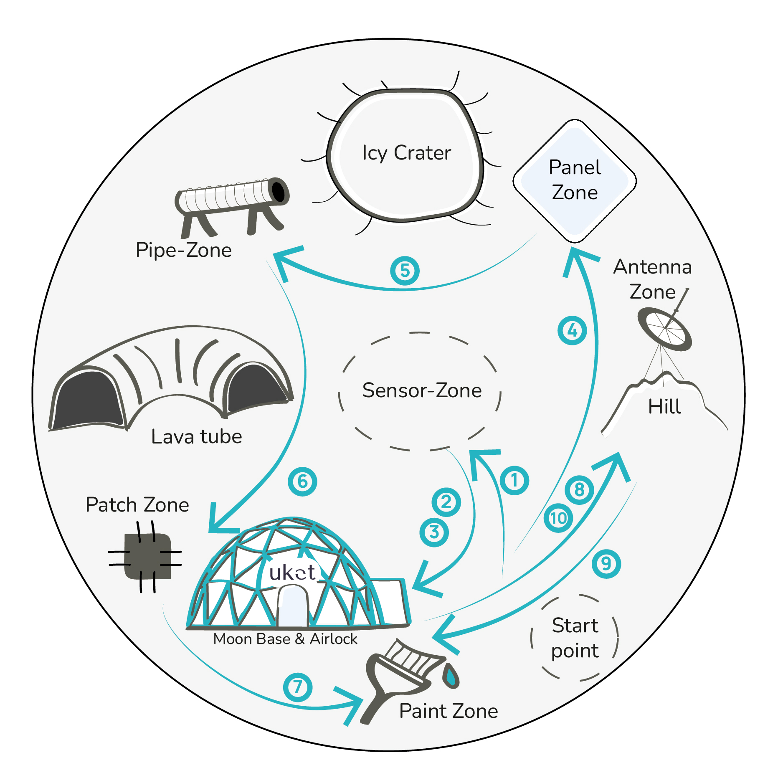
The Sketch of the Moon Field
The teams can use this sketch in their presentations if they wish.

