Slide 1
2023
Design Report

Slide 2
TEAM INFO
Team Name:
Name of the team: Team RoverX
Name of the rover: KRONOS
Name of the team and if applies,
name of the rover.
Contact:
Team Captain contact: +91 98102 05812
Official mail: teamroverx@vit.ac.in
Instagram: https://www.instagram.com/teamroverx/?hl=en
LinkedIn: https://in.linkedin.com/company/teamroverx
Contact information and
social media links of the team.

Slide 3
TEAM INFO
Academic
Institution:
Vellore Institute of Technology
Vellore Campus, Tiruvalam Rd, Katpadi, Vellore, Tamil Nadu, 632014
Name and address of the affiliated academic institution.
Academic
Consultant:
Dr. Sudhakar N
Assistant Director, Students Welfare
Vellore Institute of Technology, Vellore
Email: nsudhakar@vit.ac.in
Contact: +91 99420 02947
Name, affiliated academic institution and contact information of academic consultant.

Slide 4
TEAM INFO
History of
the Team:
Team RoverX, started in 2014 as a part of Creation Labs at VIT University, is an all undergraduate student-driven project team. We work on developing prototypes of the Martian Rovers which are then used to compete in different national and international level competitions including University Rover Challenge (URC), European Rover Challenge (ERC) and the Indian Rover Challenge (IRC).
In 2016, at the European Rover Challenge, we were placed 12th overall and 1st in Asia. Our first participation in the University Rover Challenge held in the Mars Desert Research Station in the USA, back in May of 2018 landed us the 20th position overall and 1st in Asia, among 95 participating teams from all over the world. We had also taken part in the Indian Rover Challenge 2019, where we secured 4th place, among top international teams from Poland and Bangladesh.
Also, we participated in the International Rover Design Challenge consecutively for 2 years (2021,22) and successfully secured the first position in both. This year (2023) we participated in International Rover Challenge and secured the second position worldwide.
A paragraph of teams history including foundation date, attended competitions and experience.

Slide 5
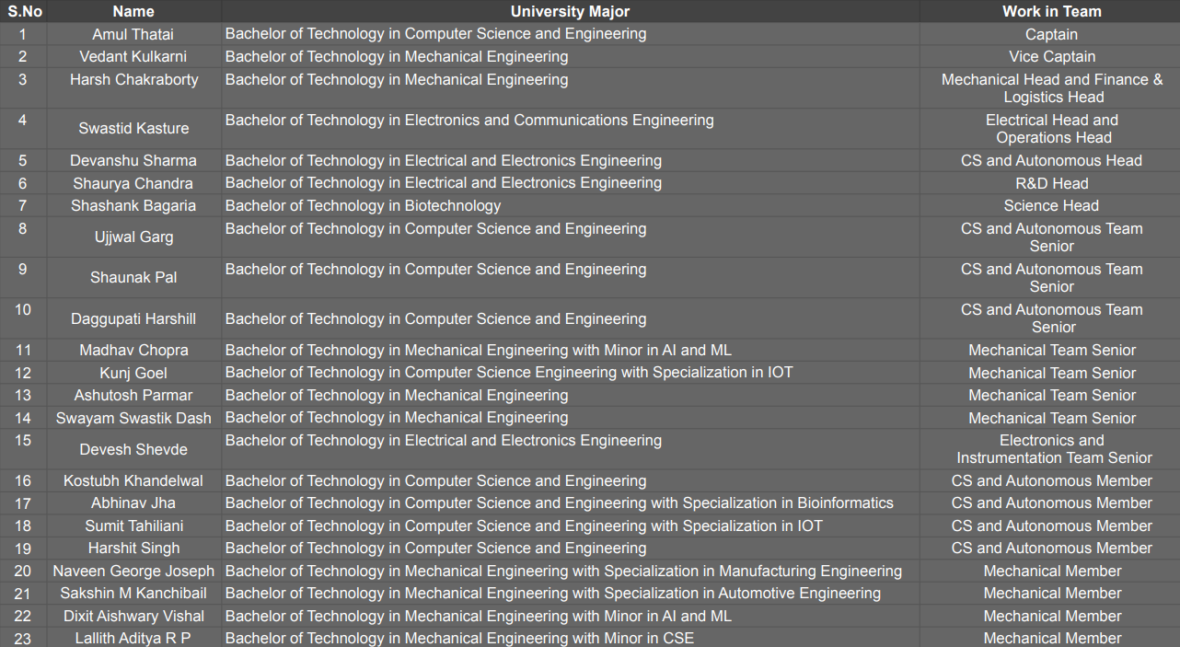
TEAM INFO
Active
Members List:
A table of active members including following information: Name, University Major*, and duty in the team.
* University majors should be written without abbreviations.

Slide 6
TEAM INFO
Active
Members List:
A table of active members including following information: Name, University Major*, and duty in the team.
* University majors should be written without abbreviations.

Slide 7
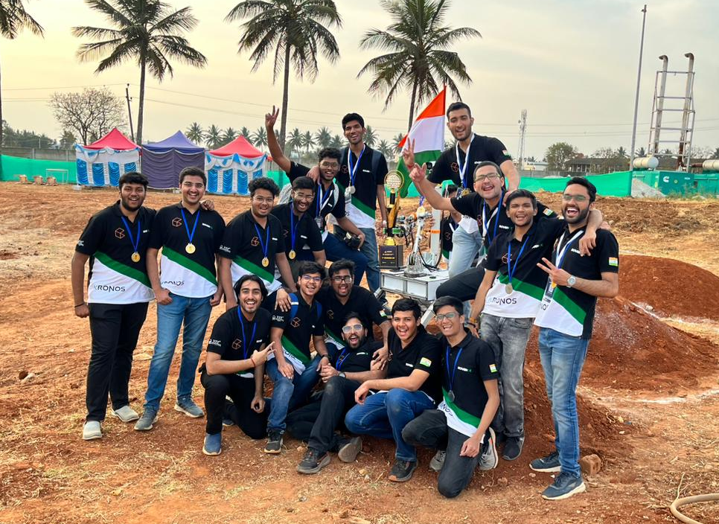
TEAM INFO
Team Photo
A photo/screenshot of the whole or part of the team.

Slide 8
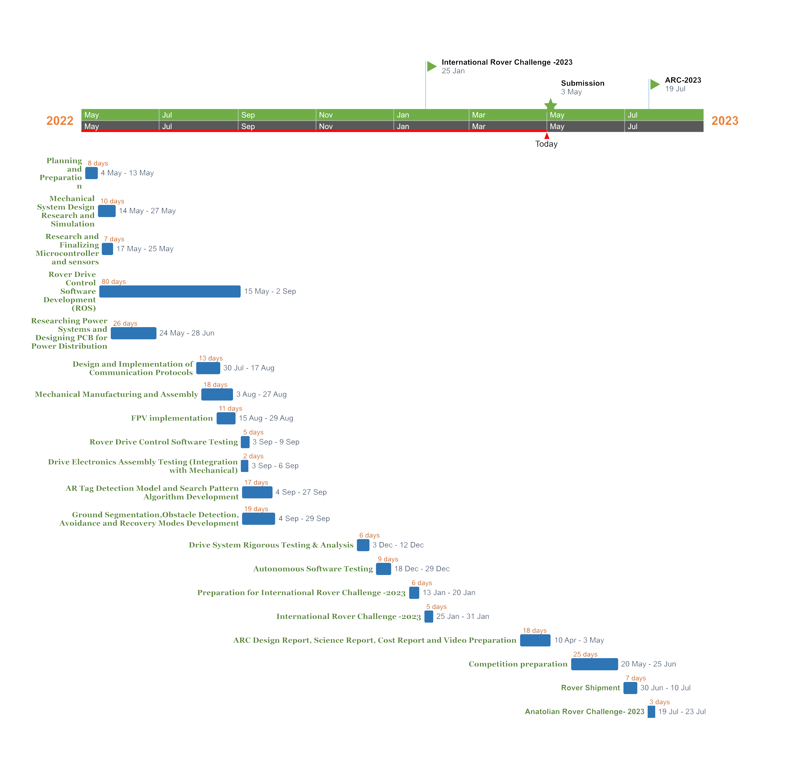
MANAGEMENT
Work
Calendar:
Explain the work on the project by a Gantt chart. Include 10-15 items in the Gantt chart.

Slide 9
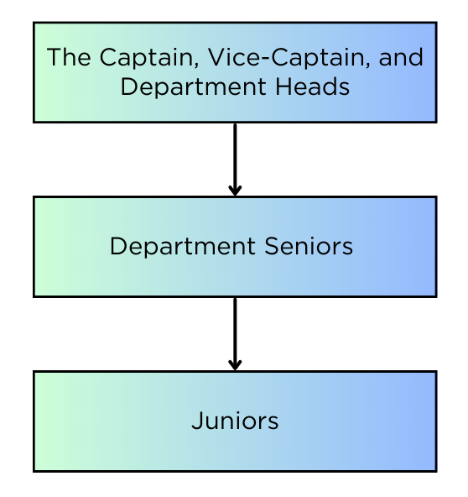
MANAGEMENT
Team
Formation:
The team functions hierarchically. The highest designations include the Captain, the Vice-Captain, and the Department Heads. After this, comes the Department Seniors and finally the Juniors. The transfer of knowledge and workflow is transferred from top to bottom. All the major decisions are taken by the highest designations, after collective response from the whole team.
How is the team workforce structured? (2-3 sentences) Include a graphic to explain the structure as well.

Slide 10
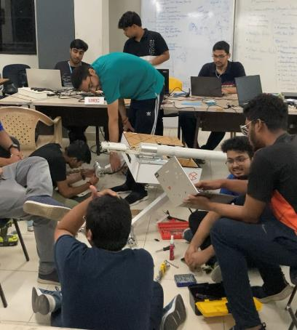
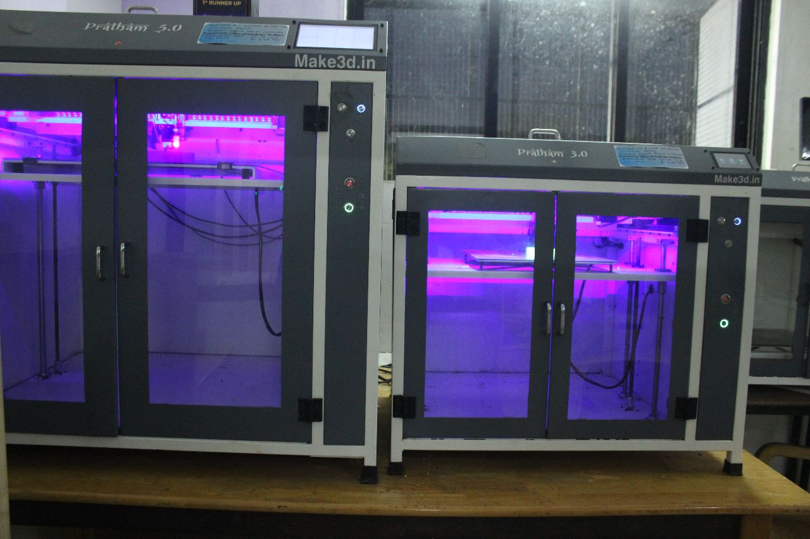
MANAGEMENT
Workplace:
The team’s official workspace is The Projects Lab at VIT University, Vellore. The designing and assembling of the rover is completely done within the lab. We also have access to multiple 3-D printers for in-house manufacturing of various components. After successfully building the rover, all the static systems are tested inside the lab, while all the dynamic systems are tested either inside the university or nearby places.
How the team design, build and test the rover physically? Explain the workplace. (2-4 sentences) Include a photo/screenshot of the workplace.

Slide 11
MANAGEMENT
Funding :
The team relied on 3 basic sources of funding- mainly the university grants, the sponsorships and the crowd funding, at the time of submission. The trio are equally important for us in order to meet the demands for the development and maintenance of our rover. We have already received a significant sum of monetary grant from our university which ensured hassle-free improvements on our system. Also many prestigious companies have helped us by providing various products required by our team, by coming on board as valuable sponsors. An estimated cost of development of the rover would be between 6000 USD and 8000 USD.
For ARC’23 we’re planning to send approximately 20-30 members from our team on site. For that, the approximate total cost of travel would be around 20,000 USD to 22,000 USD.
Taking into consideration the problem of insufficient funding, (incase the situation arises*) we have backup plans as well. Firstly, the solution would be to reduce the number of team members travelling to the site. Secondly, we shall apply for financial aid from our university which would help us fulfill any insufficiency in funds.
Present the funds of the project at the time of submission of this document? (In dollar currency)
How much spending is expected for the development costs? How much spending is expected for the travel costs?
What is the team's plan in an insufficient funding situation by the competition date?

Slide 12
MANAGEMENT
Logistics:
Since, we already have enough experience in transporting the rover because of various competitions, we are planning to ship our rover through an International courier service this time, which will ensure safe and timely delivery of all our items to Ankara, Turkey by July, 2023.
We usually disassemble our rover and pack the individual components (and spares) in a wooden box and this time also we’ll be continuing with the same procedure.
All the departments will prepare a proper list of items which are supposed to be shipped. All the necessary documents will be prepared and everything will be cross-checked twice, and finally the box will be shipped.
We also plan to carry one of our 3D printers (for immediate manufacturing of different components, which we might need on-site) which is portable enough to carry or transport.
What is the team's plan to package and bring the rover to competition site by July? (4-6 sentences)

Slide 13
ROVER DESIGN
Mobility
System:
The chassis comprises of V-slot aluminium extrusions as links which enable modularity in mounting and dismounting of various subsystems and offer efficient space management. The suspension is also made up of aluminium square pipes to maintain the rover weight. The reuse of the previous year's balloon wheels, known for their ruggedness and shock absorbance, further enhances the rover's ability to traverse through rough terrains during the missions. Acrylic panels are used to ensure proper insulation of chassis besides quick equipment servicing of electronics. Upon running simulations and conducting rigorous testing, we decided to use a combination of Aluminium 6061, mild steel, and carbon fiber tubes at critical areas.
What is used? Describe the system
(3-5 sentences)
Why the system is chosen? What are the considerations? What are weaknesses and strengths?
(3-5 sentences)

Slide 14
ROVER DESIGN
Mobility
System:
The chassis uses V-slot extrusions as links which enables modularity in mounting and dismounting of various subsystems. The suspension is a 4-wheel bar differential double rocker system which helps the rover achieve mobility during the various competition missions. Balloon wheels have been used as they are rugged, resilient, and provide good shock absorbance.
Acrylic panels are used for insulation of chassis besides quick equipment servicing of electronics box. This year, we increased the suspension's ground clearance and conducted a toppling study on the system. We have added redundancies in the structure so that the suspension remains intact in the event of a mechanical failure at any link.
Along with weight reduction, the team is also working on various simulations and lattice designs for new 3D-printed wheels to increase the rover's impact resistance and maneuverability.
Unique points and inspirations
(3-5 sentences)

Slide 15
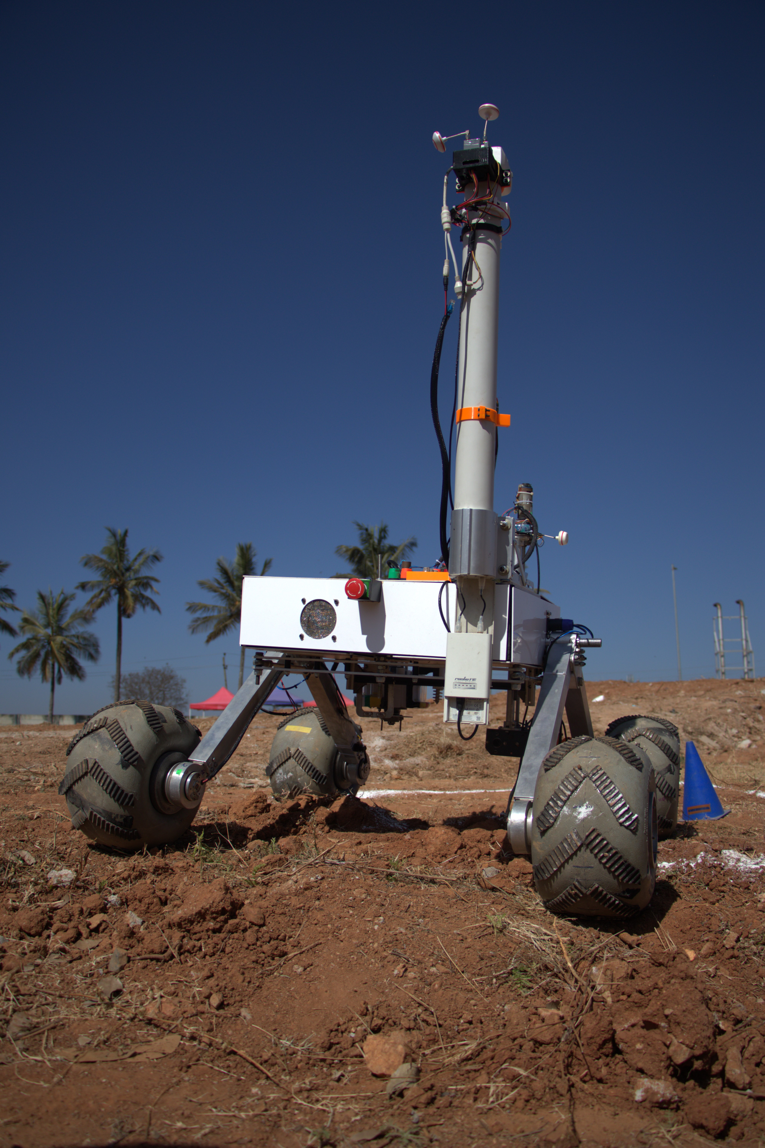
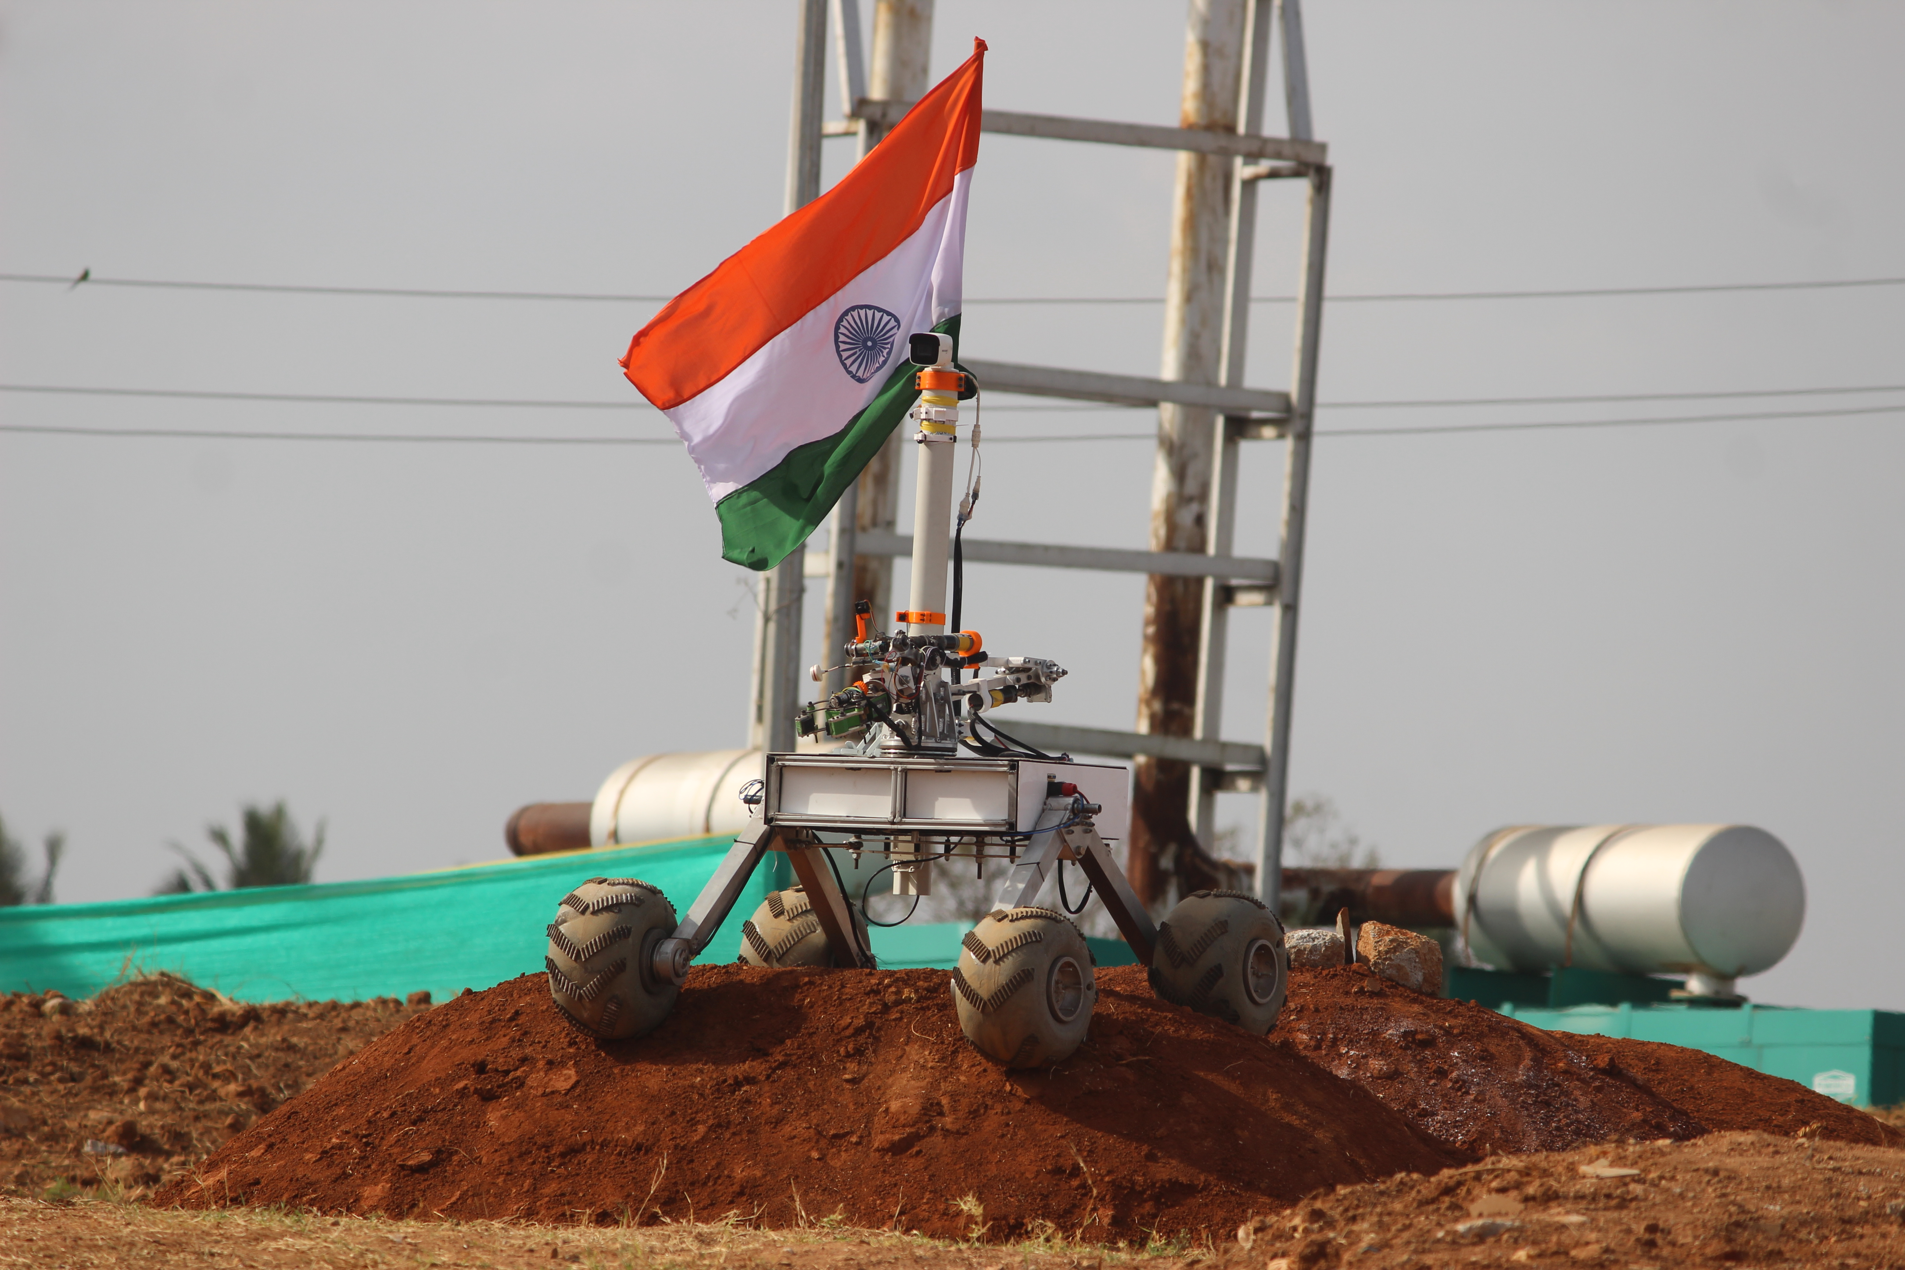
ROVER DESIGN
Mobility
System:
Visuals of the system
(2 photos/screenshots)

Slide 16
ROVER DESIGN
Mobility
System:
The mass of the overall drive system is 50 kg and the dimensions of the rover are 1.12 X 1.115 X 0.71 m (LXBXH). The mass reaches upto 60 Kg when any one of the subsystem is mounted on it (the robotic arm or the science subsystem).
The redesigned drive system using V-Slot aluminum extrusions for the chassis and a 4-wheel bar differential double-rocker suspension system provides improved mobility and efficient space management for the rover. The reuse of the previous year's balloon wheels, known for their ruggedness and shock absorbance, further enhances the rover's ability to navigate through rough terrain during competition missions. Overall, these design choices suggest that the system is adequately suited for competition missions that involve traversing challenging environments and require a high degree of mobility and durability.
Technical Specifications including mass and size (3-5 sentences)
Discuss the system's adequacy for its role in competition missions. (3-5 sentences)

Slide 17
ROVER DESIGN
Electronics and power system:
We have designed a custom Power distribution board to power up all the electronics, allowing us to deliver current up to 150 Amperes.
There are 2 hermetically sealed buck voltage convertors which helps us to maintain both 12 volts and 5 volts voltage rails within the rover effectively.
We have used planetary geared motors for proper actuation and reliable navigation for the rover. STM32F4 is used for controlling motors and actuators using a set of Pololu(s) and MD13S motor drivers.
A jetson nano has been used as a main computational unit which will send the control signals for actuation using a reliable I2C link to the STM32F4.
The power distribution board was designed to isolate different voltage rails, reducing the chance of electrical failure within the rover.
The electrical system has been designed keeping in mind the overall system integrity and requirements of other subsystems.
This type of electrical system design has been chosen to ensure maximum reliability and robustness against any electrical failure.
What is used? Describe the system
(3-5 sentences)
Why the system is chosen? What are the considerations? What are weaknesses and strengths?
(3-5 sentences)

Slide 18
ROVER DESIGN
Electronics and power system:
A custom breakout PCB has been designed for the STM32 that enables the ease of stacking up the control signals which are going in various subsystems. This helps us to eliminate any complications during the wiring process.
We have designed and routed PDB (Power distribution board) by ensuring multiple parameters like trace width, size, ESD and parasitic capacitance of PCB. We also took inspiration from HIGH POWER printed circuits boards which helped us to design a near-perfect PDB for our application. Also, this helps us to maintain an electrical isolation between different voltage rails (5 Volts and 12 Volts) within the rover.
We have used a set of 2 batteries such that communication and navigation systems will get independent power supplies which will ultimately reduce the risk of electrical failure and increase the system modularity.
Unique points and inspirations
(3-5 sentences)

Slide 19
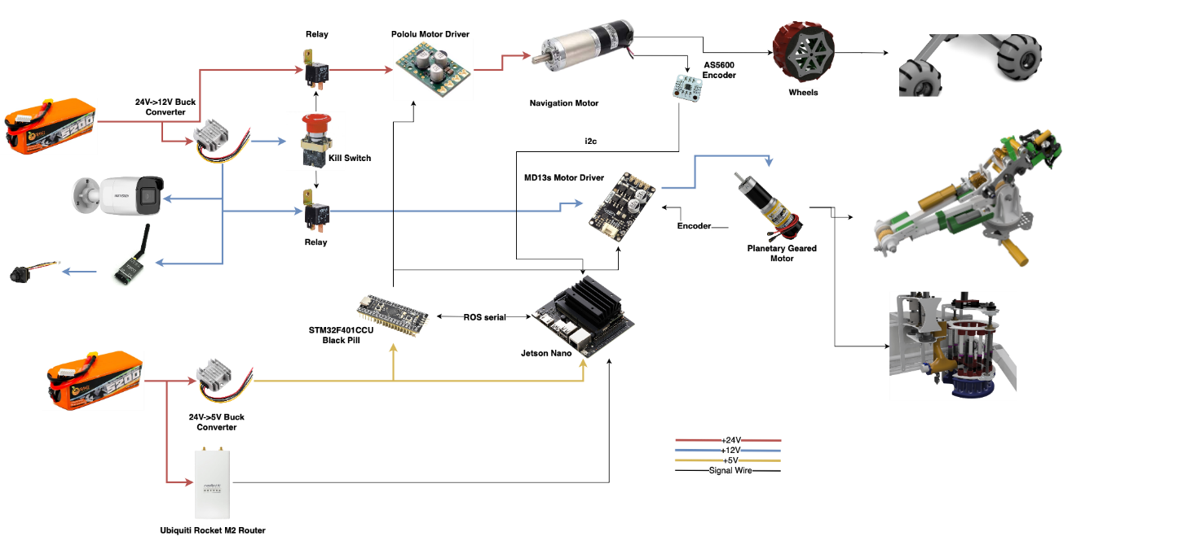
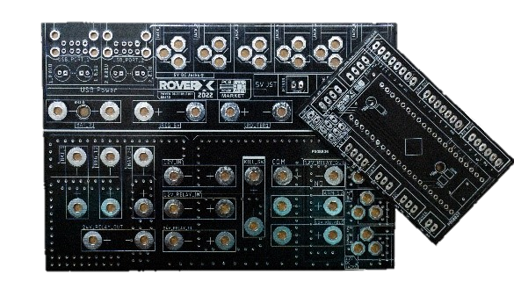
ROVER DESIGN
Electronics and power system:
Battery
IP Camera
FPV Camera
FPV Transmitter
Visuals of the system
(2 photos/screenshots)
Battery
Custom manufactured PCBs

Slide 20
ROVER DESIGN
Electronics and power system:
We are using two 24 volts, 8000 mAh high energy density Lithium polymer batteries (1.1 Kg each) for our rover which provides a total run time of about 90 minutes. A light-weight & efficient STM32F4 microcontroller having 64Kb of flash memory has been used for low level processing. To ensure safety, we have used dual relays to kill the rover in unwanted conditions using a kill switch present on the rear side of the rover.
Our modular electronics system helps us to tackle critical system failure during mission time as it provides an ease for replacing the components on the field which will ensure completion of the mission within the given time constraint.
Technical Specifications including mass and battery duration (3-5 sentences)
Discuss the system's adequacy for its role in competition missions. (3-5 sentences)

Slide 21
ROVER DESIGN
Manipulation system:
The robotic manipulator has 6 degrees of freedom which helps attain maximum maneuverability and reach. Custom-manufactured worm gears with a high reduction ratio are used in each joint to ensure negligible backlash and for providing high torque. Upon running simulations and conducting rigorous testing, we decided to use a combination of Aluminium 6061, mild steel, and carbon fiber tubes at critical areas to ensure minimal flex and high factor of safety.
STM32F4 controls the manipulator by providing control signals to the MD13S motor drivers, and a feedback system using high-precision encoders ensures the proper functioning of the robotic manipulator which allows us to complete the mission more effectively.
What is used? Describe the system
(3-5 sentences)
Why the system is chosen? What are the considerations? What are weaknesses and strengths?
(3-5 sentences)

Slide 22
ROVER DESIGN
Manipulation system:
The end effector uses a worm gear mechanism with a 4-bar linkage for carrying out high-precision tasks with ease and proper gripping. The arm can be folded completely to maintain the center of gravity. Our robotic arm has been equipped with 3D printed adaptive grippers for apt gripping of objects with variable sizes and weights.
Unique points and inspirations
(3-5 sentences)

Slide 23
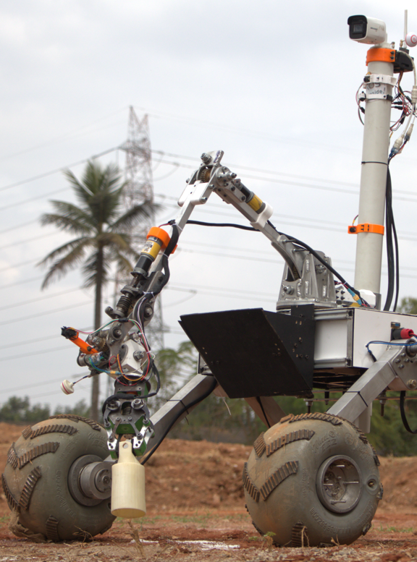
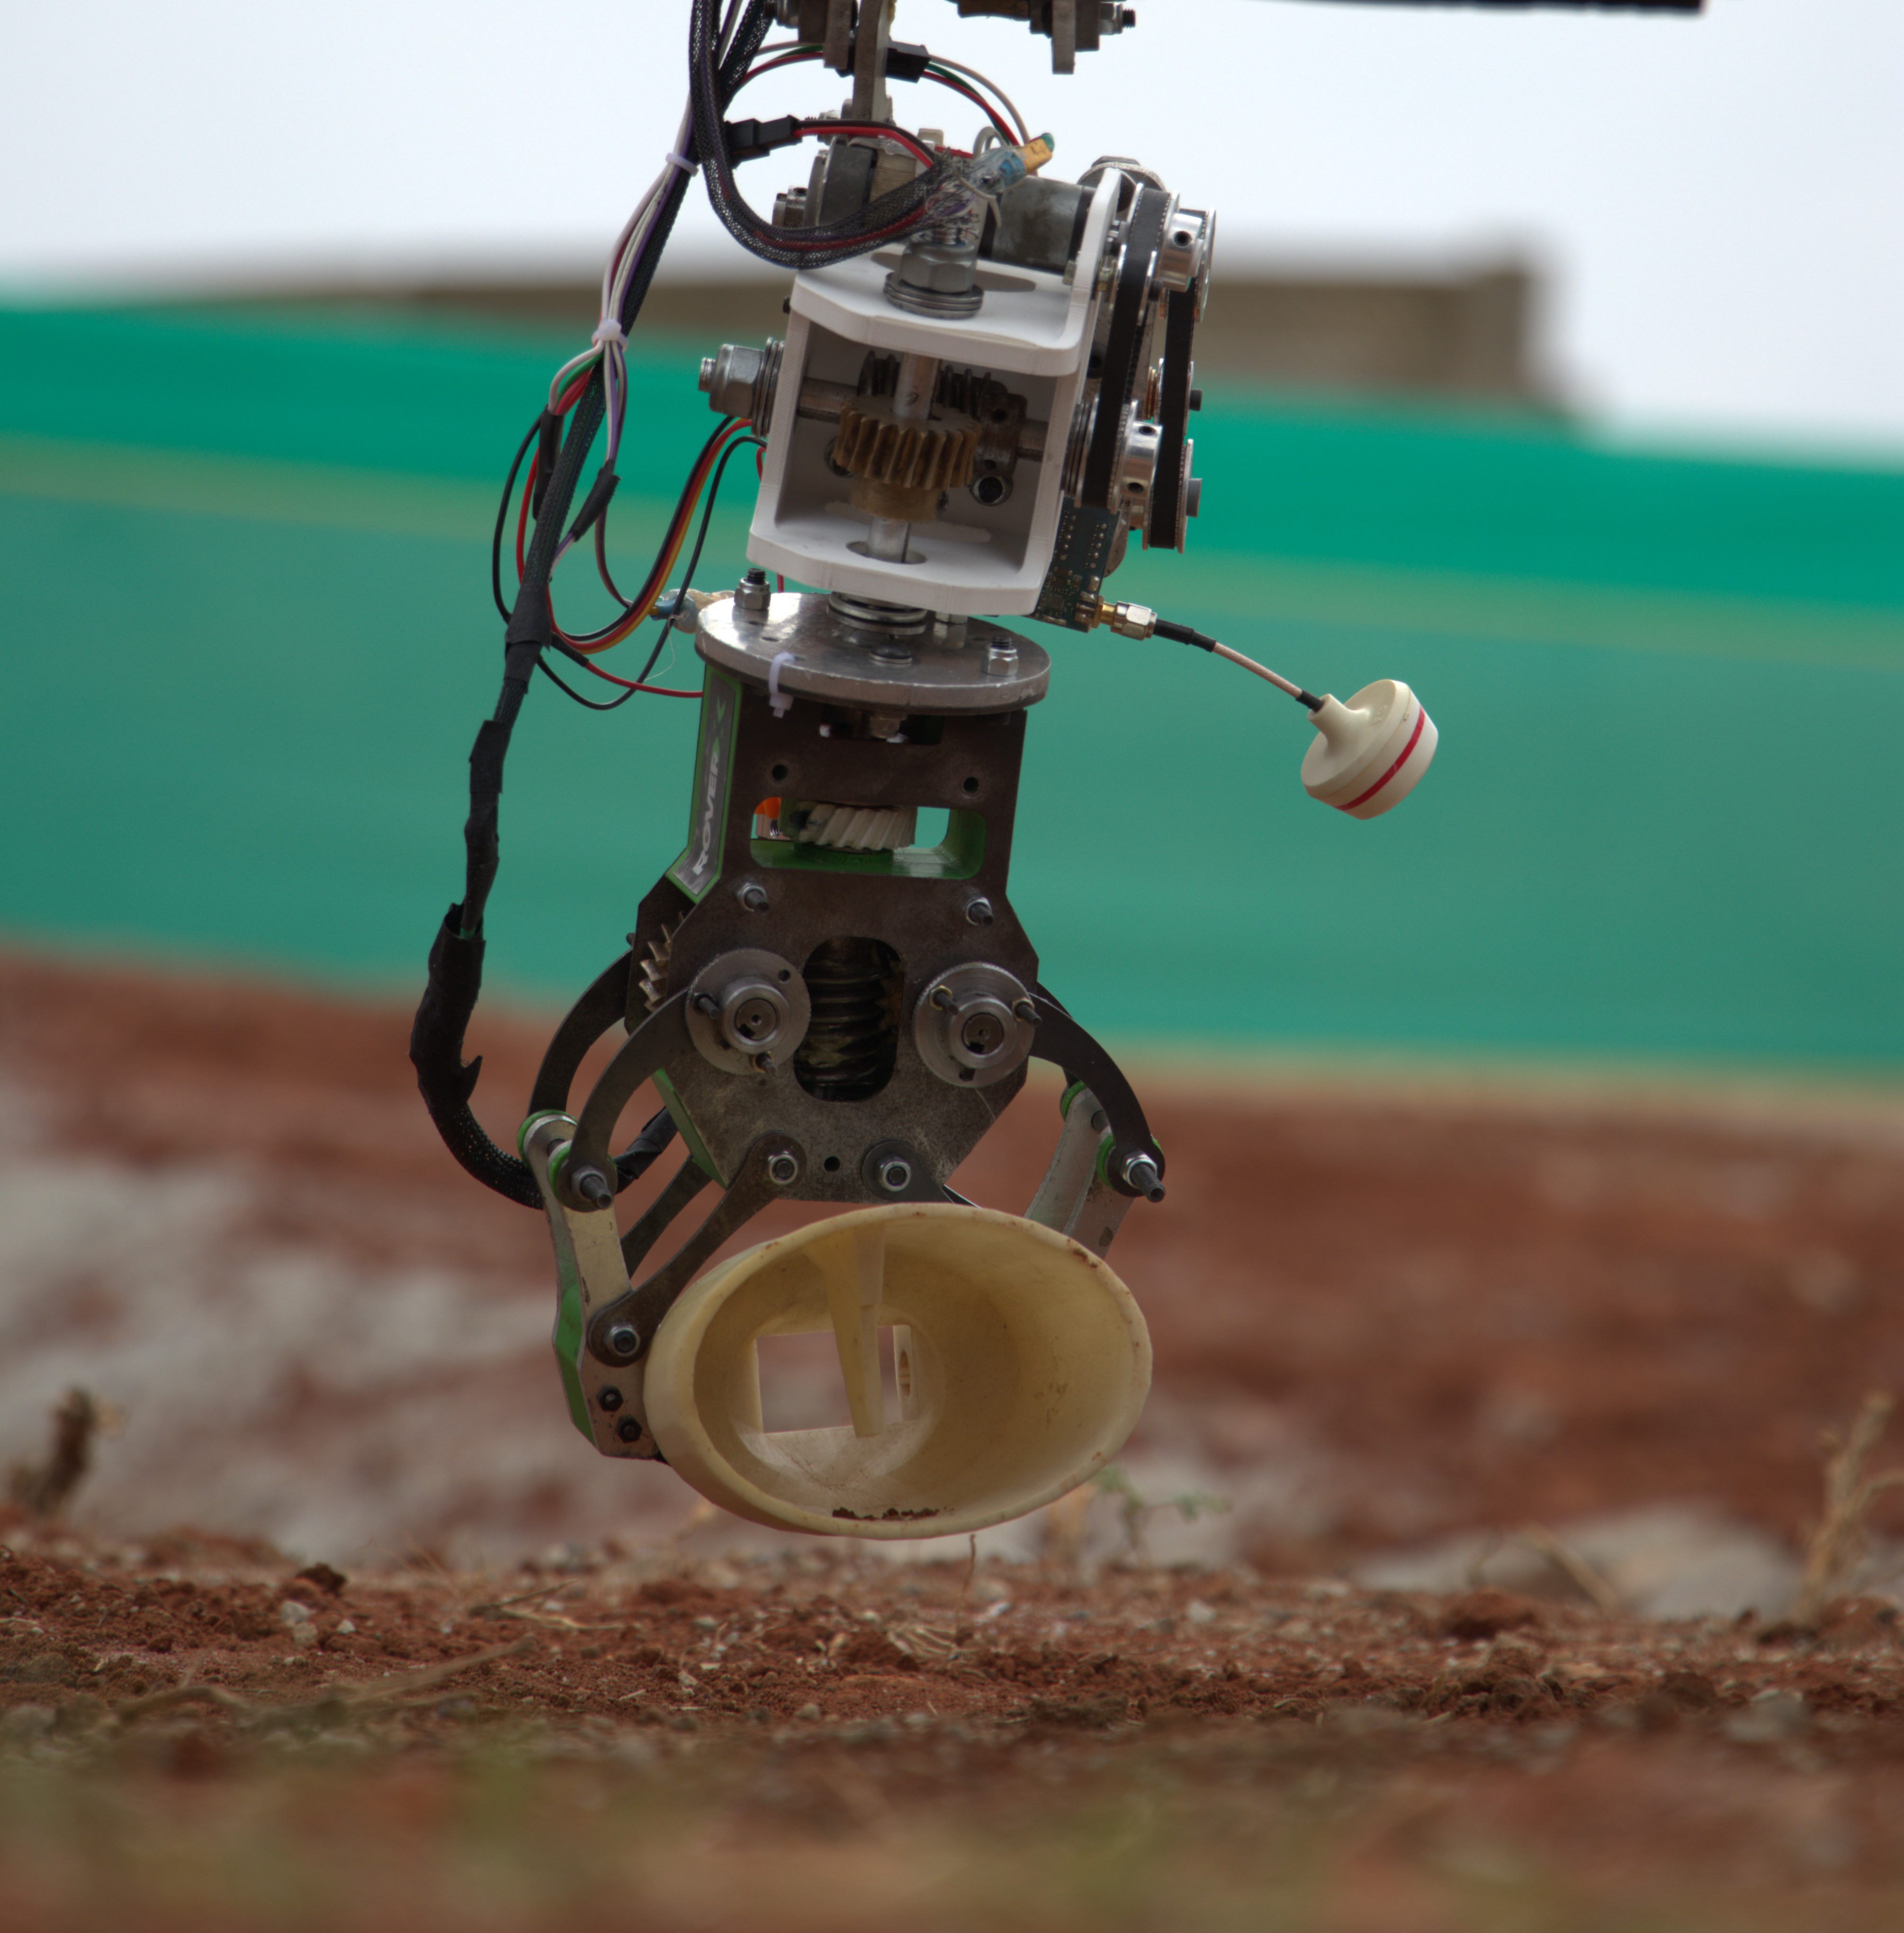
ROVER DESIGN
Manipulation system:
Visuals of the system
(2 photos/screenshots)

Slide 24
ROVER DESIGN
Manipulation system:
Our robotic manipulator weighing 12.5 Kg has a payload capacity of 7.5 Kg, which enables us to carry heavy objects and traverse on the harsh terrains. The individual joints are powered by planetary geared motors which provide sufficient torque to the gears to attain high stability. The arm can be folded completely to maintain the center of gravity, and has a reach of 1.2 metres which provides ease of access for picking up distant objects.
Technical Specifications including mass, max payload and size
(3-5 sentences)
Discuss the system's adequacy for its role in competition missions. (3-5 sentences)

Slide 25
ROVER DESIGN
Science Payload:
The Science subsystem uses an auger and screw conveyor system to collect and distribute soil samples into our caching unit which stores the samples into sealed containers which effectively insulates the samples from external environment, with minimal cross-contamination.
Our on board instruments like Raman spectrometer, NPK probe and digital microscope along with the suite of atmospheric and environmental sensors and, wet laboratory analysis enable us to properly test our hypothesis.
The custom-made Raman spectrometer is used to perform the accurate compositional analysis of a given rock sample and can also be used to detect novel substances. The NPK probe is used to analyze the soil sample for the presence of nitrogen, phosphorus and potassium, which is used to determine the organic content (C:N ratio), soil quality and its capability to harbor life. The probe also provides us with the soil pH, soil moisture and soil temperature.
Our robust science system has been designed keeping in mind all the possible scenarios that the rover might encounter, with redundancies implaced ensuring that all the data required to test the hypothesis is collected.
What is used? Describe the system
(3-5 sentences)
Why the system is chosen? What are the considerations? What are weaknesses and strengths?
(3-5 sentences)

Slide 26
ROVER DESIGN
Science Payload:
The USP of our science system includes the innovative methods for sample caching and insulation.
The drilling system mounted on the rover can be motioned into the z-axis to collect the soil sample. A vertical auger is used to dig, drill, and take the soil to the rover. A horizontally placed Archimedes Screw is used to transfer the soil from the vertical auger to the carousel system to store the soil samples in insulation. The carousel system is moved to the desired test tube using a vertically placed encoded motor coupled to the carousel. Upon a single instruction the carousel rotates and places the desired test tube mouth under the horizontal Archimedes Screw soil drop point. The test tubes have an innovative cap which acts as a one-way valve once the drop point and the mouth of the test tube are aligned the drop point opens the valve by a certain force and drops the soil in. Then the one-way valve closes due to its property of being flexible as it is 3D printed from TPU effectively sealing the tube and protecting the sample from the external environment without any additional active mechanism.
Unique points and inspirations
(3-5 sentences)

Slide 27
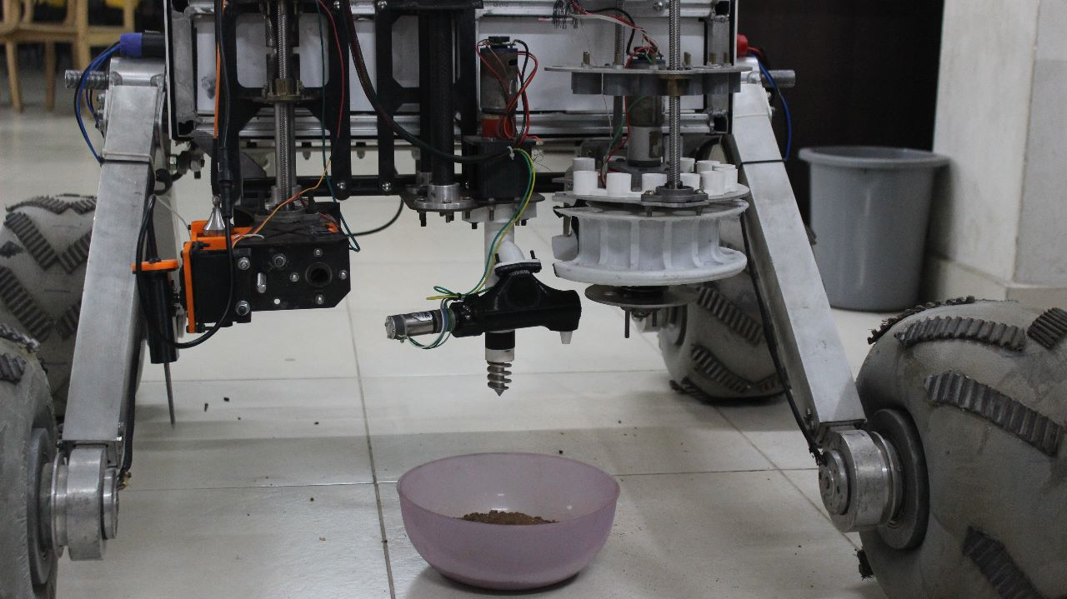
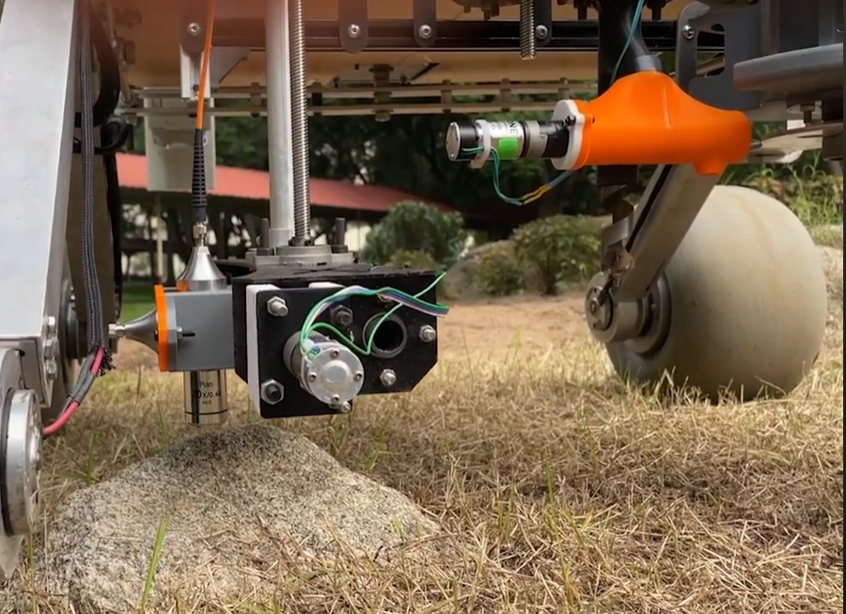
ROVER DESIGN
Science Payload:
Visuals of the system
(2 photo/screenshots)

Slide 28
ROVER DESIGN
Science Payload:
The science payload installed on the rover weighs less than 15 kg. Both the science subsystem and the drive system can function independently without putting a significant load on the battery. Our science system consists of Brushed geared dc and Servo motors for better and reliable actuation of various science subsystems. Also, these high torque light weight motors are used to minimize the overall weight of science system. The reduction of overall weight helps us on field to maneuver and perform tests accurately.
Technical Specifications including mass and battery duration (3-5 sentences)
Discuss the system's adequacy for its role in competition missions. (3-5 sentences)

Slide 29
ROVER DESIGN
Ground station equipment and communication system:
The ground station consists of two master computers which will help in monitoring and controlling the rover with the help of two joysticks.
It dwells on the video feeds gained through FPV cameras installed on the rover using their own transmission frequency channels along with IP cameras which utilize the frequency band of the antennae for the same.
The ground antennae creates a local network on which the master computers can publish messages and commands to the rover. The omnidirectional antenna on the rover receives the signals, interprets them and sends to the on-board Nvidia Jetson Nano, also connected on the same network thus allowing us to creating exchange information using ROS.
Working as the brain of the computer, The jetson processes all the incoming data and publishes the commands accordingly on ‘Drive’ Topic.
All the information received on this topic is then shared to STM32 using I2C communication protocol, which processes and further sends the signals down to the motor drivers of the motors of the drive systems and other subsystems as well.
This system is considered for its ease of debugging, robust control over the rover and flexibility.
What is used? Describe the system.
(3-5 sentences)
Why the system is chosen? What are the considerations? What are weaknesses and strengths?
(3-5 sentences)

Slide 30
ROVER DESIGN
Ground station equipment and communication system:
The omnidirectional antenna is modular and foldable, for better access and storage, as well as provides a 360-degree coverage area, allowing it to receive signals from any direction.
The height of our sector antenna is adjustable, hence giving our communication system better range, line of sight and flexibility.
The sector antenna has high gain and a narrow beamwidth to cover a specific sector of the area, which can increase the signal strength and reduce interference from other wireless networks in that particular sector.
Unique points and inspirations
(3-5 sentences)

Slide 31
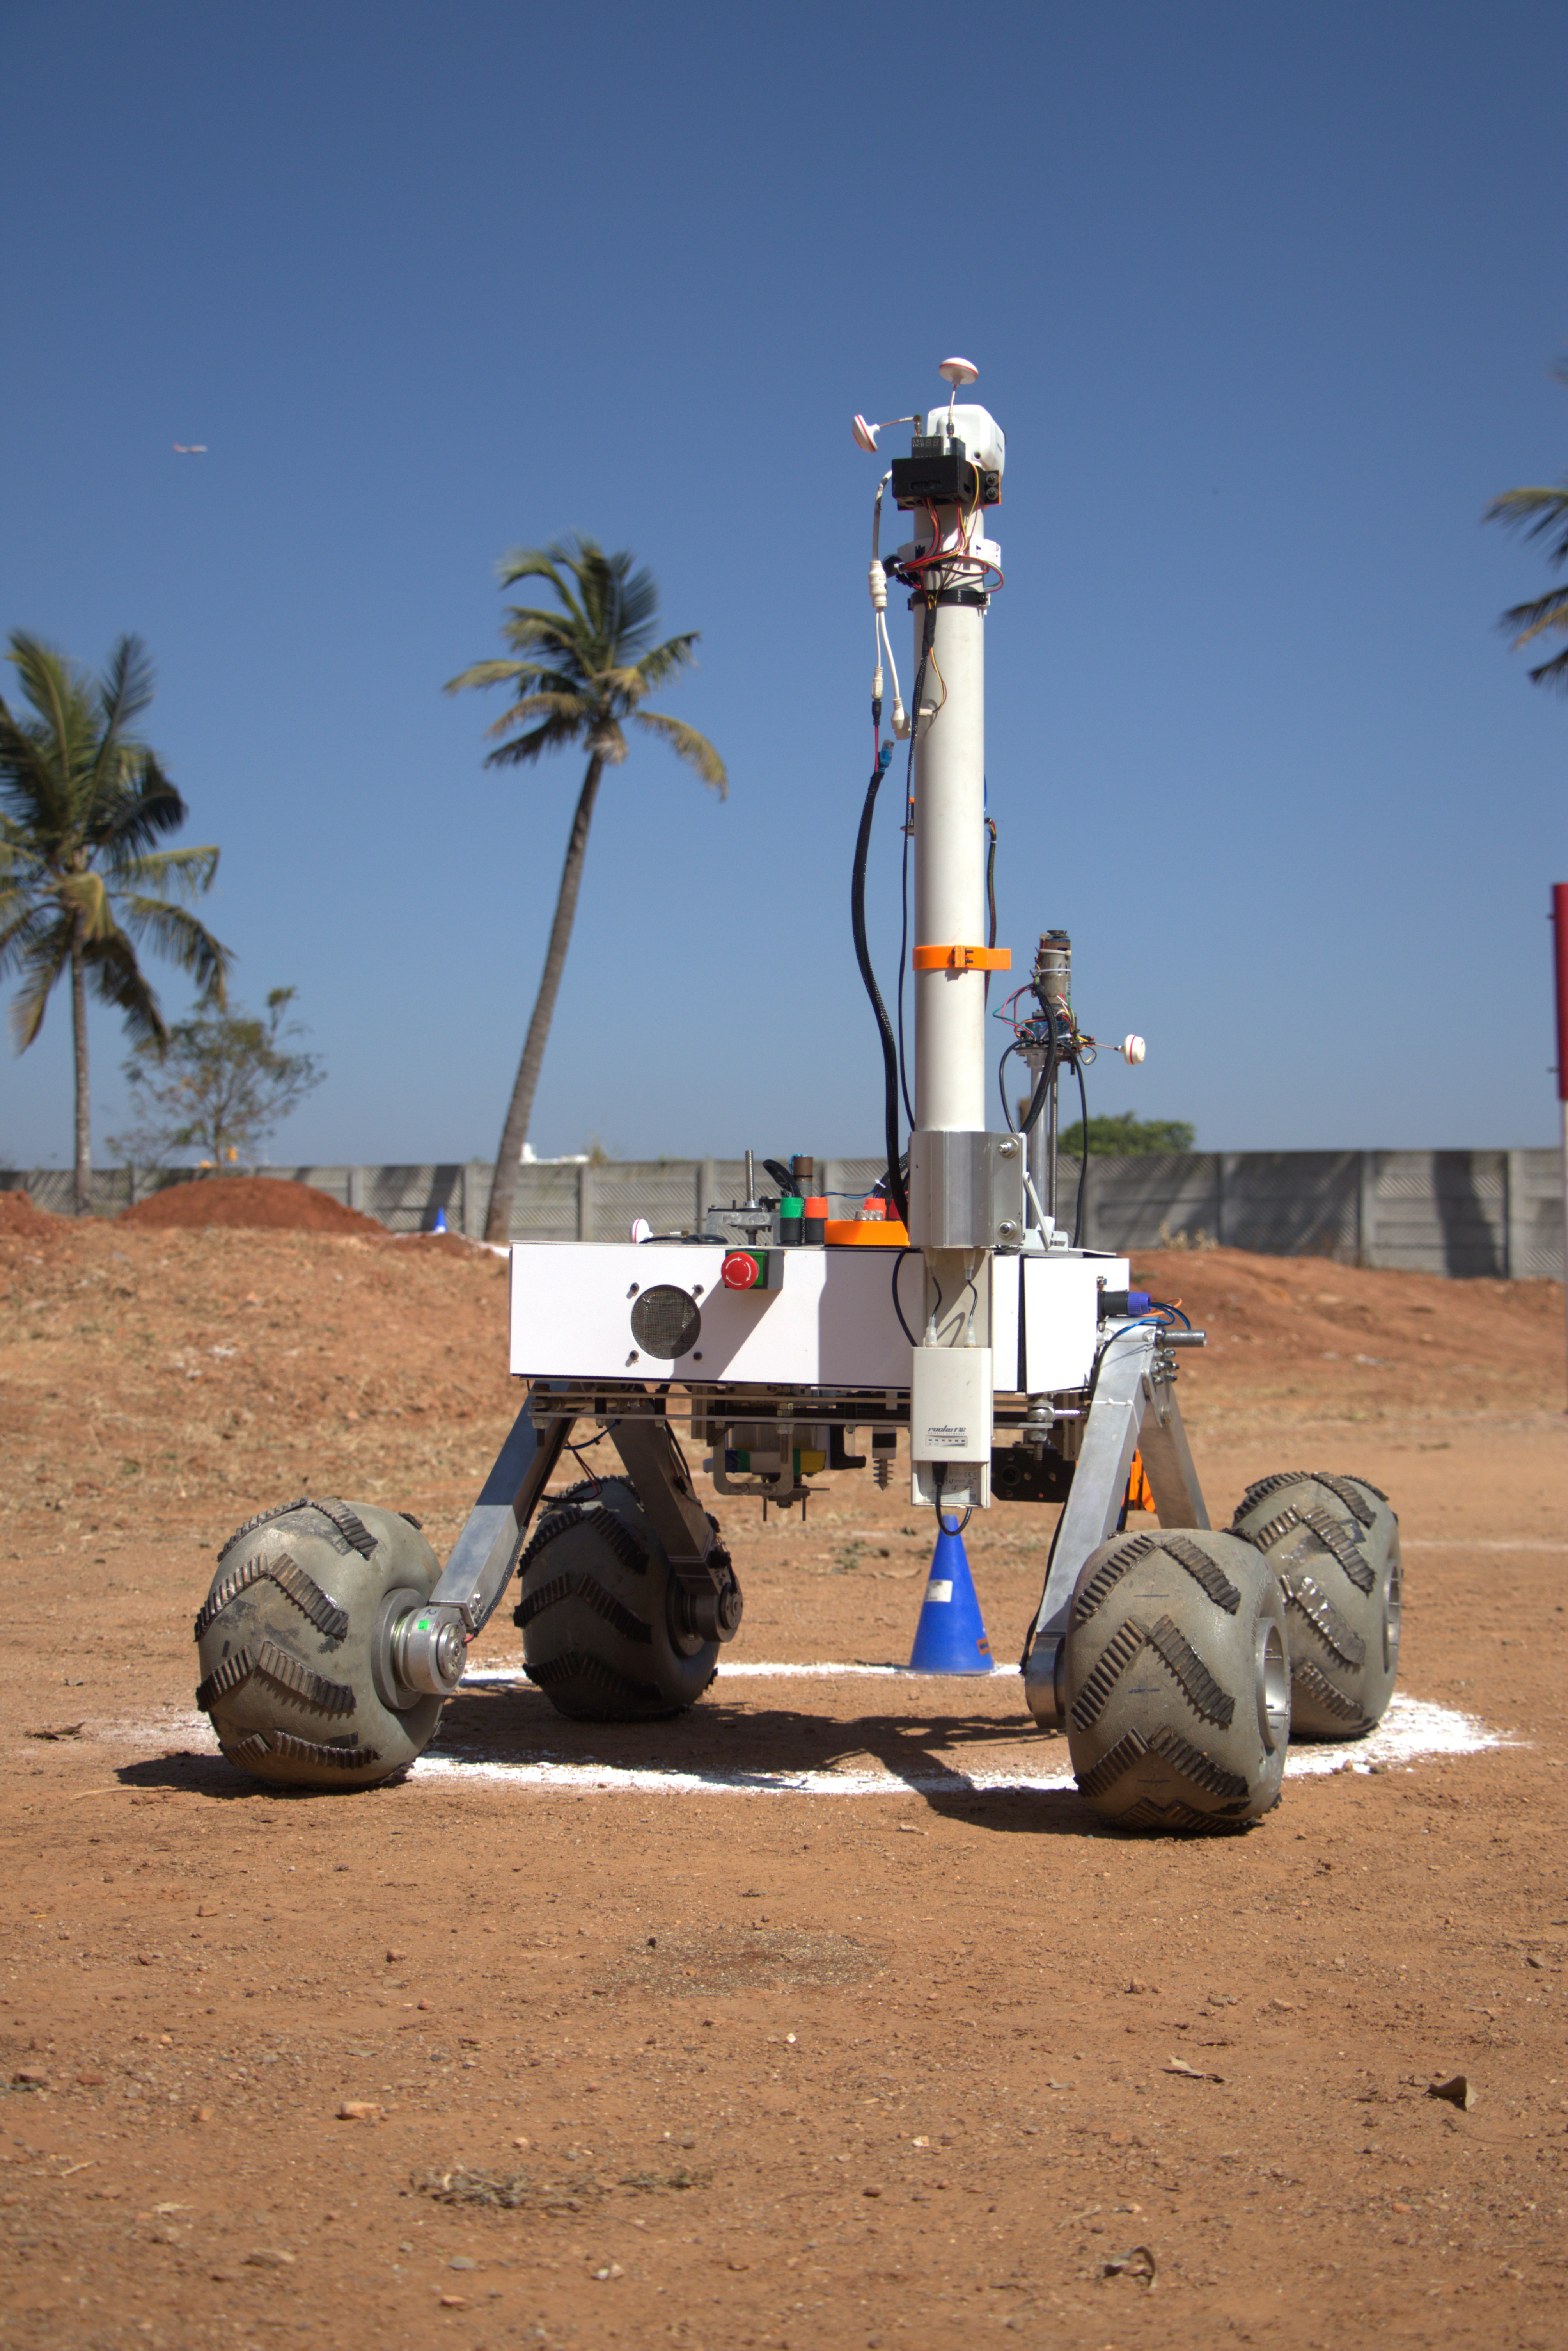
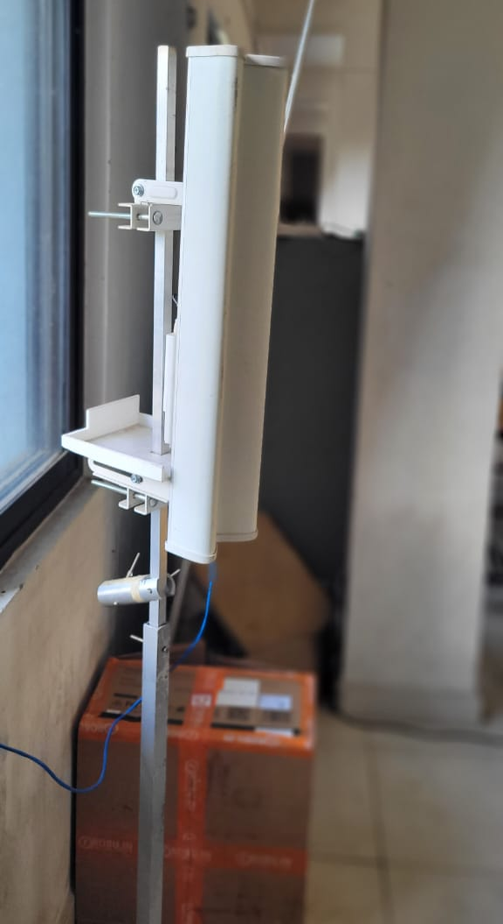
ROVER DESIGN
Ground station equipment and communication system:
Visuals of the system
(2 photos/screenshots)

Slide 32
ROVER DESIGN
Our communication system is the combination of an omnidirectional antenna on the rover and a sector antenna on the ground station. We use a Ubiquiti transceiver in the ground station and on the rover. A Ubiquiti sector antenna is placed in the base station and an omnidirectional antenna is installed in the rover.
2.4 GHz frequency band: (2.402 - 2.462 GHz): This band is utilized for data transmission to and from the rover.
Tx Power Specifications of Transceiver: 22-28 dBm
Gain of the ground station antenna (AM-2G15-120): 15dBi
Gain of antenna in the rover (AM-2G10): 10dBi
Range of the setup: up-to to 1.5 Km
5 GHz frequency band: (5.362 – 5.945 GHz): This band is utilized for video transmission from different cameras on the rover.
Tx Power Specifications of Transceiver: 600mW
Gain of the Base Station antenna: 14dBi
Gain of antenna at rover: 2dBi
Range: 650 meters
This communication system was considered due to its range, reliability, ease of configuration and use. The use of omnidirectional and sector antennas provide a large coverage area and a stronger signal along with higher gain and lesser interference. It is an adequate and well-suited selection for the competition missions.
Ground station equipment and communication system:
Technical Specifications including resilience to noise and communication range (3-5 sentences)
Discuss the system's adequacy for its role in competition missions. (3-5 sentences)

