Slide 1
2024
Design Report

Slide 2
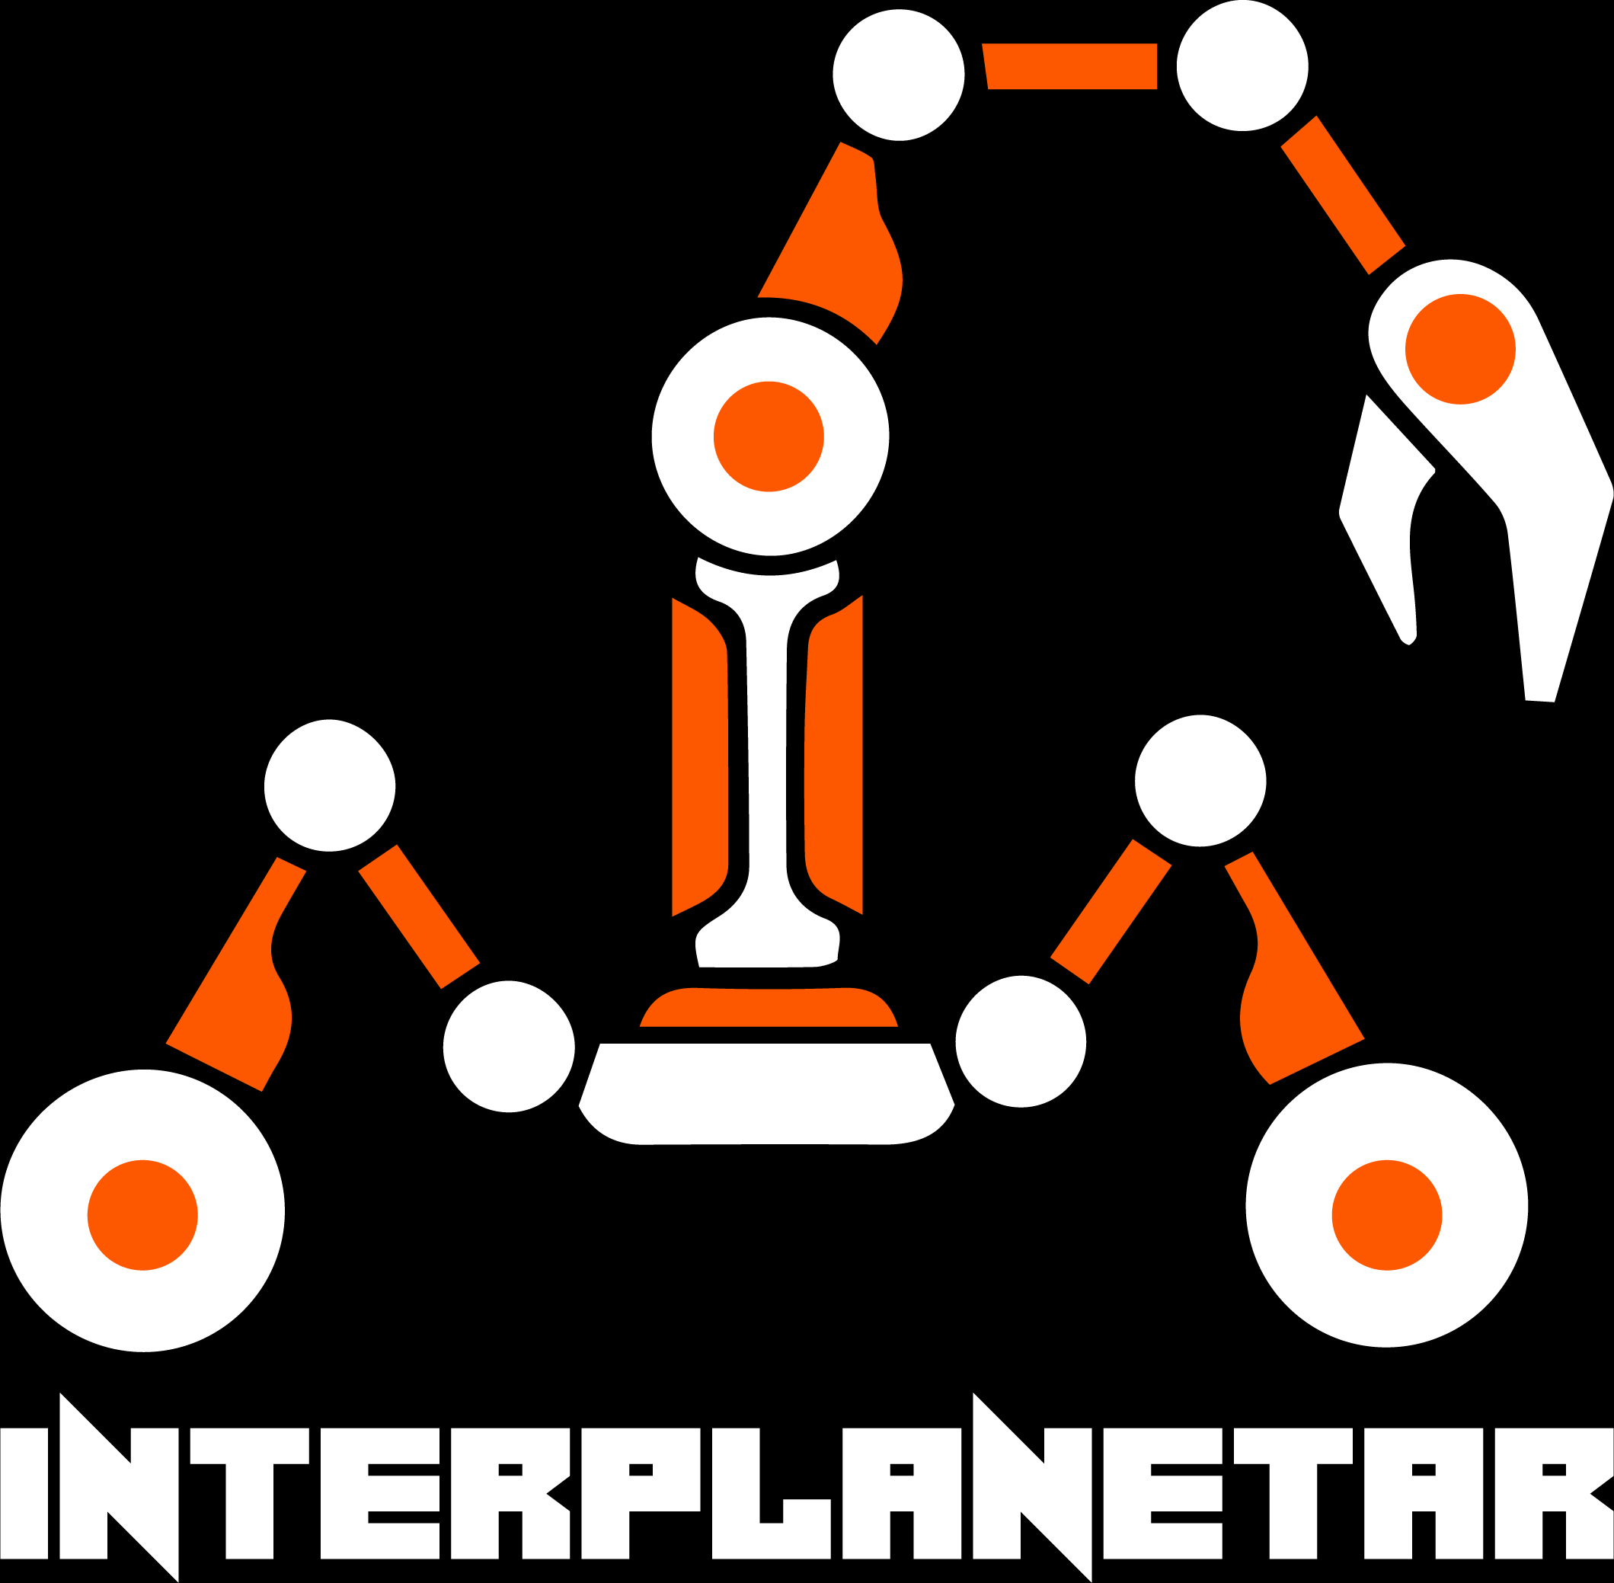
TEAM INFO
Team Name:
Team Interplanetar Prochesta V3.0
Email: interplanetar.buet@gmail.com
Website: https://buetinterplanetar.com/
Facebook: https://www.facebook.com/interplanetar.buet
LinkedIn: https://www.linkedin.com/company/team-interplanetar/
Contact:

Slide 3
TEAM INFO
Academic
Institution:
Bangladesh University of Engineering and Technology (BUET) Address: Zahir Raihan Road, Palashi, Dhaka-1000, Bangladesh
Academic
Consultant:
Dr Kazi Arafat Rahman
Team Supervisor
Assistant Professor, Department of Mechanical Engineering
Bangladesh University of Engineering and Technology
Phone Number: +8801311946837
Email: karahman@me.buet.ac.bd

Slide 4
TEAM INFO
History of
the Team:
A sense of the unknown has always lured mankind and the greatest of the unknowns of today is outer space. The terrors, the joys, and the sense of accomplishment are epitomized in the space program, with this vision and desire for innovation a group of undergraduate students from Bangladesh University of Engineering and Technology (BUET) founded The Team Interplanetar in 2011 and started designing rover for international competitions. Our goal is to build, design, and discover the potential of a world-class Mars Rover, which will provide a continuous flow of scientific information and perform different operations on the rough Martian terrain. From NASA Lunabotics Competition - 2013 to European Rover Challenge (ERC) – 2015, 2019, 2020, 2021, 2022, and 2023; University Rover Challenge (URC)- 2016, 2021, 2022 and 2023; Indian Rover Design Challenge (IRDC) - 2020 and 2023, and IPAS-2021-it’s been almost a decade since Team Interplanetar has been actively participating in worldwide space- robotic competitions. The first achievement for Team Interplanetar was securing 5th position in the Phobos Group of URC – 2016.
Current team members have the experience of achieving the team 13th position in ERC-2023 Remote, 8th in ERC-2022 Onsite and 4th in ERC-2022 Remote, 16th in ERC-2019 Onsite, 13th in ERC-2020 Remote, 11th in ERC-2021 Remote, 11th in Indian Rover Design Challenge (IRDC) 2020. Our team has also achieved Innovation award for designing a revolutionary gas compression system for a Mars aerial vehicle in International Planetary Aerial System (IPAS) Challenge 2021. To continue the legacy, we are now proposing our team take part in ARC - 2024 with our new rover, Prochesta V3.0. As ours is an interdisciplinary team with members from different engineering backgrounds, such as electrical, mechanical, material and computer science, our members possess knowledge and experience in a multitude of technical fields related to the competition.

Slide 5
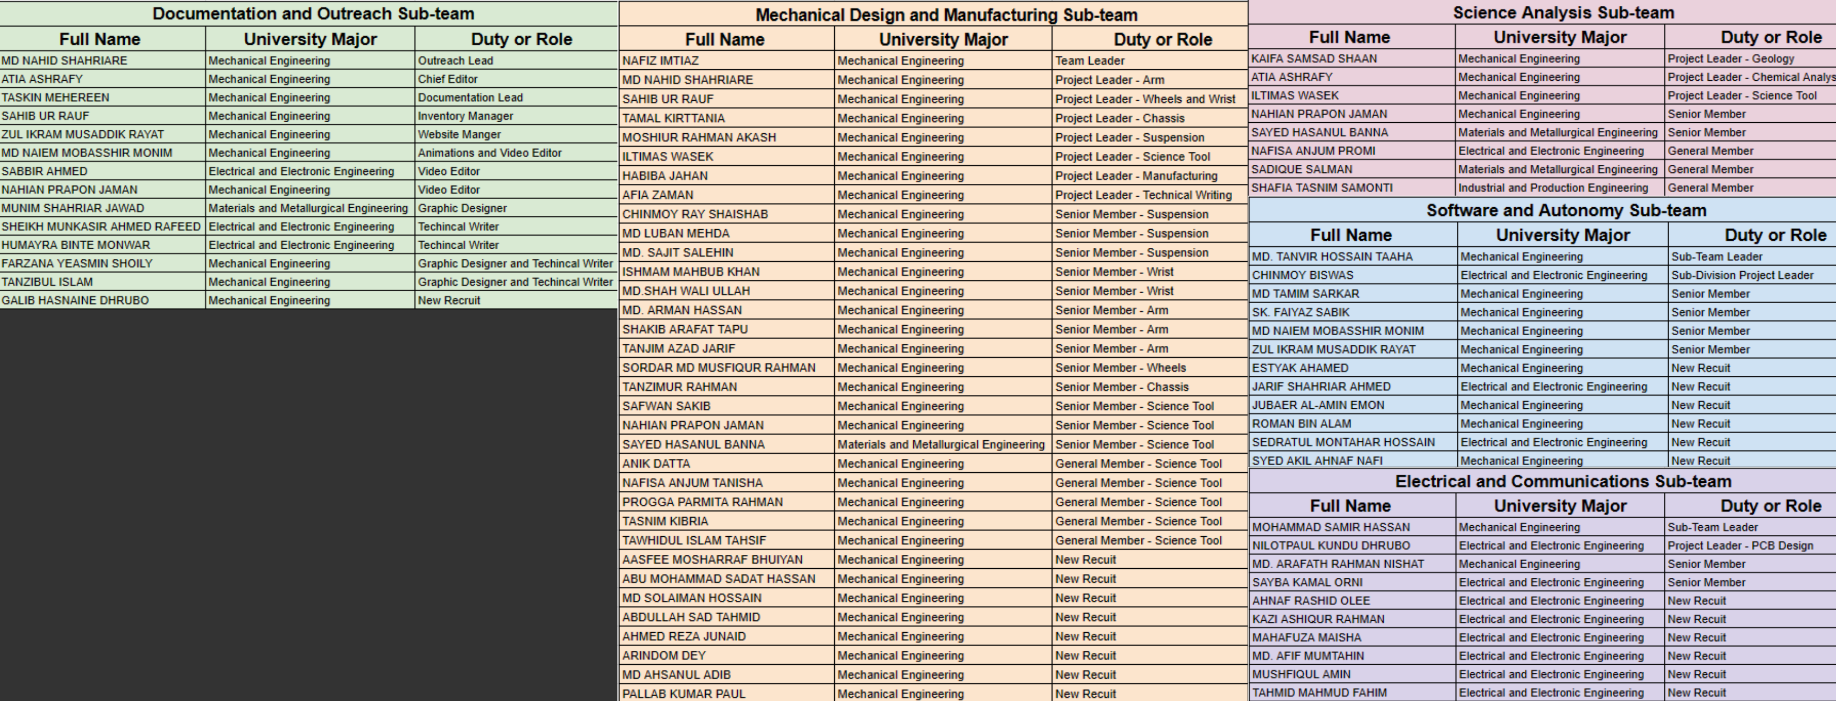
TEAM INFO
Active Members List:

Slide 6
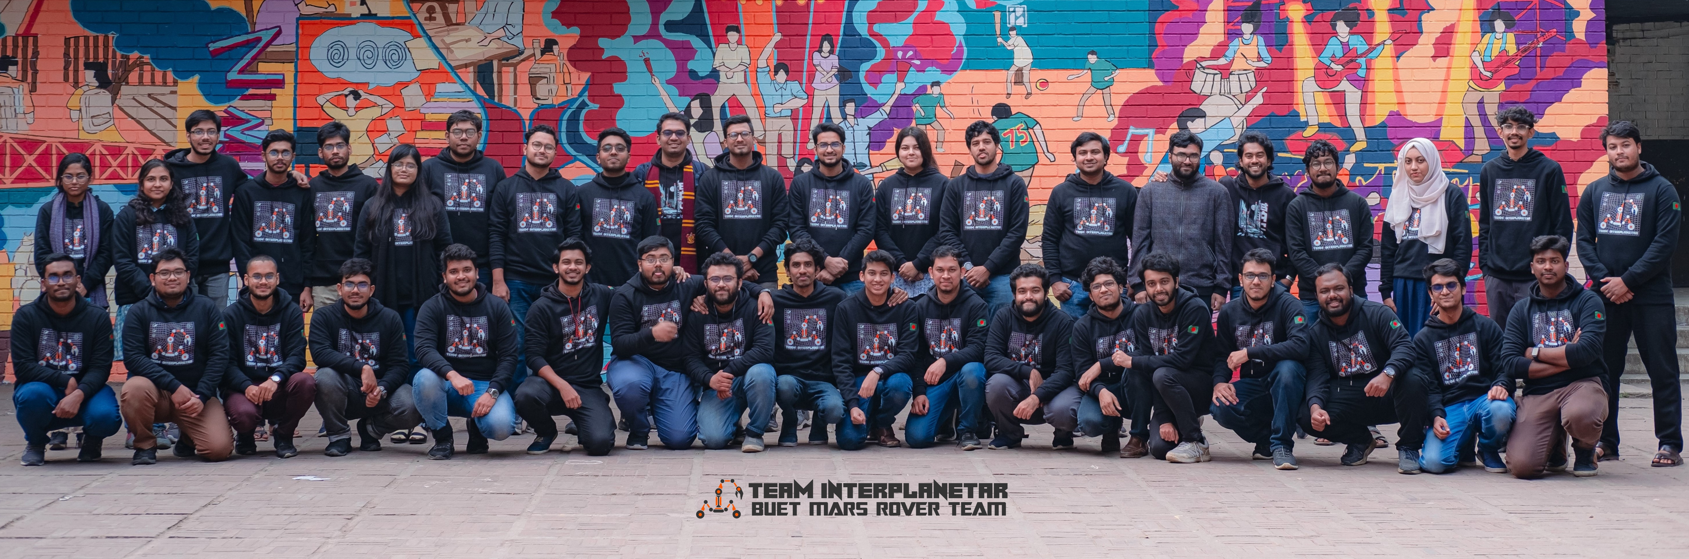
TEAM INFO
Team Photo

Slide 7
MANAGEMENT
Work
Calendar:

Slide 8
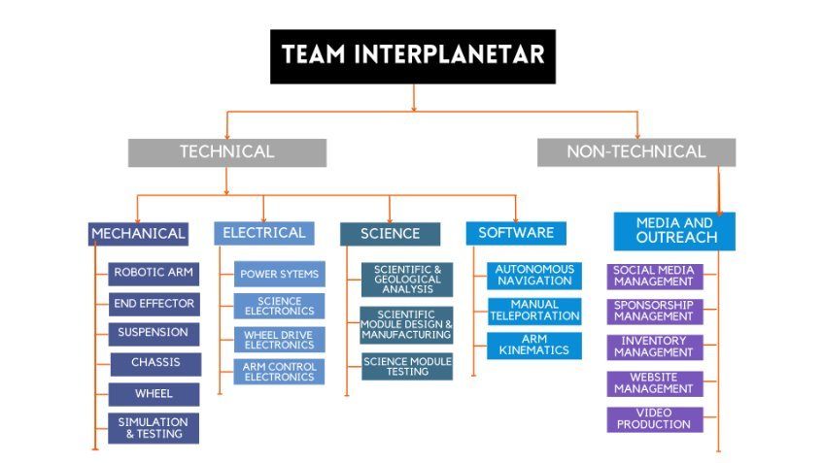
MANAGEMENT
Team Formation:
Team Interplanetar comprises five task-specific sub-teams formed of undergraduate students from different disciplines. Each sub-team has several project managers who are designated with specific categories of responsibilities (as stated in the chart) and are responsible for assigning tasks to the members of their respective sub-team.

Slide 9
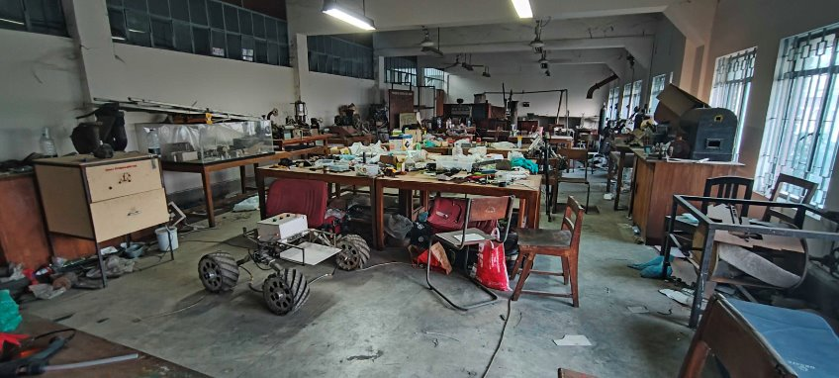
MANAGEMENT
Our university has a rover lab located in one of its buildings where the manufacturing of the rover takes place. Additionally, appropriate labs within the university are used to carry out welding and other machining processes. Generally, the rover's ability to traverse and navigate various terrains and obstacles are tested on the university ground and nearby construction sites.
Workplace:

Slide 10
MANAGEMENT
Funding:
 | Amount
Available Fund | $ 4,545
Expected Development Costs | $ 1,400
Expected Travel Costs | $ 9,000
In case there's a delay in receiving funds from our sponsor to cover travel expenses, rest assured that we have a backup plan in place.
We can apply for financial aid of approximately $1,800 from the Directorate of Students' Welfare, BUET.
We'll cover the initial costs ourselves, and our sponsor will reimburse the expenses later.

Slide 11
MANAGEMENT
Logistics:
Our plan involves implementing the following measures to ensure the safe and good-conditioned arrival of the rover:
•Disassembling the rover and carrying in personal luggage.
•Choosing air transportation as a dependable method of transportation.
•Dividing the rover components into sub-systems e.g., chassis-suspension, wheels, electronics, power tools, science tools, etc. and packaging them separately, ensuring that the components are organized, protected, and transported safely to the competition site.
•Bringing backup electronics, so that we can quickly address any technical issues that may arise during the competition and avoid any potential delays or malfunctions.
•Proper packaging following safety standards to keep the chemicals intact during transportation.

Slide 12
ROVER DESIGN
A four-wheel rocker suspension system mechanism is implemented to keep the rover lightweight. This compact four-wheel mobility system is lighter than the standard six-wheel version. A bar differential is utilized beneath the chassis bottom to maintain the rover chassis balanced at an average angle between the rockers on each side.
The chassis is made of stainless-steel square tubes, which are TIG-welded, providing strength and being lightweight.
The rover can climb over rough and hilly terrain while reducing jerking of the chassis and safe-guarding sensitive electrical components inside.
The tire is non-pneumatic and composed of recycled rubber sheets to boost traction and impact absorbency capabilities. The motors are housed within the wheel for rain and dust protection.
The rover is capable of tank-turning. Though it gives a simple solution for turning capacity, obtaining turning precision is difficult here.
Mobility
System:

Slide 13
ROVER DESIGN
Mobility
System:
The suspension mechanism is simple, lightweight, and functional enough. The link bar differential is located underneath the rover chassis, making room for the manipulation system in the front and science payloads in the rear. The bar differential has been adjusted with a unique design to improve performance while going over rocky terrain.
The wheel tire tread is designed for better grip and traction. The tread pattern has a Mecanum orientation to improve tank turning.
The chassis was designed to minimize the overall weight and increase the load capacity. The system is developed considering the center of mass.
The chassis has modular attachment system for manipulator and science payload for easy assembly and disassembly.

Slide 14
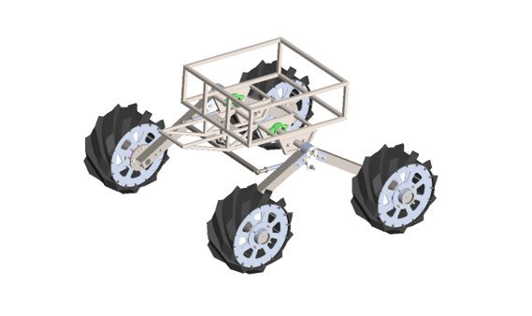
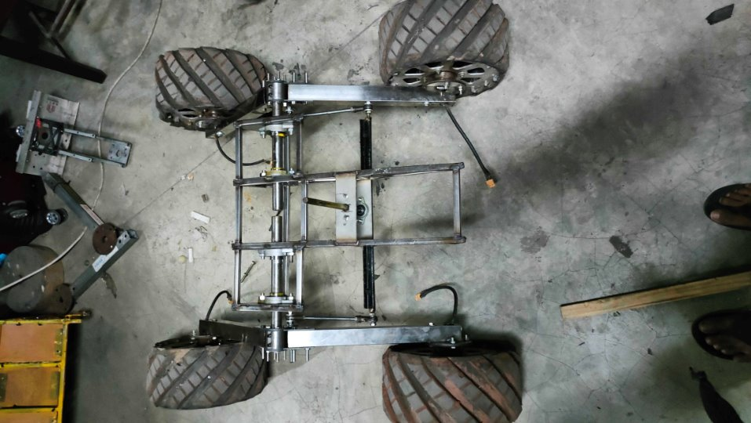
ROVER DESIGN
Mobility
System:
Mobility system in the CAD environment​
Manufactured mobility system of the rover​

Slide 15
ROVER DESIGN
Mobility
System:
The entire weight of the mobility system is roughly 30 kg (4 kg*4+14 kg). Each wheel contains 4 kilograms. While the chassis and the suspension are 14 kilograms in total. Including the additional systems of the rover, the complete rover's weight becomes roughly 55 kg.
The length of the mobility system is almost 1050 mm, and the width is approximately 1000 mm. The whole rover fits in a cube with a side length of 1.1 m with ease.
Each of the parts of the mobility system are evaluated in simulation software and can take adequate impact force and jerks without any harm. The rover was tested for traversal in extremely rocky terrain. Our rover can climb steep slopes and resist abrupt falls without any harm. The rover can also travel across sand dunes, mud and rocky terrain.
Each rover wheel is capable of carrying the full weight of the fully packed rover by itself without failing (upto 60kg)

Slide 16
ROVER DESIGN
Previously we used Planetary Gear Motors with High Current H-bridge Motor Drivers for rover movement. This year, we are planning to use Brushless DC Motors (BLDC) with hall sensors as position encoders. The B-G431B-ESC1, a sensor-based motor driver, will enable us to control our wheels with varying torque for the same RPM. Since BLDC motors are equipped with quadrature encoders, we will able to obtain precise feedback about the wheel's position at any given time.
In the arm section, L298N motor drivers are utilized to control DC roll-motion and gripper-movement motors. We employed a DC worm-gear motor for base rotation and linear actuators for the shoulder and elbow. For precise gear movement, heavy-duty 60 kg-cm servos are utilized in the pitch mechanism. Videos were captured using a Stereolabs ZED 2 depth camera, one USB camera and two pi cameras.
In the science module, we utilized the BTS7960 motor driver to control our auger drill, and the L298N motor driver to control DC motors responsible for the movement of the science module. One MG996R servo and one DS5150 high-torque servo motor are used in the scooper for sample collection. Another MG996R servo motor used in rotatable sample storage enables the rover to collect different samples separately. To measure the collected samples, we've integrated load cells with HX711 load amplifier modules.
Electronics and power system:

Slide 17
ROVER DESIGN
For navigation, the Stereolabs ZED 2 depth camera was chosen to acquire point cloud data, which is then processed using an open-source SLAM algorithm (RTAB-model) to create a 3D model of the environment projected onto a 2D plane, providing a grid map with identified obstacles. The ZED 2's IMU enhances the rover's depth awareness in any circumstance when the camera moves.
The Nvidia Jetson Xavier NX provides strong computing power and autonomy to the rover while consuming very little power. The Raspberry Pi Pico and Arduino Nano V3.0 are utilized in electric boards for low-level control of all actuators and sensors. We utilized the Arduino Mega in our science board as it supports a greater number of I/O pins.
While the electronic system has been designed to handle all possible scenarios, there are a few minor shortcomings. Our method of controlling BLDC motors is very complex, so we are planning for a more efficient algorithm to control these motors. Additionally, we are developing a more efficient power distribution board that can handle any abnormalities like current overflow through our circuits.
Electronics and power system:

Slide 18
ROVER DESIGN
Strength: We prioritize safety first. Hence, we used high-current relays with current measurement capabilities so that, in the event of a short circuit, it can autonomously shut off the power supply. To make the rover cost-effective, different PCBs are made with varying copper thicknesses based on the current rating. Additionally, we have utilized CSI connectors for cameras to ensure that the Zetson won't run out of ports, which we have encountered previously.
Weakness: Due to the decentralized system, wiring is a significant issue, especially for the arm, as I2C communication cannot be properly implemented if the cable length is too long. Additionally, using microcontrollers with different logic levels has made the implementation quite challenging.
Electronics and power system:

Slide 19
ROVER DESIGN
The uniqueness of the system is decentralization. Here each of the PCBs has a local microcontroller (Arduino Mega in the science board, Raspberry Pi Pico in the arm board, Arduino Nano in the Power Distribution Board) which is centrally operated by Xavier NX.
We have failsafe system for PCBs: if one system is fails, for example, science task board, we can still perform some science board related task by using Arm board.
To make the electrical system simpler, we have used the available modules (such as BTS 7960, and L298N as Motor drivers) rather than making the circuit from scratch. But for simpler systems such as relay, and voltage regulator, we have made the circuit from scratch for better reliability.
Most of the electrical components aren't directly soldered to PCB rather than connected with headers/pins so that we can simply replace it if needed.
We designed our Power Distribution Board (PDB) in such a way that we can operate the kill switch relay remotely in case of an emergency. There is also a physical large Red Kill Switch that cuts power of all the PCBs from the PDB.
Electronics and power system:

Slide 20
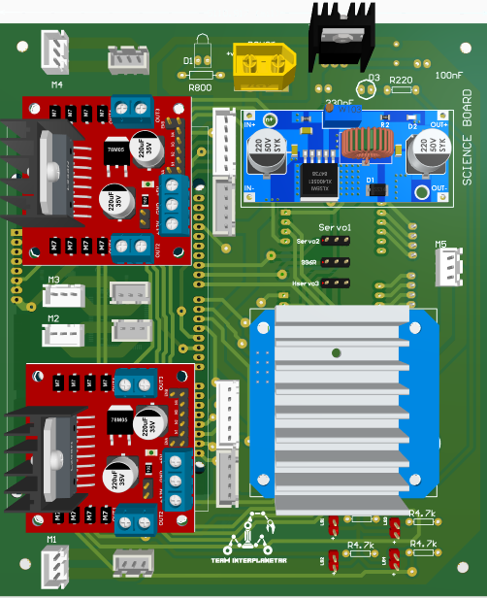
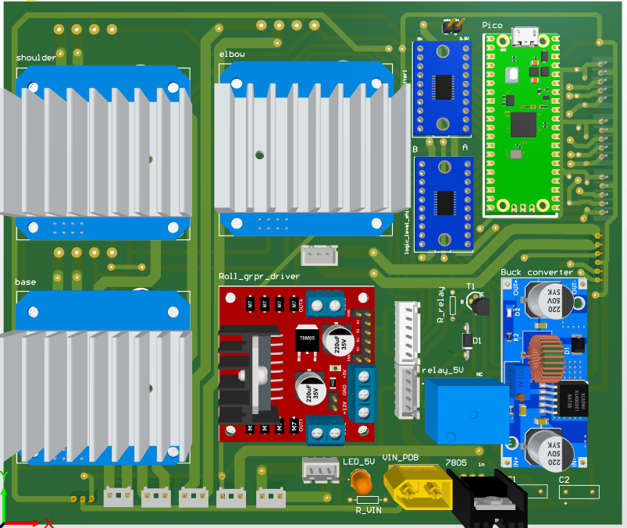
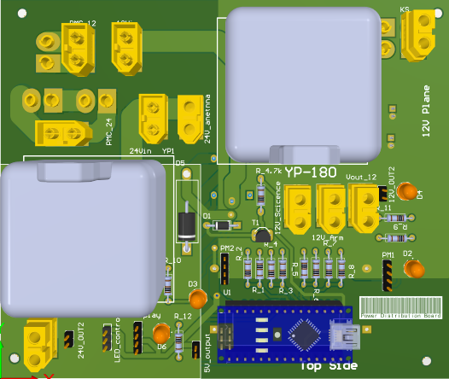
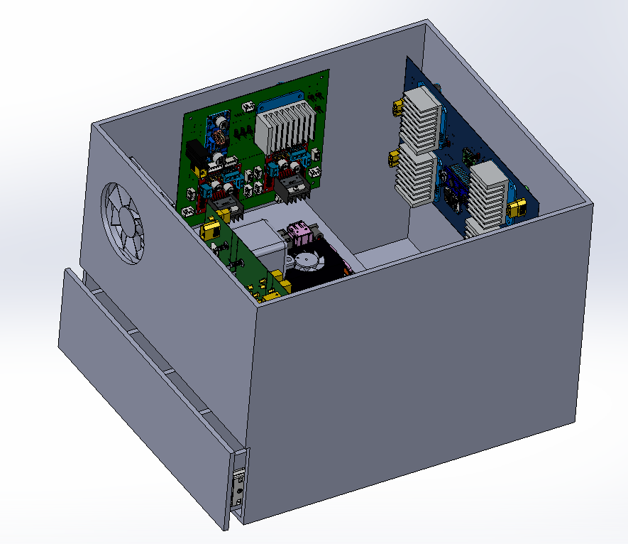
ROVER DESIGN
Electronics and power system:
Science Board PCB layout
Arm Board PCB
Electronics Box with all PCBs and
Batteries
Power Distribution Board PCB layout

Slide 21
ROVER DESIGN
Custom made PCB boards designed by our electrical team are used to connect all the components of the rover. Implementation of connectors allow easy assembly disassembly the rover whenever necessary. For power supply we used four 3S and one power bank. It will give us approximate one hour backup (depending on the battery size we used). All 4 batteries have a combined weight of 2kg. A 12*10*6 cubic inch electric box contain all these PCBs and power supplies. It is approximately 4 kg with all components.
On all PCBs, thick copper traces are employed to support high current DC motors and high torque servos. Hardware interface is achieved by using microcontrollers (one for each board), which are then connected to the Jetson Xavier NX through serial ports via USB hub, providing fast and reliable inter-component communication. The Jetson Xavier NX is powered by a separate power bank, allowing for longer operation times and the preservation of data and images even if the rover is abruptly stopped.
When pushed, an industry standard emergency 'kill-switch' stops all rover operations at once.
All the joints of the base rotation, elbow, and shoulder have absolute encoders and the Roll motor has an incremental encoder for precision Arm control. All these characteristics make the system adequate for the competition missions.
Electronics and power system:

Slide 22
ROVER DESIGN
Strengths:
We have used a 5-degree-of-freedom robotic arm for the manipulation system. For the base rotation, a detachable worm gearbox is used while the movement of the shoulder and elbow joint is attained by DC linear actuators.
A combination of 3D printed parts and aluminum alloy bent sheets are used to complete the roll and pitch movement of the end-effector.
A two-claw gripper is attached at the end to complete the precise actions required for the maintenance tasks.
We selected this system based on its modularity, manufacturability, and precision during operations. The design was created with consideration of the availability of materials and components in our local markets. The arm's greatest strength is its ability to provide precise movements during manual operation with minimal vibration.
Weaknesses
As for its weakness, the operation may be slower due to our emphasis on precision.
The 3D printed plastic parts used for achieving lightweight manipulator have a tendency of fatigue failure. So, to encounter this, the plastic parts are replaced regularly.
Manipulation system:

Slide 23
ROVER DESIGN
Manipulation system:
Unique Points:
The rover arm base modular that it can be attached to and detached from the rover chassis under a minute effortlessly.
The base rotation is attained by a worm gear set ensuring zero backlash.
The robotic wrist is designed in a compact manner achieving high precision while being lightweight. Last year we reduced the size of the wrist by 74%. This year by removing yaw movement, we could reduce the size by another 33%
Inspiration:
The arm's design was inspired by the urge to overcome the weaknesses our rover arm had in the previous years, such as- being overweight, difficult to attach and detach from the rover chassis, and lack of precision due to vibration.

Slide 24
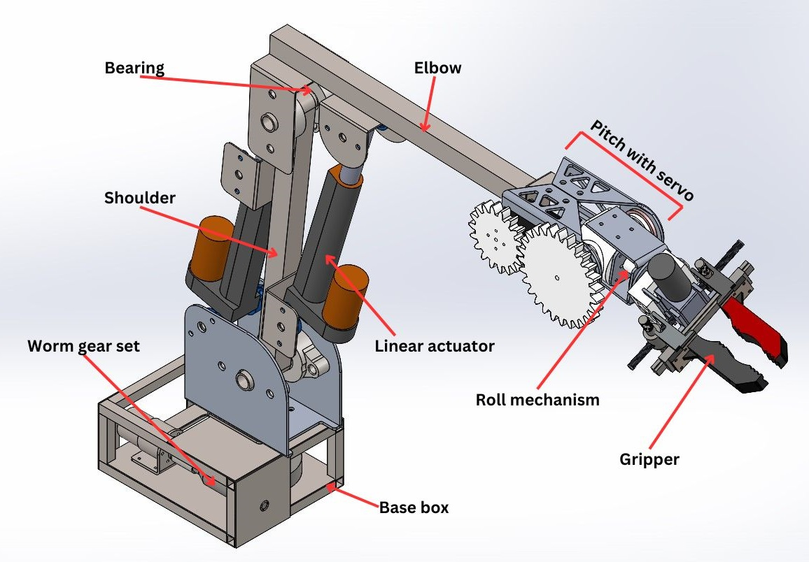
ROVER DESIGN
Manipulation system:
CAD of Arm
Manufactured Arm

Slide 25
ROVER DESIGN
Technical Specifications
The shoulder and elbow of the rover arm is made of 201 grade square stainless-steel tubes with TIG welded attachments at their ends for joints.
To move the shoulder and elbow joints, two linear actuators are used, each with 100 mm stroke and 90 kg loading capacity.
The arm base is a 6:1 ratio worm gearbox with a 45-rpm 15 kg-cm DC brushed motor.
The wrist uses a spur gear system coupled with high torque 60 kg-cm servo motors for pitch movement, while a 5-rpm 10 kg-cm DC brushed motor is used for roll movement. The two-claw gripper has linear operation using a dual shaft worm gear DC brushed motor.
The total arm weighs about 9 kg and has a maximum reach of 1 meter horizontally and 1.2 meters vertically when mounted on the rover. The simulation results show the maximum payload capacity to be 8 kg with a minimum Factor of Safety of 1.4.
System's Adequacy
With the aid of on-board cameras, the 5-degree-of-freedom arm is capable of several tasks that include: turning knobs, flip switches, undoing latches, pulling ropes, picking up and placing objects, opening and closing drawers, plugging in USB. These abilities have been tested and improved upon in our labs. This ensures that the rover can perform tasks assigned to it during the competition.
Manipulation system:

Slide 26
ROVER DESIGN
Science payload consists of soil drilling, collection (using a scooper), and a storage device. Drill and scooping mechanisms are used to collect soil and three rotating covered containers are used for storing.
The auger drill can go to a depth of up to 15 cm, bring loose soil to the surface, and then it can go back to its initial position and ascertain enough space for scooping.
The opening and closing position of the scooper is controlled by a servo motor. The full drilling and scooping platforms can move up and down independently using lead screws mechanisms.
Strengths:
This science payload is modular and easy to manufacture. Besides each device is prepared with some simple mechanisms using less equipment and avoiding complex motion. The total system weighs under 7.5 kg with a dimension of 343(L) x 260(W) x 490(H) mm. Height is 1050 mm when fully extended.
Weaknesses:
One major weakness of this design can be the containers which can seal air but small amount of water can enter and they aren't properly insulated.
Science Payload:

Slide 27
ROVER DESIGN
Science Payload:
Whole payload is modular so that it can be detached from main rover if any critical situation arise.
As multiple soil sample collection was one of the goals, the possibility of cross-contamination was considered. So, the science payload system is designed in such a way (multiple containers) that cross-contamination can be avoided.
Every component of the payload, like drilling, scooping and storage is modular and easily replaceable.
The complete drilling, scooping and storage systems can be modified for autonomous control.

Slide 28
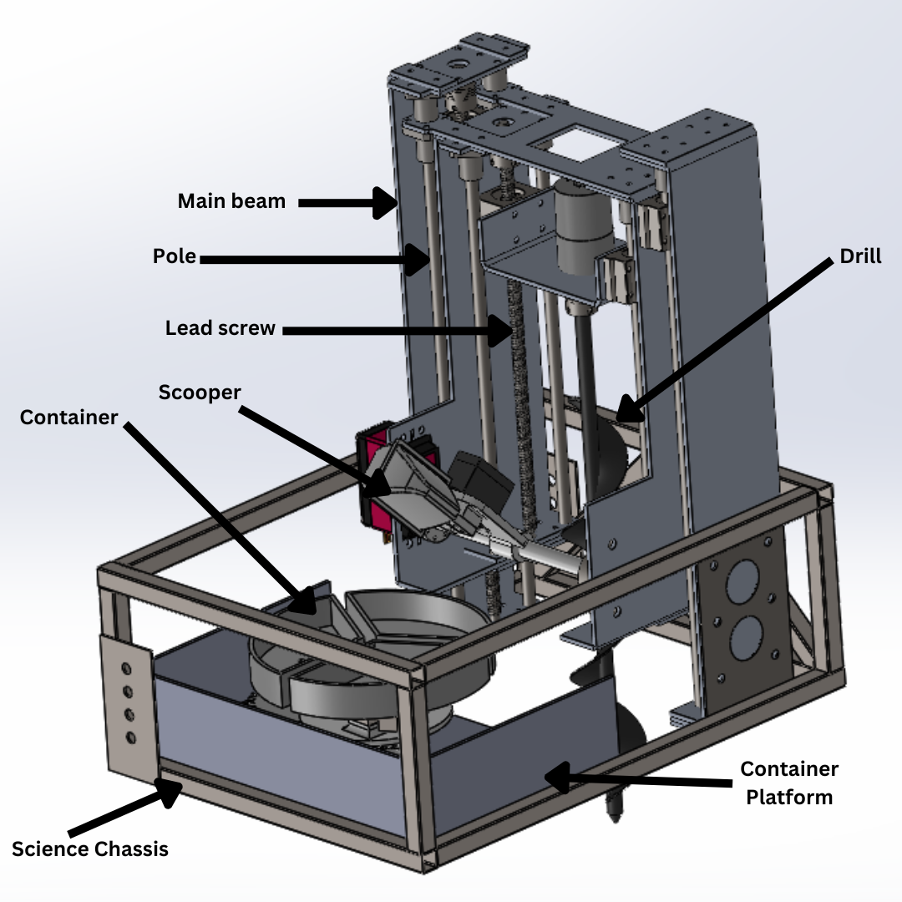
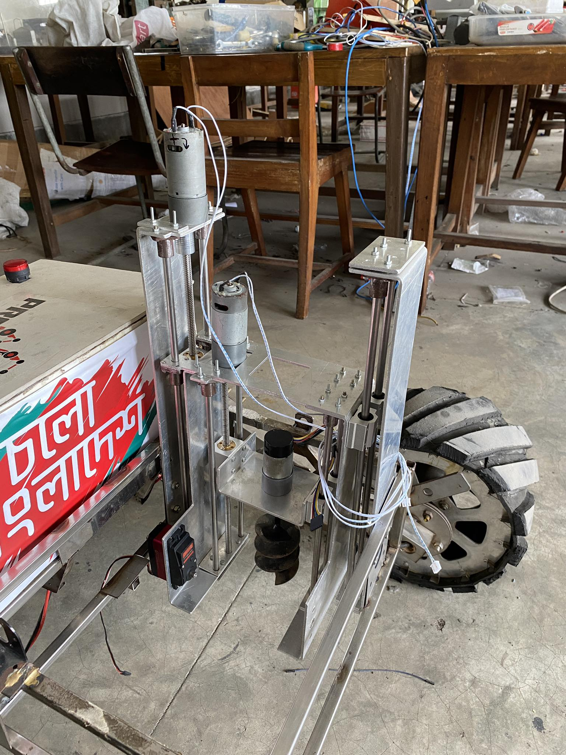
ROVER DESIGN
Science Payload:
CAD of science tool
Manufactured science tool

Slide 29
ROVER DESIGN
Components/Parts | Specification | Weight (in grams) | Duration
Drill and drilling motor with platform | Lead screw(quantity-2): 385&300 mm(SS) Drill platform motor(dc): 30 rpm & 12V Drill motor(dc): 250 rpm & 12V Platform: Aluminum & Drill: Cast Iron | 4650-4700 | The rover can operate up to 1 hour using its onboard power unit for Science mission.
Scooper with motor and chassis | Platform motor(dc): 100 rpm & 12V Motor (rotation): DS5160servo (60kg-cm at 8.4V) Motor (claw):MG996R (11 kg-cm at 6V) Scooper body parts: 3D printed with PLA + filament | 1800
Container system with load cell and platform | Load Cell (quantity-3): YZC-131 (1V, Insulation resistance 2000 M ohm, 12*5*4 cm, material- Aluminum) Containers(Material): PEI Motor: MG996R (11kg-cm at 6V) | 1000
Science Payload:
For affirmation of the soil analysis results, multiple testing methods of multiple soil will be done. Instant data (such as humidity, temperature & pH of the soil samples) will be collected using sensors on the scene. Soil samples can be collected from a depth of 15 cm. Taking these measures will ensure the state of quality of being adequate.

Slide 30
ROVER DESIGN
Ubiquiti Rocket M2 AirMax routers are used on both the rover and base station for peer-to-peer connection. Rover uses a 2.4 GHz 10 dB high gain omnidirectional antenna and the base station uses a 2.4 GHz 15 dB high gain 120-degree sector antenna. The Rocket M2s are connected to the base and rover's computers using ethernet cables. Both antennas are from Ubiquiti too. The system is chosen for its reliability in long-range connectivity and high-speed communication.
Strengths:
The system has high data rates (up to 150 Mbps), long-distance coverage (up to 1.5 kilometers of no-line-of-sight and up to 5 kilometers of direct line-of-sight), versatility, and ease of installation and setup. The complete setup is weather-proof (dust and rain resistant).
Weaknesses:
A clear line-of-sight between the transmitter and receiver and proper orientation of the sector antenna are necessary for optimal results. The Rocket M2 also does not provide advanced security features, which makes it vulnerable to attacks.
Ground station equipment and communication system:

Slide 31
ROVER DESIGN
Ground station equipment and communication system:
Ubiquiti Rocket M2 AirMax with Ubiquiti AMO-2G10 10dBi omni antenna is mounted on the rover for communication with the base station
Jetson Xavier NX is connected with Rocket M2 AirMax through ethernet. At the base station another Rocket M2 AirMax with AM-2G15 120 degree sector antenna.
Base station computers communicate with the Jetson through ROS network setup.
The communication system is mounted with the main chassis of the body.
The communication system allow us to have seamless data and video feed transfer with minimum lag.

Slide 32
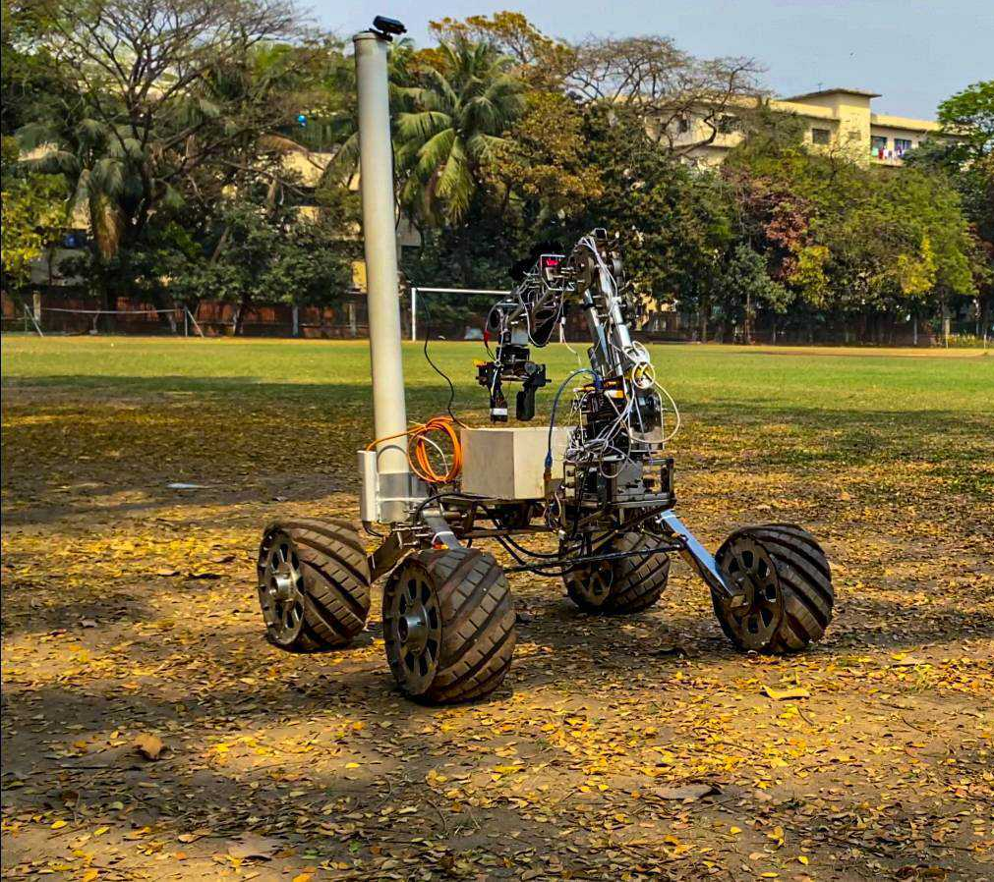
ROVER DESIGN
Ground station equipment and communication system:
Base Station Sector Antenna
Omni Antenna Mounted on Rover

Slide 33
ROVER DESIGN
Ground station equipment and communication system:
Technical Specifications:
The system uses a 2.4 GHz frequency channel for communication between the rover and the base station that can cover a range of 1.5 kilometers for no-line-of-sight and 5 kilometers for direct line-of-sight. The Rocket M2 features a high-gain radio with a receiver sensitivity of up to –97 dBm, which can pick up weak signals in noisy environments. The base station uses a 120-degree directional antenna that reduces the impact of noise and interference by focusing the wireless signal in a specific direction.
System Adequacy:
The communication equipment used in the rover are of industrial grade. They ensure high performance and reliability in difficult situations. The technical capabilities of the system exceed the competition requirements with ease. And it is expected to perform adequately in the competition missions.

